Slide 1
Faculty of Social Sciences

Slide 2
UiO – Norway`s oldest institution for research and higher education
Education, research, dissemination and innovation since 1811
Faculty of Social Science

Slide 3
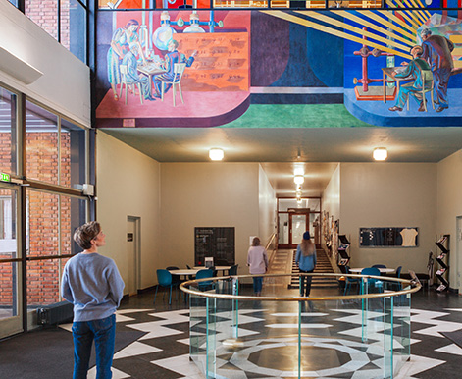
University of Oslo today
World’s 73rd best research university (Shanghai Ranking)
5 Nobel Prize winners
8 faculties
2 museums
Photo: AART Architects
Foto: Jarli & Jordan
240 study programmes
30 Centres of Excellence
92 ERC-funded projects
7 000 employees
26 070 students
Photo: Jarli & Jordan
Photo: Jarli & Jordan
Faculty of Social Science
Notes:
UiO er med i totalt 30 fremragende sentre: Sentre for fremragende forskning, sentre for fremragende utdanning, sentre for fremragende forskningsdrevet innovasjon, forskningssentre for miljøvennlig energi.
UiO er prosjekteier/vertsinstitusjon for 16 fremragende sentre.
50 aktive ERC-prosjekter per 31.12.2022. Totalt har UiO fått tildelt 92 ERC-prosjekter.
Nobelprisvinnere: https://www.uio.no/om/tall-og-fakta/nobelpriser/

Slide 4
Strategy 2030
Our ambitions:
Promote independent, ground-breaking, long-term research
Educate students with the knowledge, ability and willingness to create a better world
Strengthen the dialogue with the outside world and work to ensure that knowledge is put to use
Be an innovative organisation and an attractive place of work and study
Faculty of Social Science

Slide 5
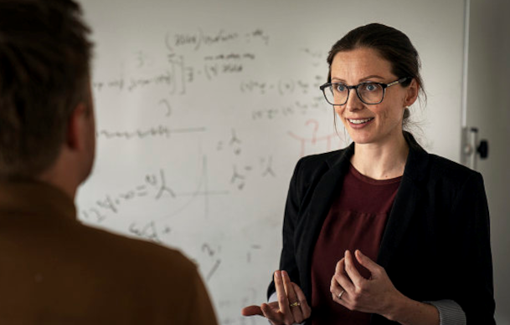
Faculty of Social Science– numbers and facts
Photo: Jarli & Jordan
Photo: Jarli & Jordan
Photo: Jarli & Jordan
Students
4840 students
330 Ph.D. candidates
Studies
1 Professional program
12 Master programmes
11 Bachelor programmes
4 Foundation years
Employees
Academic staff: 510
Technical-administrative staff: 165
Faculty of Social Science

Slide 6
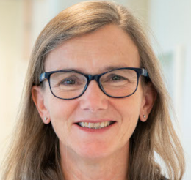
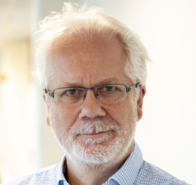
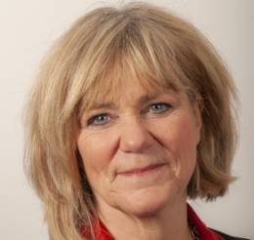
Faculty Management
Foto: Nicholas Doherty/Unsplash
Foto: Jarli & Jordan
Photo: UiO
Photo: UiO
Photo: UiO
Dean of the Faculty
Anne Julie Semb
Vice Dean (Research)
Tore Nilssen
Vice Dean (Studies)
Trine Waktaar
Faculty of Social Science

Slide 7
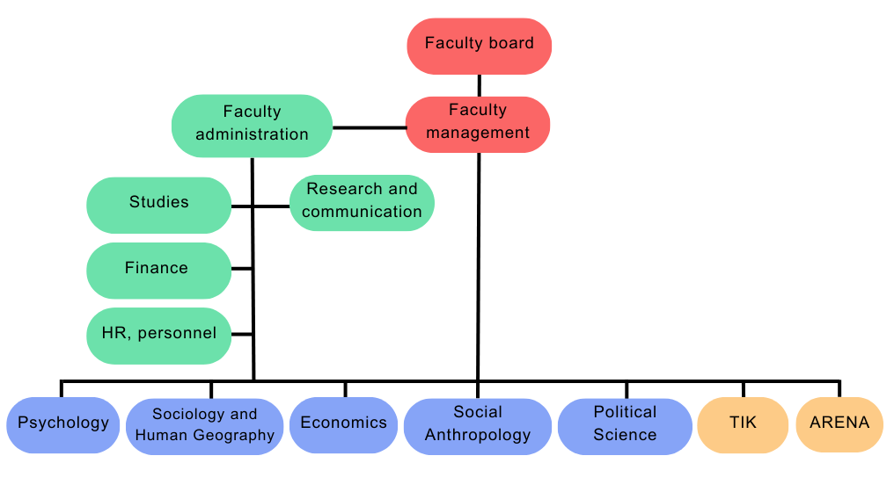
Organization
Faculty of Social Science

Slide 8
Study programmes and courses at the Faculty of Social Science

Slide 9
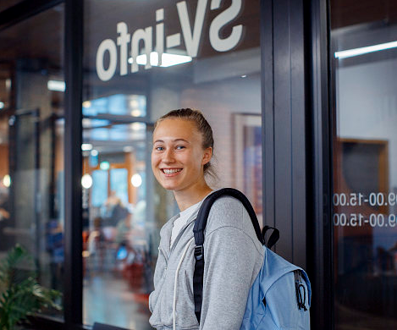
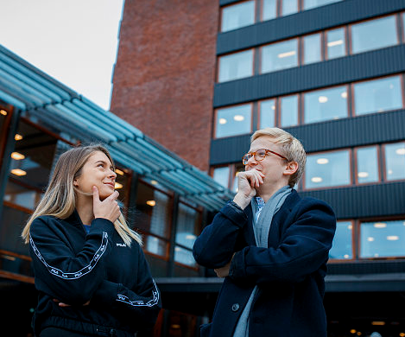
Bachelor programme
Economics
Political Science
Sociology and Human Geography
Photo: Jarli & Jordan
Photo: Jarli & Jordan
Foto: Jarli & Jordan
Foto: Jarli & Jordan
Technology, Innovation and Culture
Interdisciplinary courses
Psychology
Social Anthropology
Photo: Jarli & Jordan
Photo: Jarli & Jordan
Foto: Jarli & Jordan
Faculty of Social Science
Notes:
Seks disiplinære og fire tverrfaglige programmer.

Slide 10
Master's degree programmes offered in English
Economics
Human Geography
Photo: Jarli & Jordan
Photo: Jarli & Jordan
Foto: Jarli & Jordan
Foto: Jarli & Jordan
Peace and Conflict Studies
Psychology
Social Anthropology
Photo: Jarli & Jordan
Photo: Jarli & Jordan
Foto: Jarli & Jordan
Faculty of Social Science

Slide 11
Professional education
Psychology
Provides the student with the competence to work as an authorized psychologist
6 years of education
360 credits
Economics
Socioeconomic analysis
5-year master's program
300 credits
Photo: Jarli&Jordan
Foto: Maylinn Hovengen Byrknes

Slide 12
Interdisciplinarity and sustainability
Examples:
SAMKLIMA: Samfunn, klima og miljø (40-gruppe)
Faculty of Social Science

Slide 13
Center for Interdiciplinary Education - INTED
Brings together students from:
The Faculty of Humanities
The Faculty of Social Sciences
The Faculty of Mathematics and Natural Sciences at UiO
Goal: Develop students’ interdiciplinary competence
Sett inn bilde her
Faculty of Social Science
Photo: Unsplash
Foto: Colourbox

Slide 14
Exchange programmes
148 student exchange agreements with higher education institutions
The Faculty of Social Science offers 233 English-language courses
Faculty of Social Science
Photo: Jarli & Jordan

Slide 15
WORKING LIFE RELEVANCE
Internship
- work life experience
- resources
- network
Active learning
- learn to learn
- relevance to working life
Career competence
- Knowledge of and communicate own competencies
- tranisssion from studies to work
Alumni
- ambassadors
- job profiles
- network
Society and working life
- relevans
- point of contact and frequency
- nettverk
5 focus areas aimed at strengthening the content of education and the student's learning experience and perceived working life relevance.
Foto: Getty stock image
Foto:Audum Braastad/NTB
Foto: Jarli & Jordan
Foto: Jarli & Jordan
Ensure the relevance of students' competencies for the workforce after completing their education.
Increase students' own understanding and ability to articulate their competencies.
Ensure employers' understanding of and knowledge about students' competencies after completing their education.
Faculty of Social Sciences
Referanse: Sluttrapport Samfunns- og arbeidslivsrelevante studier, 2021, SV, UIO

Slide 16
DISCOVER YOUR FUTURE
Integrated career support throughout the study period
First to offer this in Norway
One course per semester
You will learn more about how you can plan and set goals for yourself, and what you may not be able to plan for.
You will gain insight into what may be relevant experiences on the way forward and how you can use your time to explore your options for further education or work.
You will also get concrete tools along the way that you can use to find your direction.
Faculty of Social Sciences

Slide 17
EILIN - Network for Learning and Teaching
Pjoto: Unsplash
Photo: Unsplash
Photo: Jarli & Jordan
Digital Tools
Student – active learning methods
Varied assessment methods
Teaching support
Development projects
Support and assistance for IT in education
First-line support
Subject-specific services
Sharing of experiences
Competence development
Pedagogical development work
Faculty of Social Science

Slide 18
Focus on teaching quality
Positive trend
Good results – even with a large scope
600 high-quality courses
Preventive measures against dropout
High student-to-teacher ratio: 9,02
Faculty of Social Science

Slide 19
Research at the Faculty of Social Science

Slide 20
Funding allocations from the Research Council of Norway 2015 - 2022
30 FRIPRO research projects
11 FRIPRO young research talents
6 projects under Fellesløftet
40 researcher/collaborative projects
Photo: Jarli & Jordan
7 research centres
Center of Excellence (SFF)
Photo: Unsplash
Photo: Unsplash
Faculty of Social Science
Notes:
Bilder fra unsplash og uio bildearkiv

Slide 21
EUs Framework Programme
ERC
4 Advanced Grants
8 Consolidator Grants
14 Starting Grants
Thematic (H2020 and HE)
3 coordinator projects
17 partner projects
Marie Skłodowska-Curie Actions
5 doctoral networks (1 coordinator)
7 postdoctoral projects
Total funding 2014-2022: 43,9 millions euros
Foto: Unsplash
Photo: Wikipedia

Slide 22
Targeted initiative
ERC
The first two in 2012, a total of 26 approved
One researcher - three projects
Marie Skłodowska-Curie Actions
Recruit young, excellent researchers
7 awards since 2018
Thematic
Great potential
Initiative with Horizon Europa
Foto: Unsplash
Notes:
unsplash

Slide 23
Circle U.
European university alliance consisting of 9 universities
Will facilitate students and staff to study and collaborate across borders
Photo: Circle U.
Photo: Circle U.
Faculty of Social Science
Notes:
Målet er å etablere et inkluderende, forskningsintensivt og tverrfaglig europeisk universitet.
Samarbeid på tvers av institusjoner, mellom ansatte, mellom studenter, og mellom studenter og ansatte.
Etablering av forskningsprosjekter og nye studietilbud.
Medlemmer: Universitetet i Oslo, Aarhus Universitet, Humboldt-Universität zu Berlin, King’s College London, Univerzitet u Beogradu, Université catholique de Louvain, Université Paris Cité, Università di Pisa, Universität Wien.

Slide 24
The Guild of European Research-Intensive Universities
21 research-intensive universities from 16 European countries
Working on research and education policies, as well as contributions to EU programmes
Faculty of Social Science
Photo: imageBROKER/Wilfried Wirth
Notes:
For UiO er påvirkning på den europeiske arenaen viktig, gitt norske universiteters avhengighet av innretningen på EUs politikk, programmer og utlysninger, i tillegg til at forsknings- og utdanningspolitikken som utformes i Brussel i stor grad påvirker nasjonal politikk og nasjonale virkemidler.
Om The Guild-samarbeidet: https://www.uio.no/om/internasjonalt/the-guild/

Slide 25
Social Science at UiO: Ranking
Times Higher Education
Shanghai ranking
Leiden 2021
QS 2022
Public administration 25th place
Political sciences 36th place
Economics 37th place
Sociology 45th place
47th plass
(#1 in Norway and the Northern countries)
Anthropology 40th place
Sociology 49th place
51st place
(#1 in Norway)
Faculty of Social Science

Slide 26
Financing
Faculty of Social Science

Slide 27
Research support
Strategies, consultations, processes
Information and guidance on the Research Council of Norway and Horizon Europe
Guidance in grant writing
Research infrastructure
Research ethics and GDPR
Research support
Faculty of Social Science
Photo: imageBROKER/Wilfried Wirth
Notes:
For UiO er påvirkning på den europeiske arenaen viktig, gitt norske universiteters avhengighet av innretningen på EUs politikk, programmer og utlysninger, i tillegg til at forsknings- og utdanningspolitikken som utformes i Brussel i stor grad påvirker nasjonal politikk og nasjonale virkemidler.
Om The Guild-samarbeidet: https://www.uio.no/om/internasjonalt/the-guild/

Slide 28
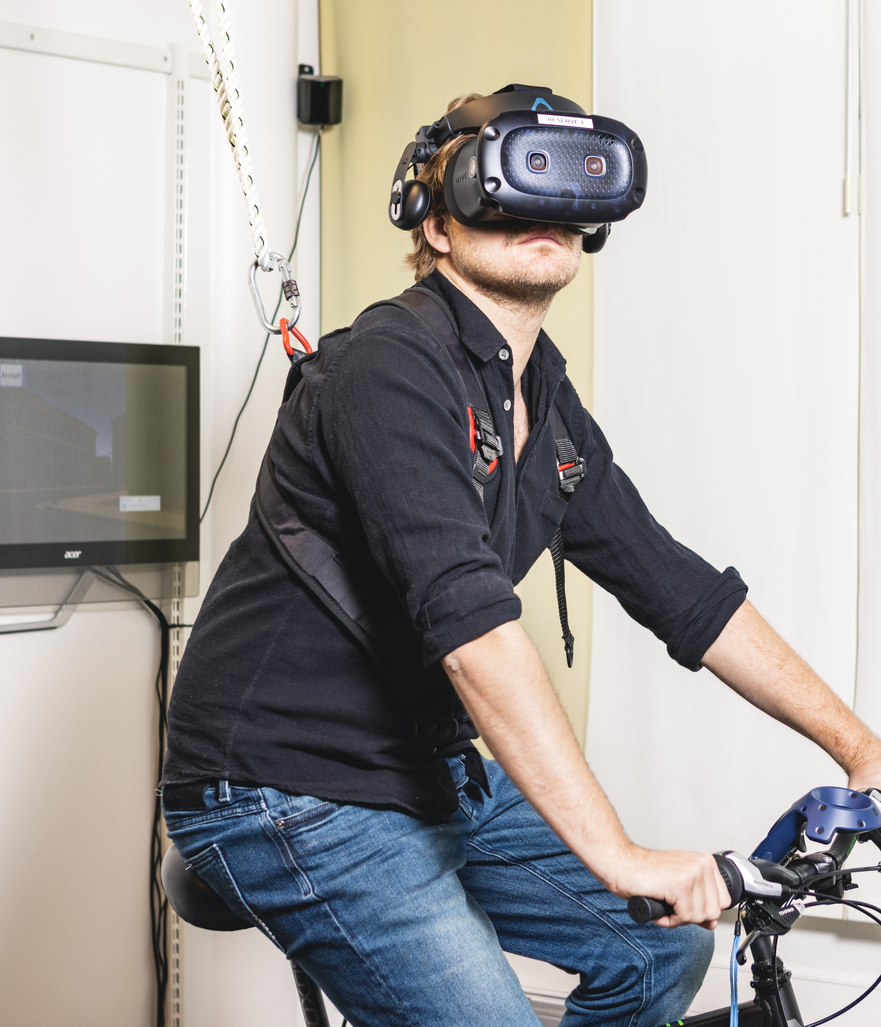
The Ph.D. programme
The number of doctoral dissertations in 2022 is higher than in previous years – despite the pandemic.
Increased admissions as a result of success in external funding.
Sett inn bilde her
Faculty of Social Science
Foto: Jarli & Jordan
Foto: Colourbox
Notes:
uio bildearkiv

Slide 29
Strategic objectives
Development in gender balance
EQUALITY

Slide 30
Social innovation – applied knowledge
Public Commissions
Changes in policy, regulations and systems
SPARK Social innovation
Knowledge dissemination
Participation in the Innovation Council
ERC – Proof of concept
Faculty of Social Science

Slide 31
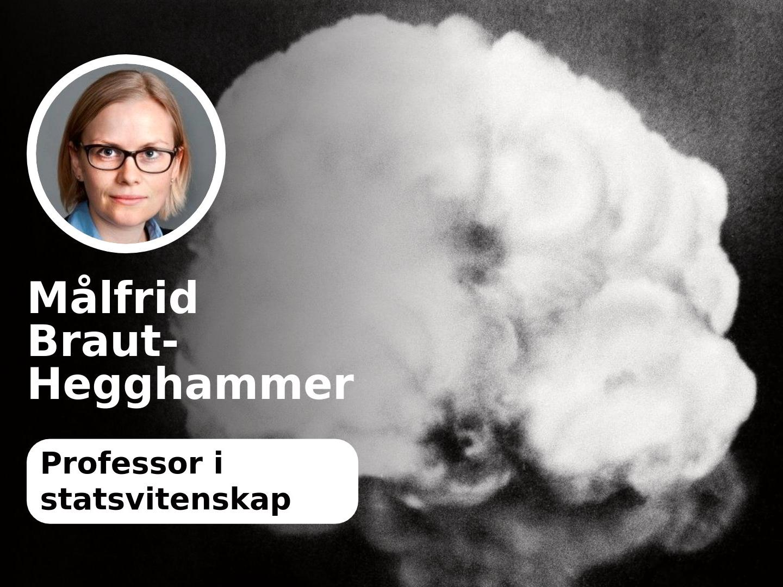
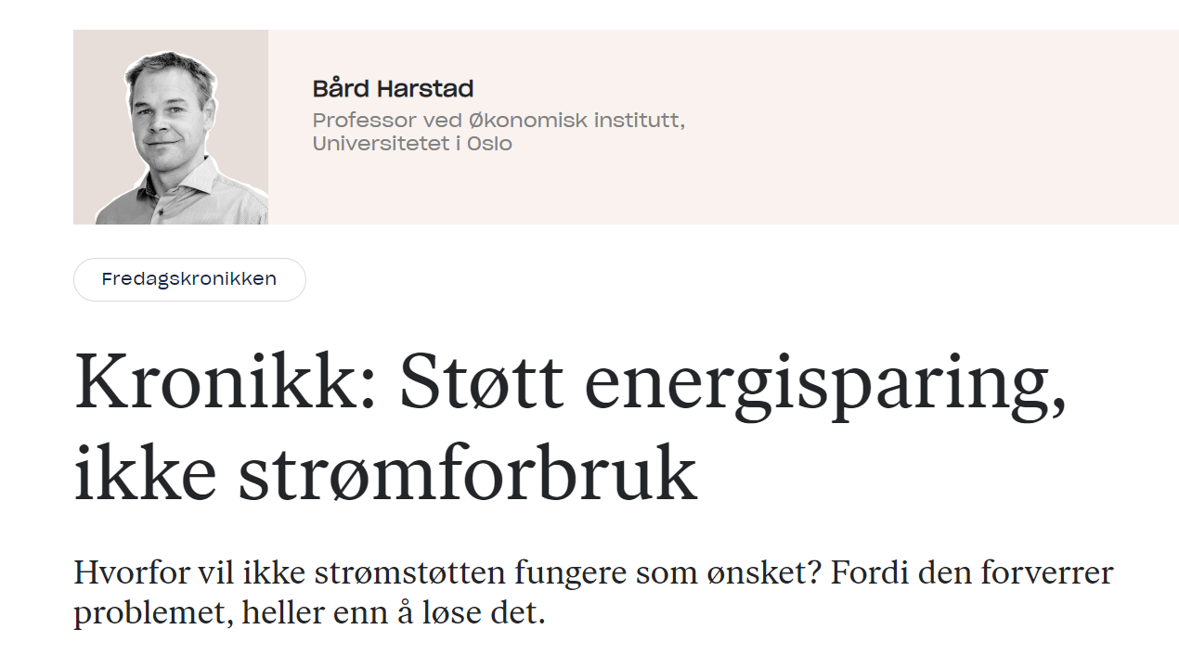
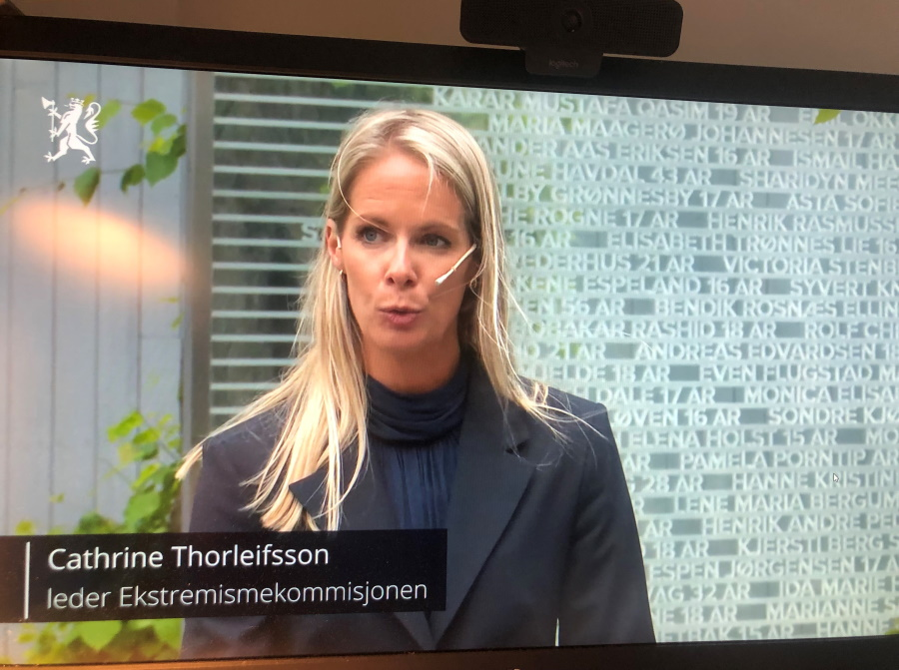
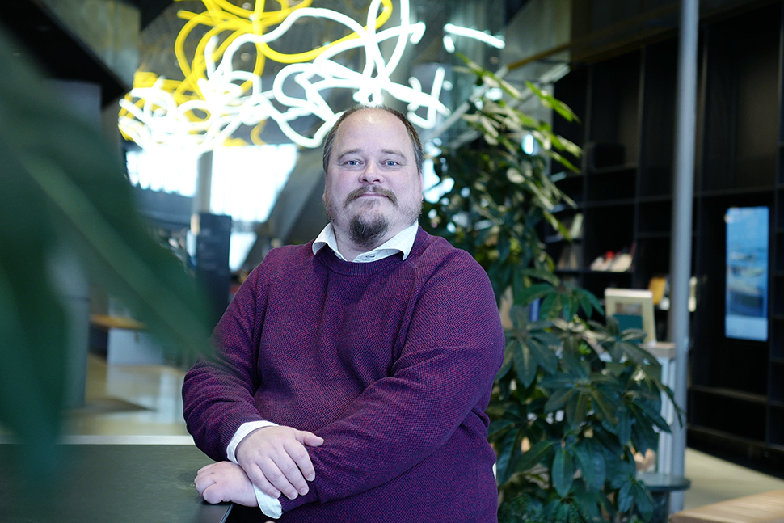
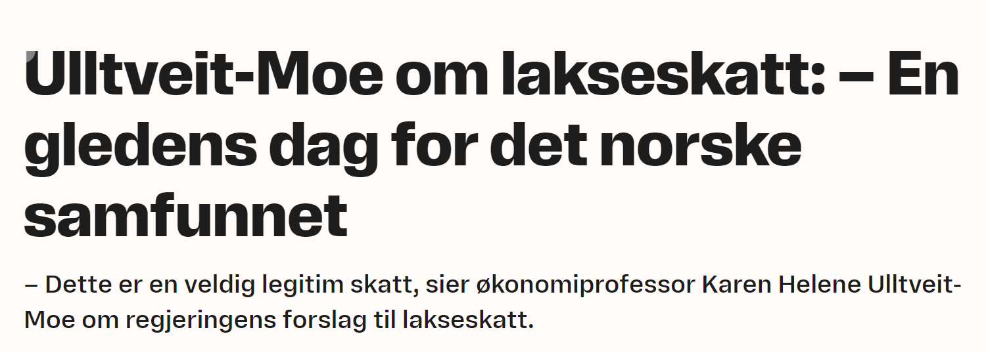
We contribute to a knowledge-based public debate
Faculty of Social Science

Slide 32
The way ahead
Continued focus on excellent research and education
Equality and diversity among students and staff
Social innovation
Investing in research infrastructure and research ethics.
Sett inn bilde her
Faculty of Social Science
Foto: Jarli & Jordan
Foto: Colourbox
Notes:
uio bildearkiv

