Slide 1
Faculty of Social Sciences

Slide 2
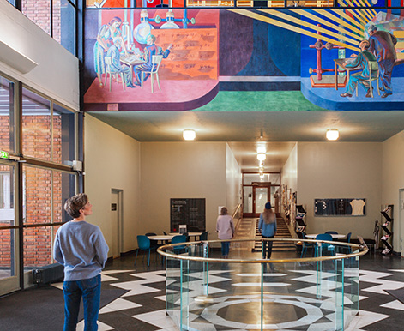
University of Oslo today
World’s 73rd best research university (Shanghai Ranking)
5 Nobel Prize winners
8 faculties
2 museums
Photo: AART Architects
Foto: Jarli & Jordan
240 study programmes
30 Centres of Excellence
92 ERC-funded projects
7 000 employees
26 070 students
Photo: Jarli & Jordan
Photo: Jarli & Jordan
Faculty of Social Science
Notes:
UiO er med i totalt 30 fremragende sentre: Sentre for fremragende forskning, sentre for fremragende utdanning, sentre for fremragende forskningsdrevet innovasjon, forskningssentre for miljøvennlig energi.
UiO er prosjekteier/vertsinstitusjon for 16 fremragende sentre.
50 aktive ERC-prosjekter per 31.12.2022. Totalt har UiO fått tildelt 92 ERC-prosjekter.
Nobelprisvinnere: https://www.uio.no/om/tall-og-fakta/nobelpriser/

Slide 3
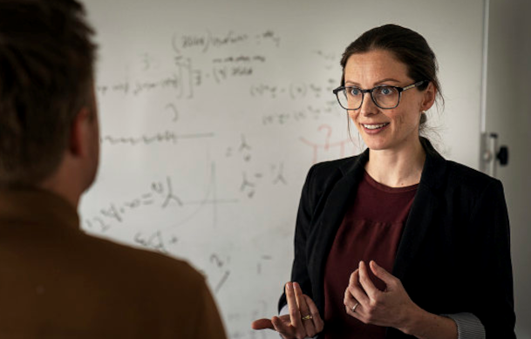
Faculty of Social Science– numbers and facts
Photo: Jarli & Jordan
Photo: Jarli & Jordan
Photo: Erik Engblad
Students
4676 students
500 Ph.D. candidates
Studies
1 Professional program
12 Master programmes
12 Bachelor programmes
5 Foundation years
Employees
Academic staff: 616
Technical-administrative staff: 157
Faculty of Social Science

Slide 4
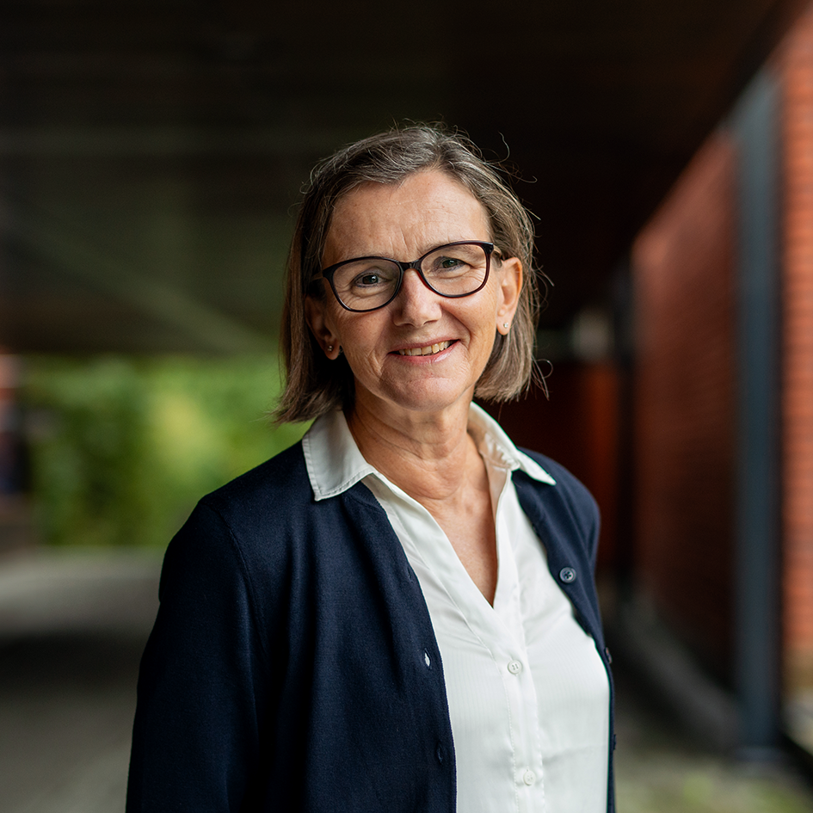
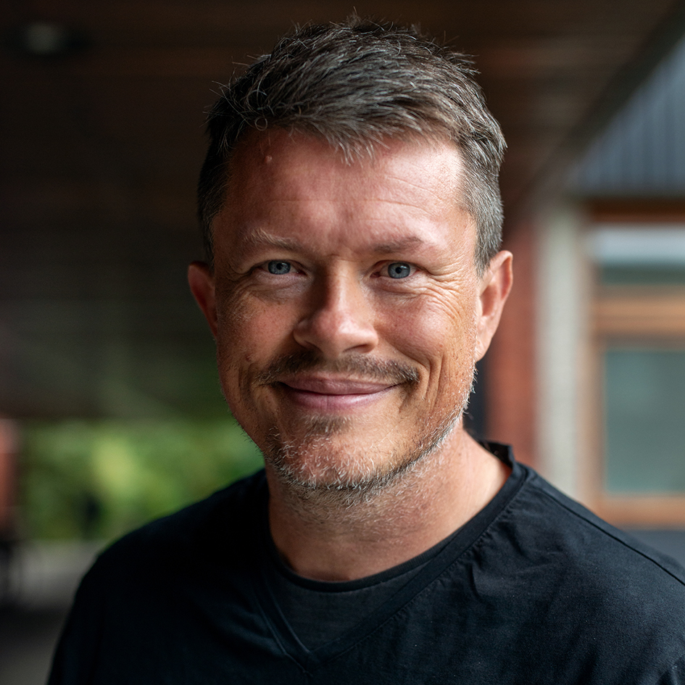
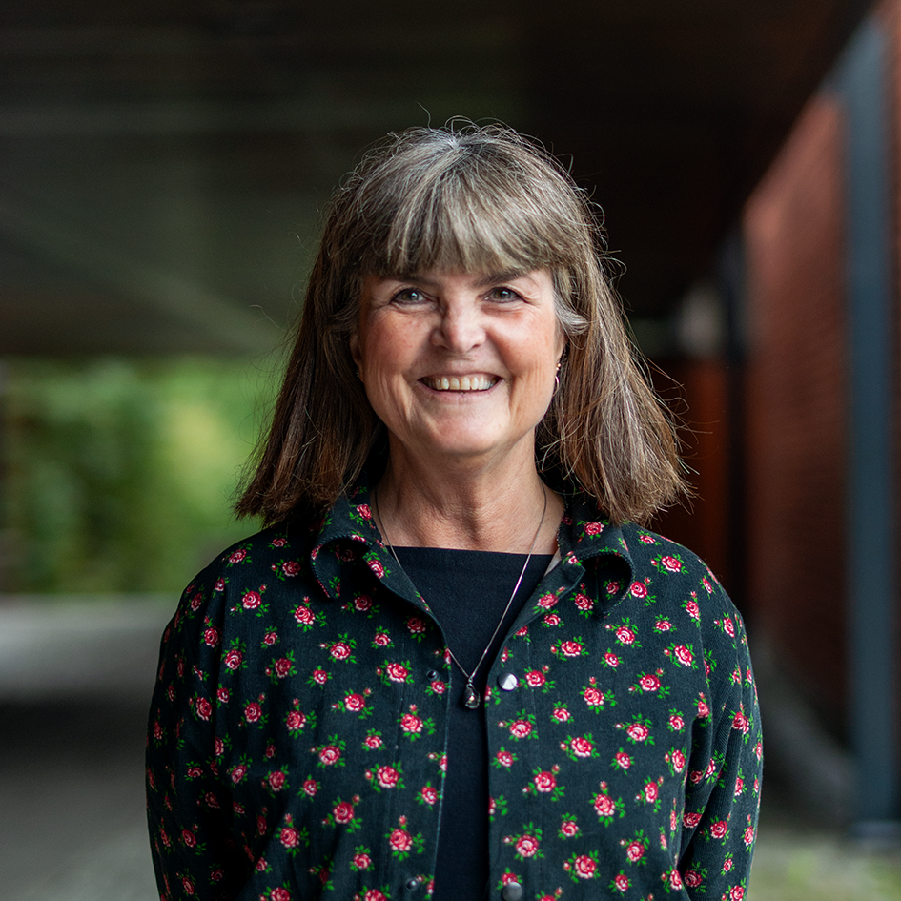
Faculty Management
Foto: Nicholas Doherty/Unsplash
Foto: Jarli & Jordan
Foto: UiO
Foto: UiO
Foto: UiO
Dean of the Faculty
Anne Julie Semb
Vice Dean (Research)
Lars Tjelta Westlye
Vice Dean (Studies)
Tora Skodvin
Faculty of Social Science

Slide 5
Organization
Faculty Board
Faculty administration
Faculty management
Finance section
Section for research and communications
HR section
Section for studies
Department of Psychology
Department of sociology and human geography
Department of economics
Department of social anthropology
Department of political science
TIK Centre for technology, innovation and culture
ARENA Centre for european studies
Faculty of Social Science

Slide 6
Study programmes and courses at the Faculty of Social Science

Slide 7
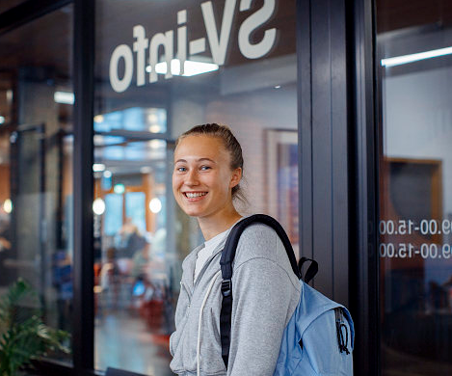
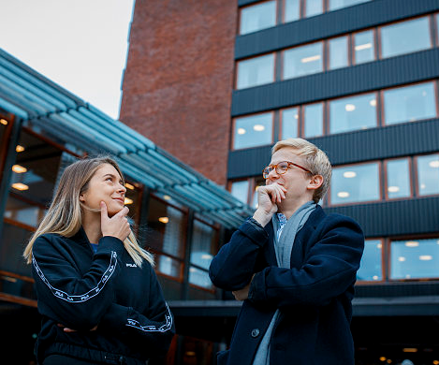
Bachelor programme
Economics
Political Science
Sociology an human geography
Photo: Jarli & Jordan
Photo: Jarli & Jordan
Foto: Jarli & Jordan
Foto: Jarli & Jordan
Technology, Innovation and Culture
Interdisciplinary courses
Psychology
Social Anthropology
Photo: Jarli & Jordan
Photo: Jarli & Jordan
Foto: Jarli & Jordan
Faculty of Social Science
Notes:
Seks disiplinære og fire tverrfaglige programmer.

Slide 8
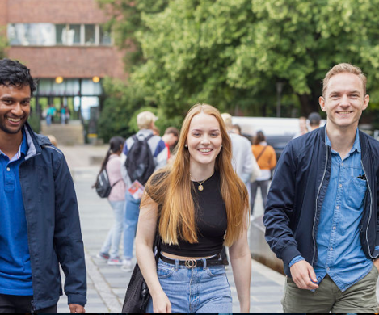
Master's degree programmes offered in English
Economics
Human Geography
Photo: Jarli & Jordan
Photo: Jarli & Jordan
Foto: Jarli & Jordan
Foto: Jarli & Jordan
Peace and Conflict Studies
Psychology
Social Anthropology
Photo: Jarli & Jordan
Photo: Jarli & Jordan
Foto: Jarli & Jordan
Faculty of Social Science

Slide 9
Professional education
Psychology
Provides the student with the competence to work as an authorized psychologist
6 years of education
360 credits
Economics
Socioeconomic analysis
5-year master's program
300 credits
Photo: Jarli&Jordan
Foto: Maylinn Hovengen Byrknes

Slide 10
Interdisciplinarity and sustainability
Examples:
SAMKLIMA: Environment, society and sustainability (40 group)
Faculty of Social Science

Slide 11
Center for Interdiciplinary Education - INTED
Brings together students from:
The Faculty of Humanities
The Faculty of Social Sciences
The Faculty of Mathematics and Natural Sciences at UiO
Goal: Develop students’ interdiciplinary competence
Sett inn bilde her
Faculty of Social Science
Photo: Unsplash
Foto: Colourbox

Slide 12
Exchange programmes
116 student exchange agreements with higher education institutions
The Faculty of Social Science offers 331 English-language courses
Entries in 2023: 310
Departures in 2023: 250
Faculty of Social Science
Photo: Jarli & Jordan

Slide 13
WORKING LIFE RELEVANCE
Internship
- work life experience
- resources
- network
Active learning
- learn to learn
- relevance to working life
Career competence
- Knowledge of and communicate own competencies
- transission from studies to work
Alumni
- ambassadors
- job profiles
- network
Society and working life
- relevance
- point of contact and frequency
- network
5 focus areas aimed at strengthening the content of education and the student's learning experience and perceived working life relevance
Foto: Getty stock image
Foto:Audum Braastad/NTB
Foto: Jarli & Jordan
Foto: Jarli & Jordan
Ensure the relevance of students' competencies for the workforce after completing their education
Increase students' own understanding and ability to articulate their competencies
Ensure employers' understanding of and knowledge about students' competencies after completing their education
Det samfunnsvitenskapelige fakultet
Referanse: Sluttrapport Samfunns- og arbeidslivsrelevante studier, 2021, SV, UIO

Slide 14
DISCOVER YOUR FUTURE
Integrated career support throughout the study period
First to offer this in Norway
One course per semester
You will learn more about how you can plan and set goals for yourself, and what you may not be able to plan for
You will gain insight into what may be relevant experiences on the way forward and how you can use your time to explore your options for further education or work
You will also get concrete tools along the way that you can use to find your direction
Faculty of Social Sciences

Slide 15
EILIN - Network for Learning and Teaching
Pjoto: Unsplash
Photo: Unsplash
Photo: Jarli & Jordan
Digital Tools
Student active learning methods
Varied assessment methods
Teaching support
Development projects
Support and assistance for IT in education
First-line support
Subject-specific services
Sharing of experiences
Competence development
Pedagogical development work
Faculty of Social Science

Slide 16
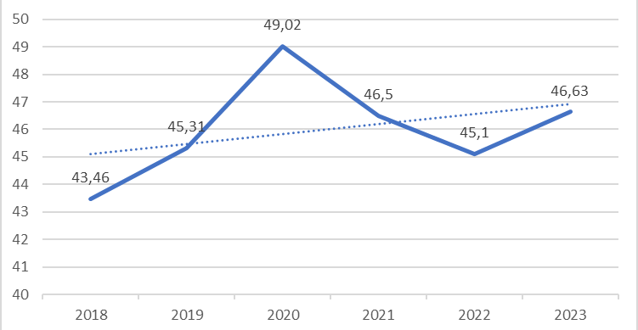
Focus on teaching quality
Study credits per student (DBH)
Positive trend
Good results – even with a large scope
600 high-quality courses
Preventive measures against dropout
High student-to-teacher ratio: 8,6
Faculty of Social Science

Slide 17
Research at the Faculty of Social Science

Slide 18
Funding allocations from the Research Council of Norway 2015 - 2023
19 FRIPRO research projects
18 FRIPRO young research talents
2 big interdisciplinary research projects
26 researcher/collaborative projects
Photo: Jarli & Jordan
4 research centres
Center of Excellence (SFF)
Photo: Unsplash
Photo: Unsplash
Faculty of Social Science
Notes:
Bilder fra unsplash og uio bildearkiv

Slide 19
EUs Framework Programme
ERC
8 Advanced Grants
8 Consolidator Grants
14 Starting Grants
Thematic (H2020 and HE)
4 coordinator projects
18 partner projects
Marie Skłodowska-Curie Actions
7 doctoral networks (1 coordinator)
7 postdoctoral projects
Total funding 2014-2022: 43,9 millions euros
Foto: Unsplash
Photo: Wikipedia

Slide 20
Targeted initiative
ERC
The first two in 2012, a total of 30 approved
One researcher - three projects
Marie Skłodowska-Curie Actions
Recruit young, excellent researchers
7 awards since 2018
Thematic
Great potential
Aiming at Horizon Europa
Foto: Unsplash
Notes:
unsplash

Slide 21
Circle U.
European university alliance consisting of 9 universities
Will facilitate students and staff to study and collaborate across borders
Photo: Circle U.
Photo: Circle U.
Faculty of Social Science
Notes:
Målet er å etablere et inkluderende, forskningsintensivt og tverrfaglig europeisk universitet.
Samarbeid på tvers av institusjoner, mellom ansatte, mellom studenter, og mellom studenter og ansatte.
Etablering av forskningsprosjekter og nye studietilbud.
Medlemmer: Universitetet i Oslo, Aarhus Universitet, Humboldt-Universität zu Berlin, King’s College London, Univerzitet u Beogradu, Université catholique de Louvain, Université Paris Cité, Università di Pisa, Universität Wien.

Slide 22
The Guild of European Research-Intensive Universities
21 research-intensive universities from 16 European countries
Working on research and education policies, as well as contributions to EU programmes
Faculty of Social Science
Photo: imageBROKER/Wilfried Wirth
Notes:
For UiO er påvirkning på den europeiske arenaen viktig, gitt norske universiteters avhengighet av innretningen på EUs politikk, programmer og utlysninger, i tillegg til at forsknings- og utdanningspolitikken som utformes i Brussel i stor grad påvirker nasjonal politikk og nasjonale virkemidler.
Om The Guild-samarbeidet: https://www.uio.no/om/internasjonalt/the-guild/

Slide 23
Social Science at UiO: Ranking
Times Higher Education
Shanghai ranking
Leiden 2023
QS 2023
Political sciences 29th place
Sociology 29th place
42nd place
(#1 in Norway and the Northern countries)
Anthropology 44th place
Sociology 45th place
61st place
(#1 in Norway)
Faculty of Social Science

Slide 24
Financing
Percentage of external funding in 2023
Development of funding 2018 - 2023
KD
RCN
EU
Others
Others
EU
RCN
Faculty of Social Science

Slide 25
Research support
Strategies, consultations, processes
Information and guidance on the Research Council of Norway and Horizon Europe
Guidance in grant writing
Research infrastructure
Research ethics and GDPR
Research support
Faculty of Social Science
Photo: imageBROKER/Wilfried Wirth
Notes:
For UiO er påvirkning på den europeiske arenaen viktig, gitt norske universiteters avhengighet av innretningen på EUs politikk, programmer og utlysninger, i tillegg til at forsknings- og utdanningspolitikken som utformes i Brussel i stor grad påvirker nasjonal politikk og nasjonale virkemidler.
Om The Guild-samarbeidet: https://www.uio.no/om/internasjonalt/the-guild/

Slide 26
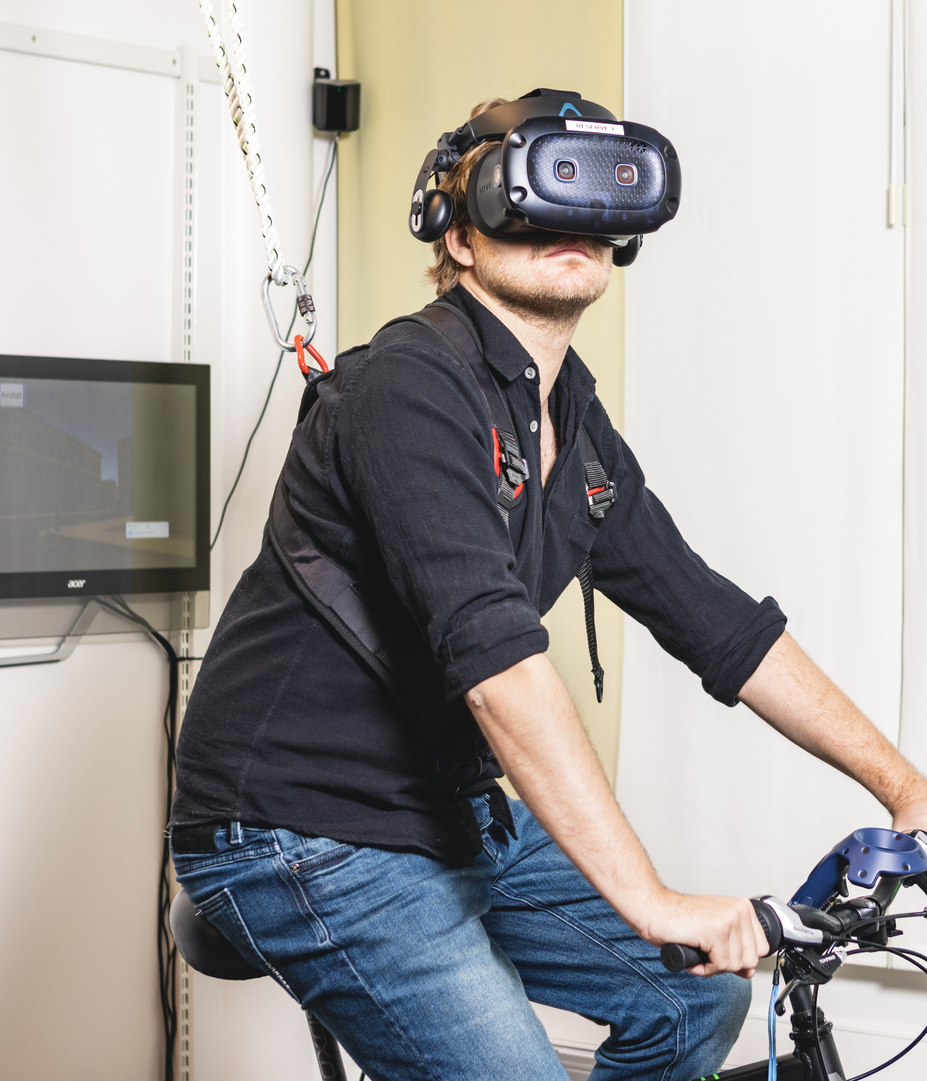
The Ph.D. programme
50 doctoral dissertations in 2023
29 got their first job at a research or educational institutions. 7 of these abroad.
Increased admissions as a result of success in external funding.
Sett inn bilde her
Faculty of Social Science
Foto: Jarli & Jordan
Foto: Colourbox
Notes:
uio bildearkiv

Slide 27
Strategic objectives
Development in gender balance
EQUALITY

Slide 28
Social innovation – applied knowledge
Public Commissions
Changes in policy, regulations and systems
SPARK Social innovation
Knowledge dissemination
Participation in the Innovation Council
ERC – Proof of concept
Faculty of Social Science

Slide 29
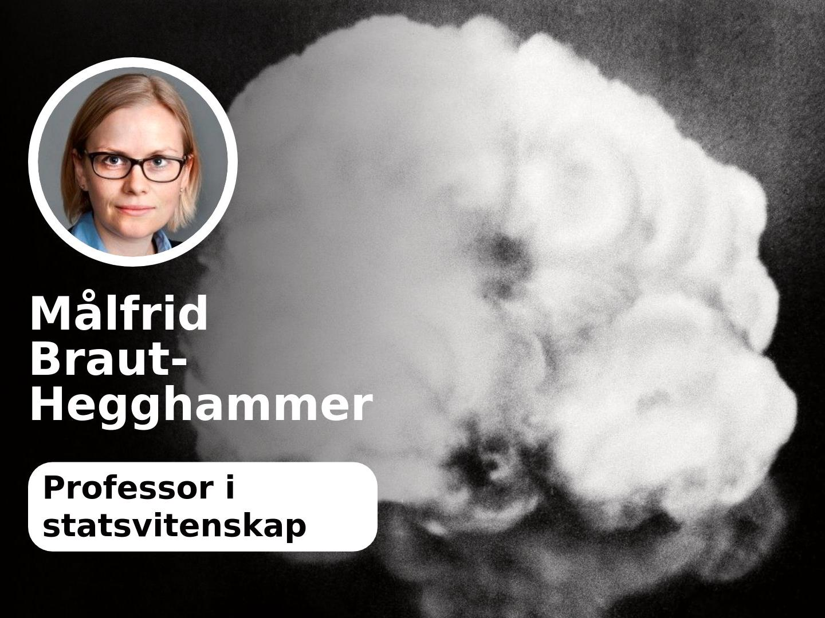
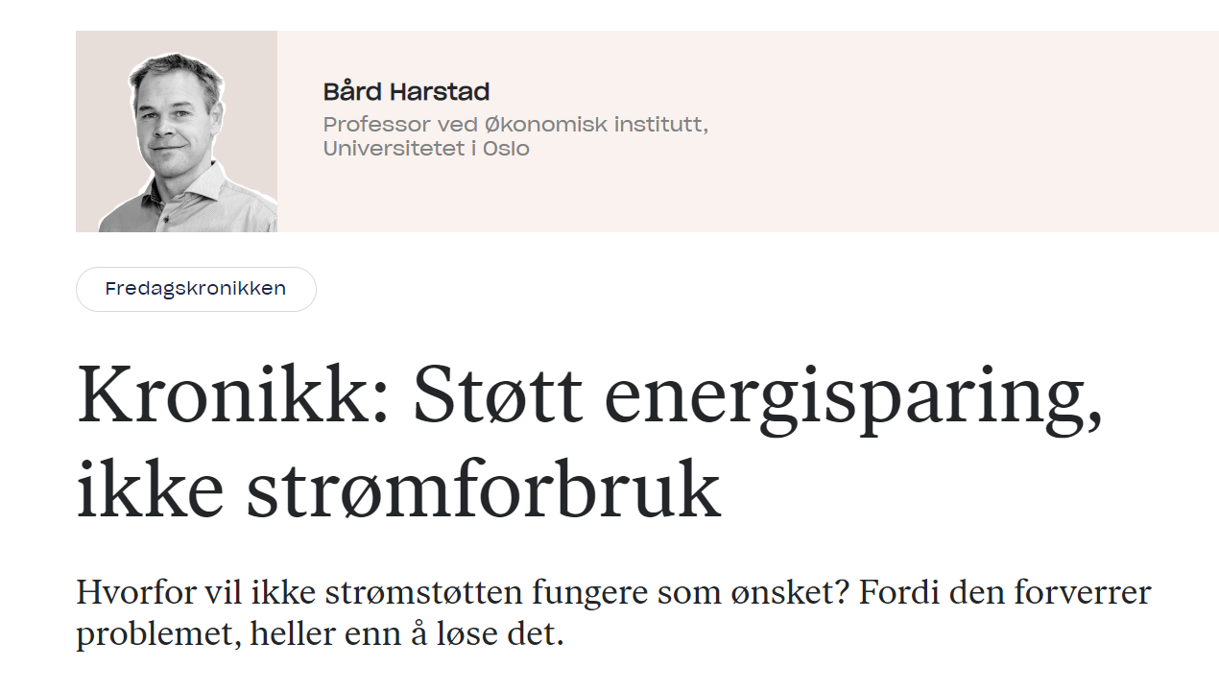
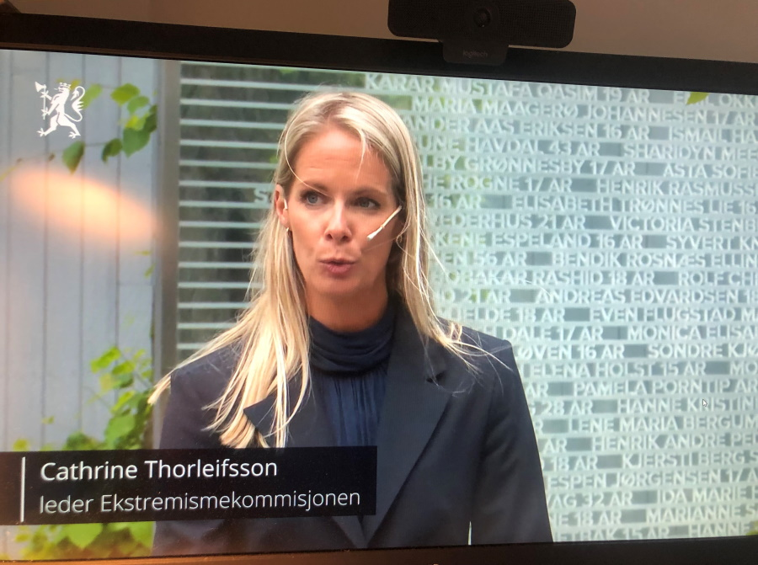
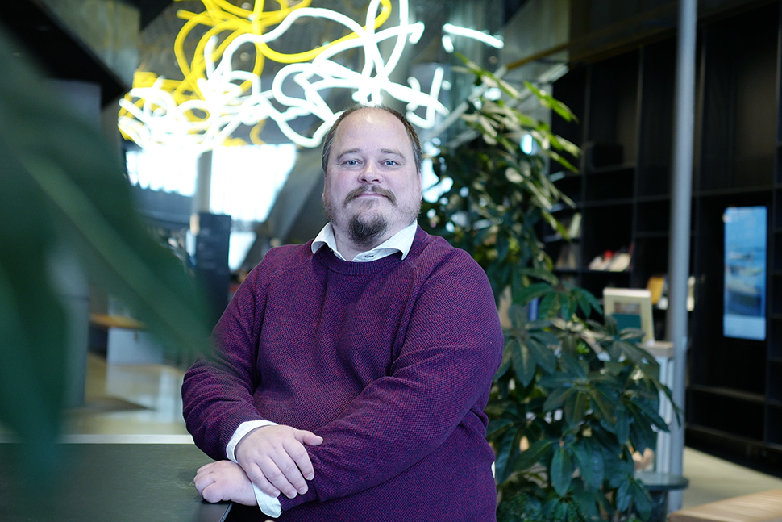
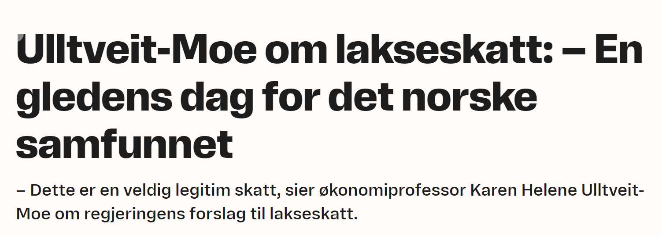
We contribute to a knowledge-based public debate
Faculty of Social Science

Slide 30
The way ahead
Continued focus on excellent research and education
Equality and diversity among students and staff
Social innovation
Investing in research infrastructure and research ethics.
Sett inn bilde her
Faculty of Social Science
Foto: Jarli & Jordan
Foto: Colourbox
Notes:
uio bildearkiv

