Slide 1
Psychology for Climate seminar 31.10.23
The stubbornness of meaty routines: Meat consumption and reduction in Norway
Arve Hansen
SUM

Slide 2
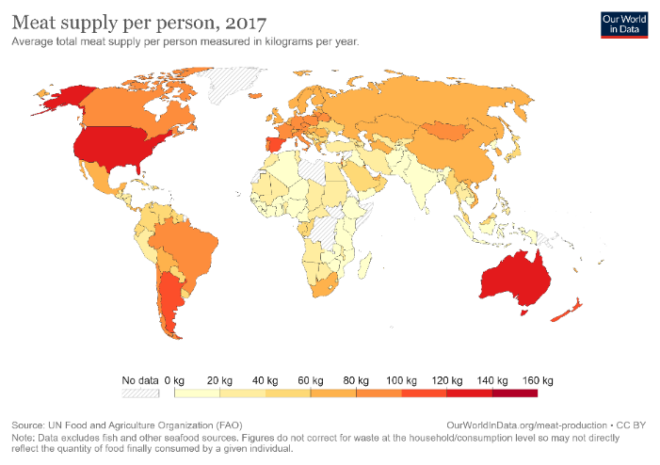
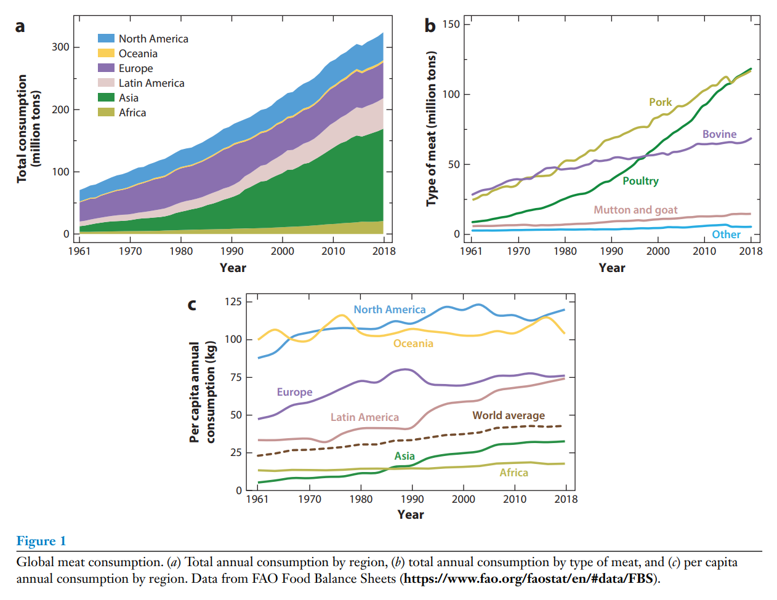
Meatifying the world (?)
Global per capita meat consumption
1961: 23 kgs
2020: 43 kgs
(while global pop doubled)
Livestock systems globally:
emit up to 18 percent of total Greenhouse gases
use 25-32 percent of fresh water
(Sources: Herrero et al. 2015: Livestock and the Environment: What Have We Learned in the Past Decade?; FAOSTAT; Our World in Data; Parlasca and Qaim (2022): Meat consumption and sustainability, Annual Review of Resource Economics

Slide 3
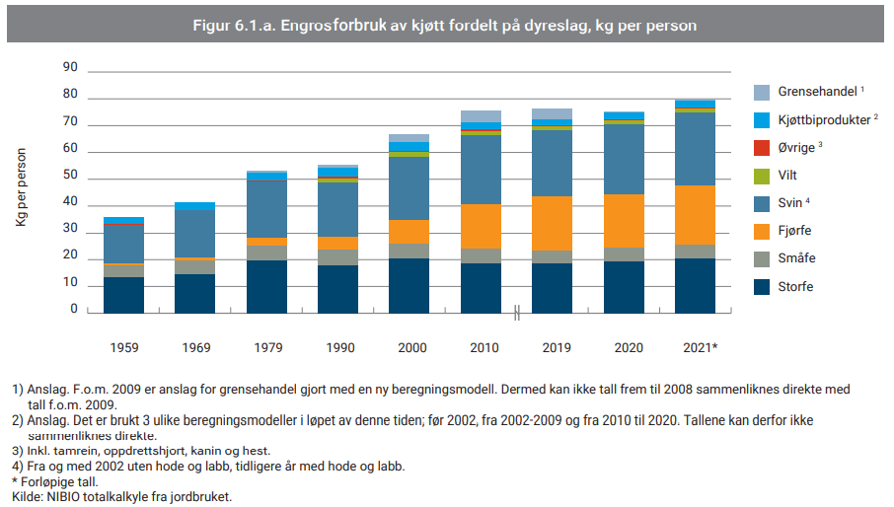
Meat consumption in Norway
Do you eat meat?
N=1520
Consumption of meat per capita by type
Source: Kantar, from MEATigation survey
Source: Animalia (2022): Kjøttets tilstand

Slide 4
WP2: Eating meat:
What are the food-related practices contributing to meat consumption in Norwegian households, and how are these justified/explained by different actors? What conditions facilitate and complicate a reduction of meat consumption in Norwegian households?

Slide 5
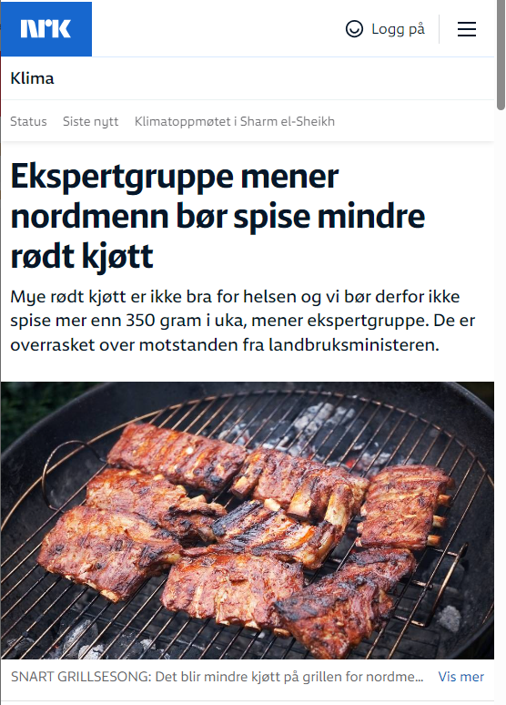
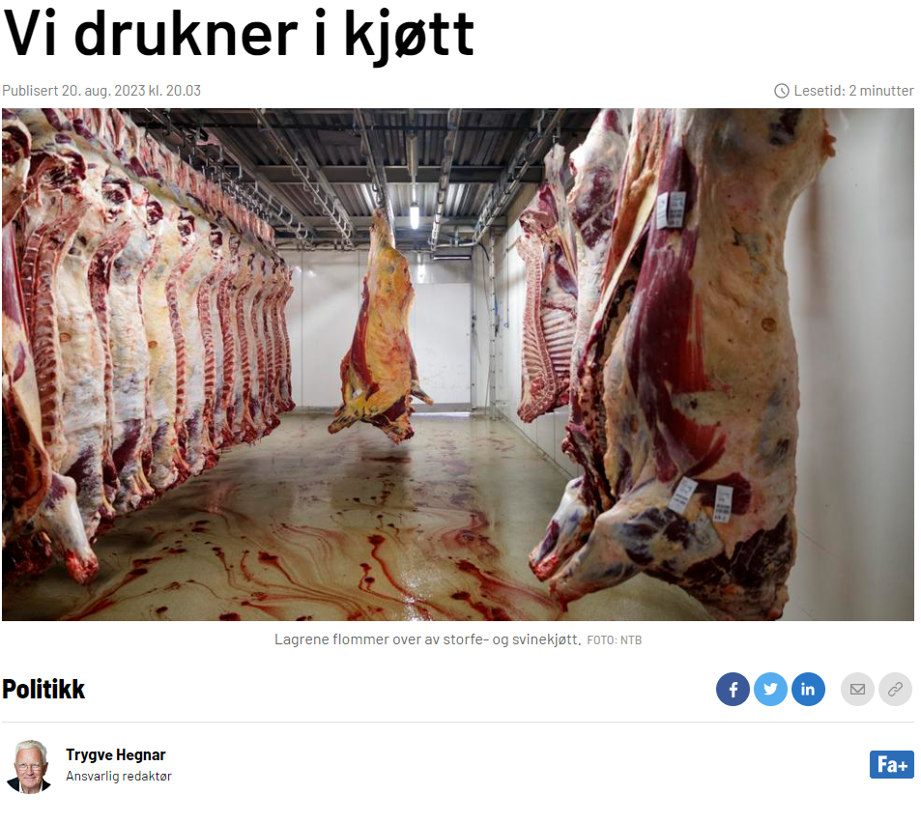
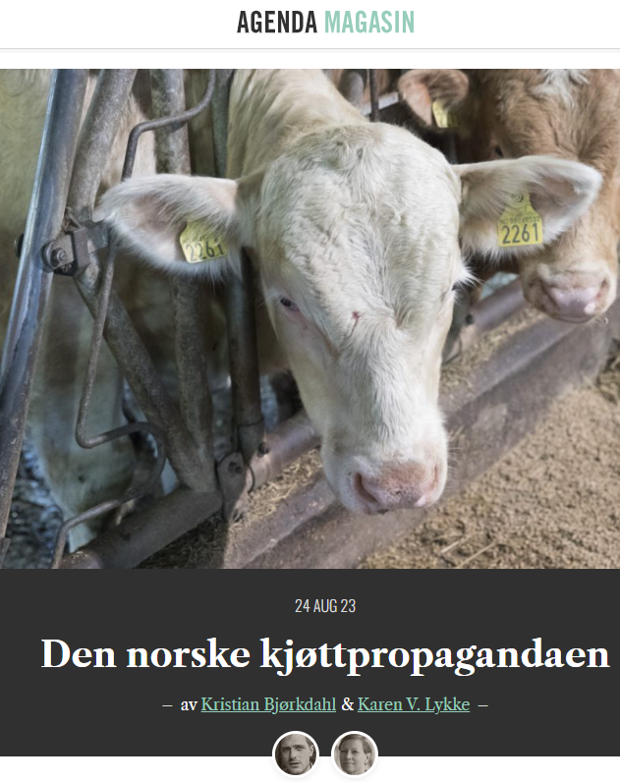
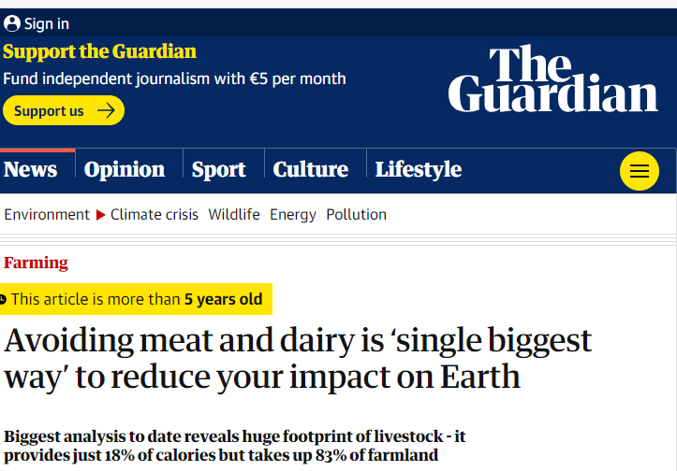
We should reduce our meat consumption..

Slide 6
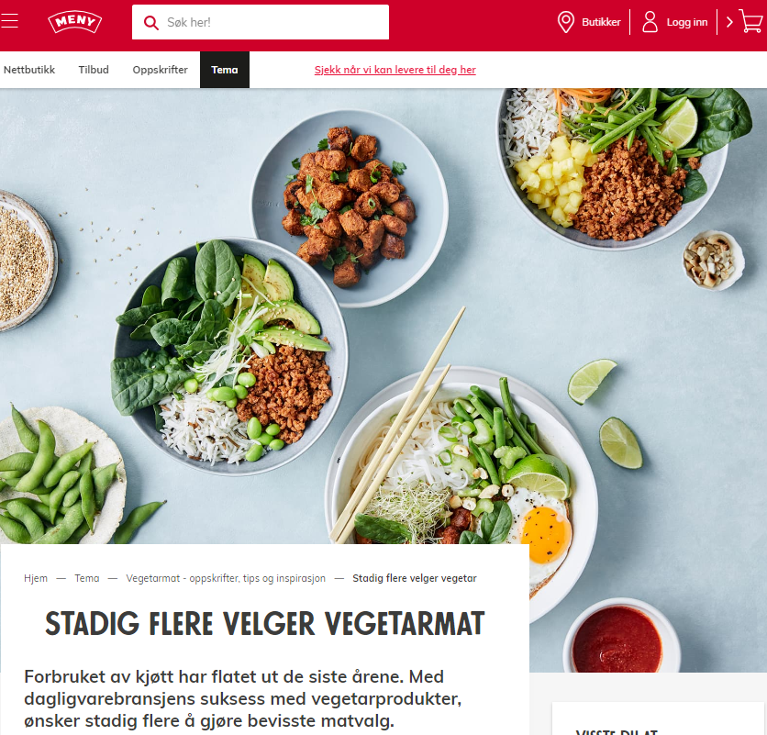
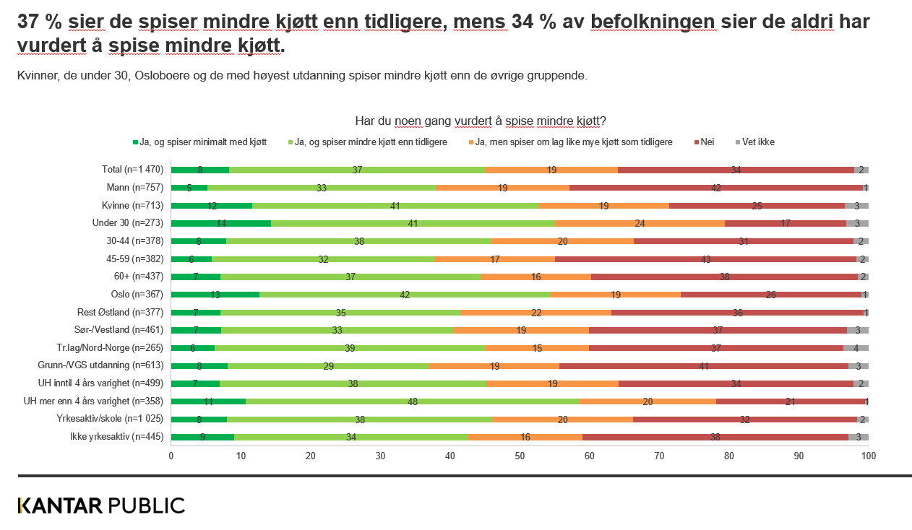
..and Norwegians are increasingly on board with cutting back on meat..
Skjermdumpar frå (1) forskning.no, (2) Klassekampen, (3) meny.no og (4) Kantar for UiO

Slide 7
..but this is not making an impact on national consumption levels

Slide 8
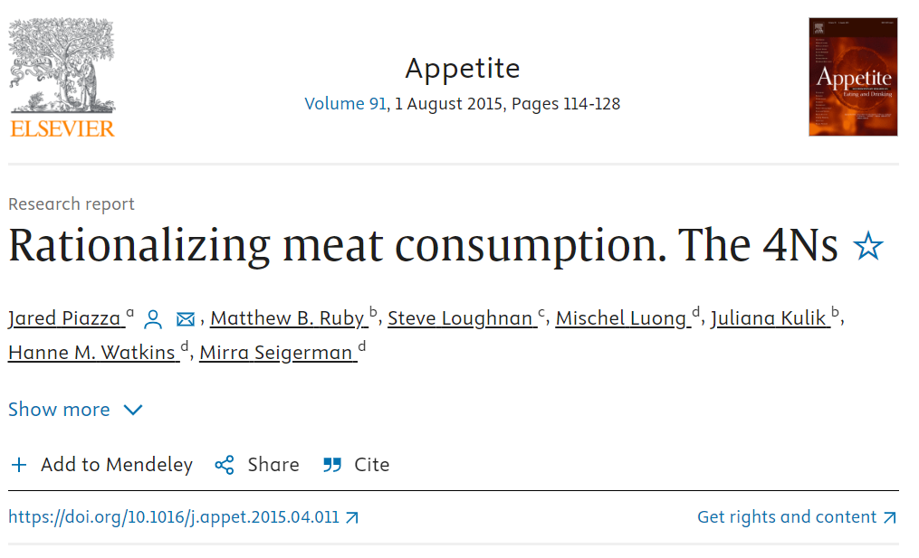
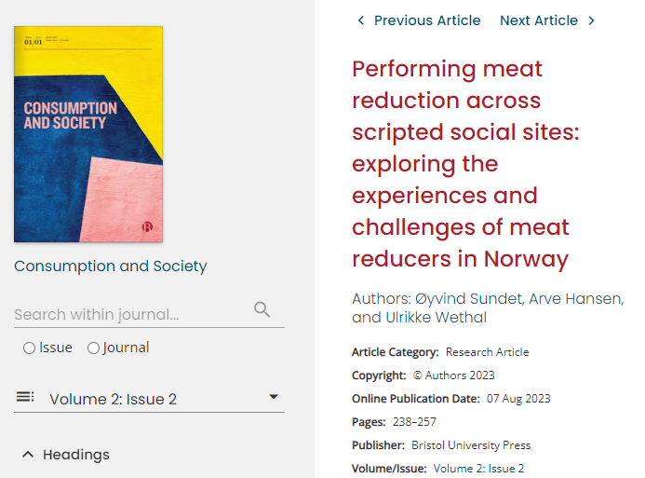
Why is it so hard to eat less meat?
Economic-structuralist explanations:
The meatification of diets through capitalist, industrialised agriculture
Systems of provision and ‘manufactured ignorance’
Behavioural explanations:
Value-action gaps
The meat paradox and cognitive dissonance
Denialism
Identity
Biology
Meat as ‘Necessary, Natural, Normal, Nice’
Nudges and sludges
+++
‘Socio-material’ explanations:
Food culture
Competences
Everyday negotiations
Routinised and embodied eating practices
Convenience
Scripting
Meat intensive socio-material arrangements
+++

Slide 9
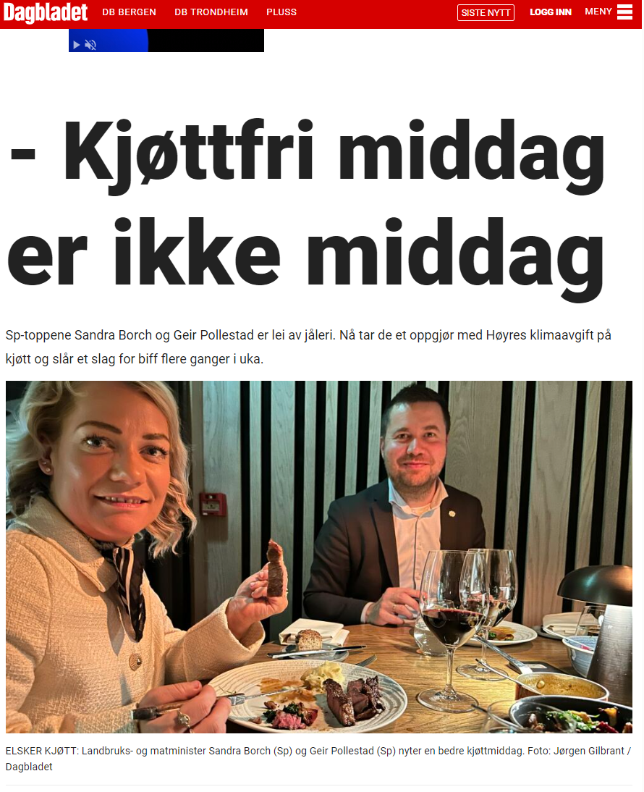
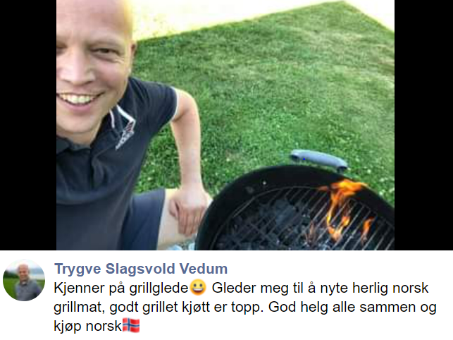
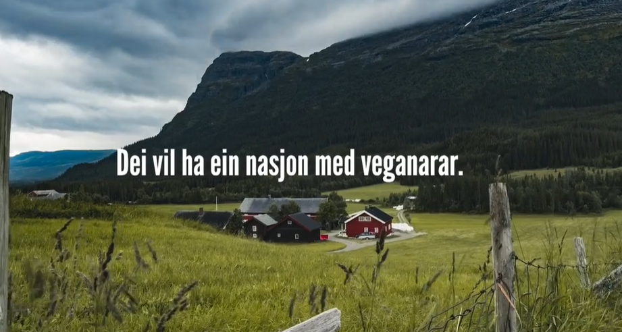
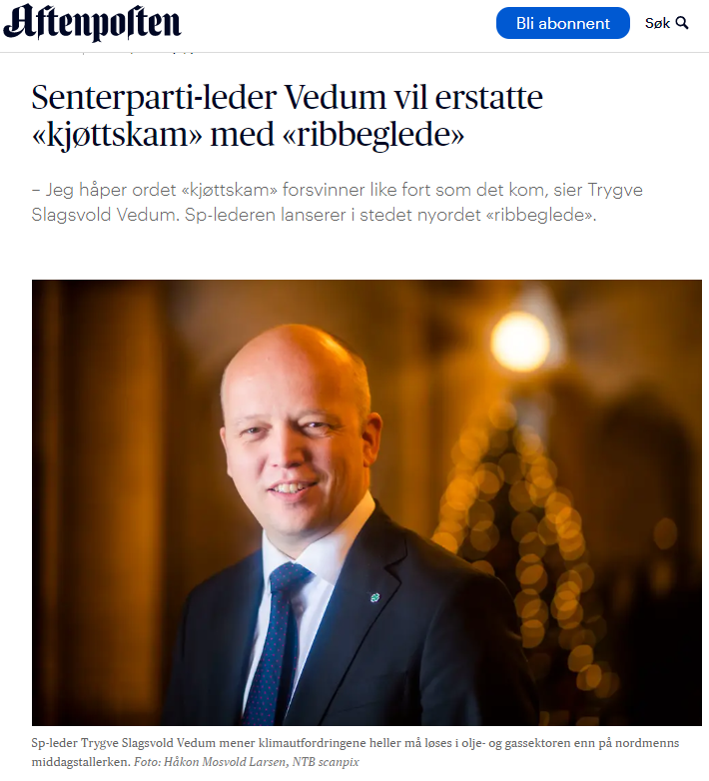
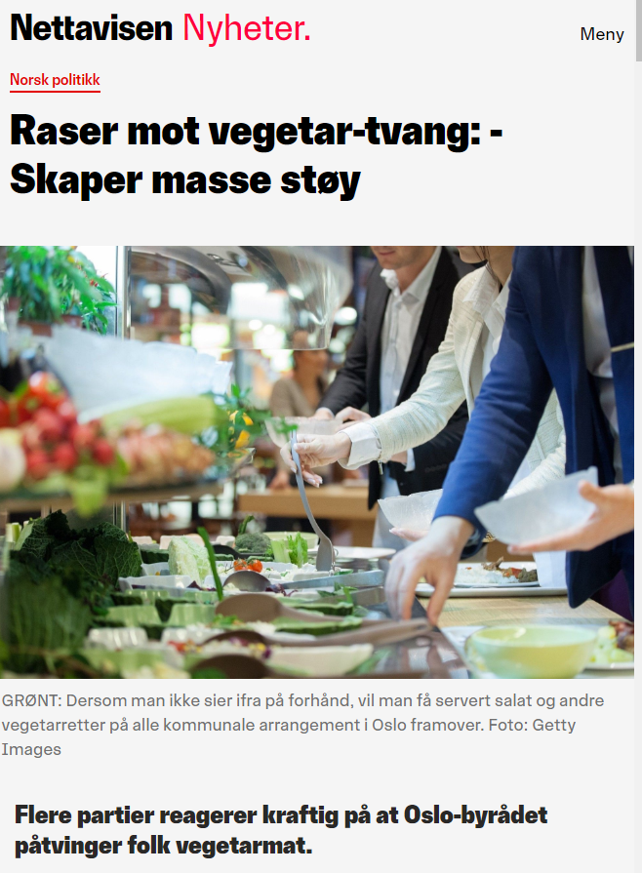
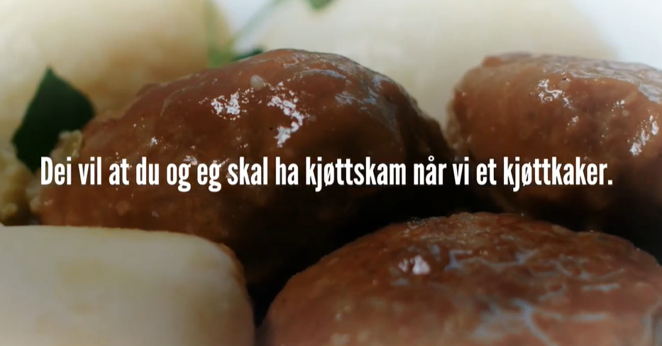
Meat reduction and meat friction
Screen shot: Aftenposten, Nettavisen, db.no og Vedum på FB
Screen shot from Sp ad in 2020

Slide 10
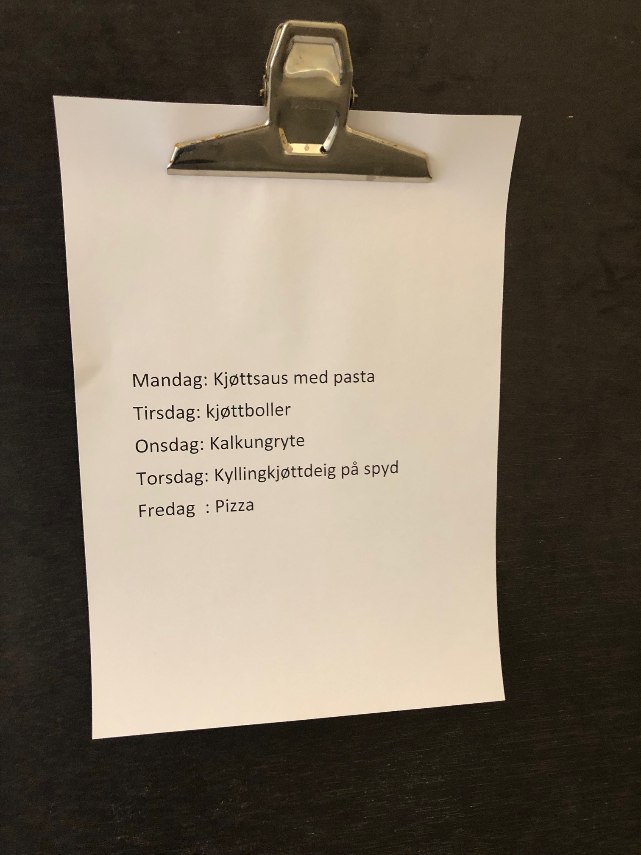
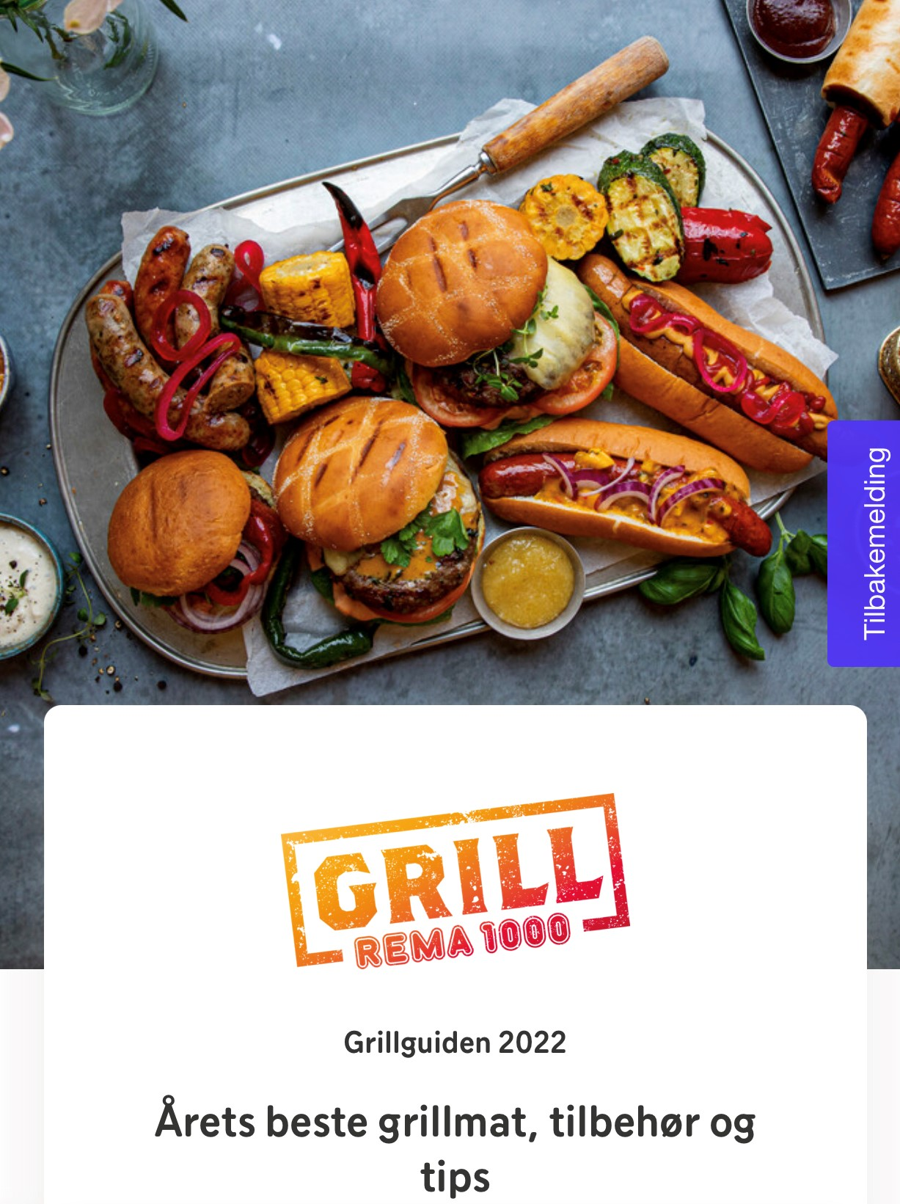
Meat intensive food environments
‘If I buy meat, it is usually as take-away [referring to eating on-the-go], not dinner but for lunch or a snack. For me that’s the most difficult situation to get hold of something meat-free. When I stop by 7-Eleven for a baguette, or I’m at an airport, I feel that all options include meat.’ (Ylva, 29, Drammen)
Foto: Arve Hansen
Screenshot from Rema 1000

Slide 11
Negotiating meat reduction
[E]arly in our relationship … I really wanted him to consider vegetarianism, in my mind I wasn’t willing to settle with someone who wasn’t vegetarian … I felt quite strongly about it back then … [now] we make compromises, he will only buy ethically produced meat
(Yvonne, 33, Trondheim).
…you just want your children to eat…
(Sigrid, 39, family of four, Oslo)
I kind of feel that pølse is so ‘default’ at a condominium party. Had I brought some kind of fancy… some fancy vegetable dish I would have felt it was more like that; ‘I have made something, look what I have made’, I don’t know, pølse are somehow completely neutral, it is completely neutral, it says nothing about us, it’s just pølse
(Anna, 28, family of four, Oslo)

Slide 12
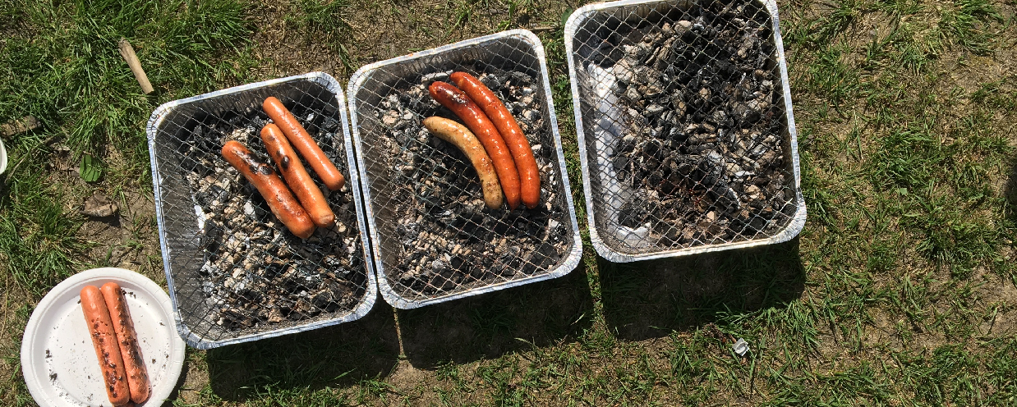
Scripted food practices and ‘bounded creativity’

Slide 13
Can’t we just use meat replacements instead?
Rapid expansion in products
Often unpopular (due to health, distrust..)
Often more a way for vegetarians and vegans to take part in meat-intensive practices than a way to achieve meat reduction

Slide 14
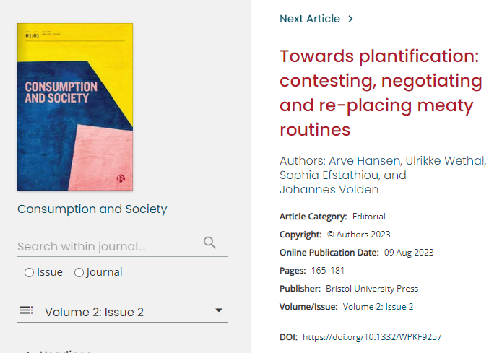
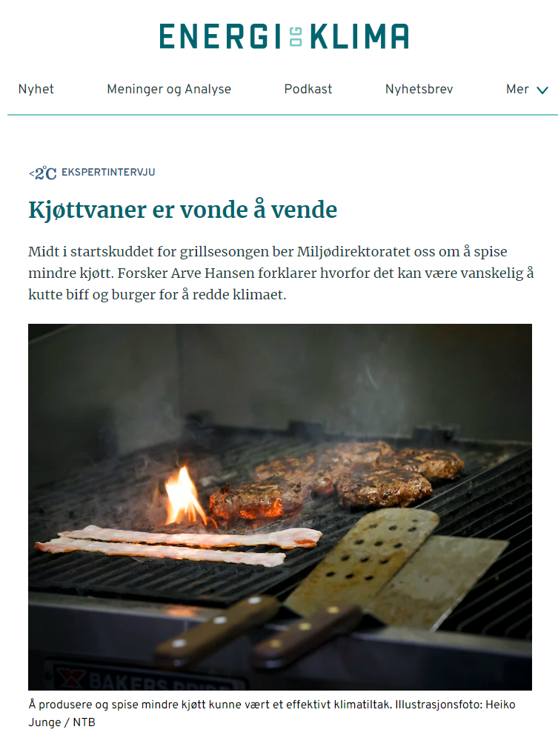
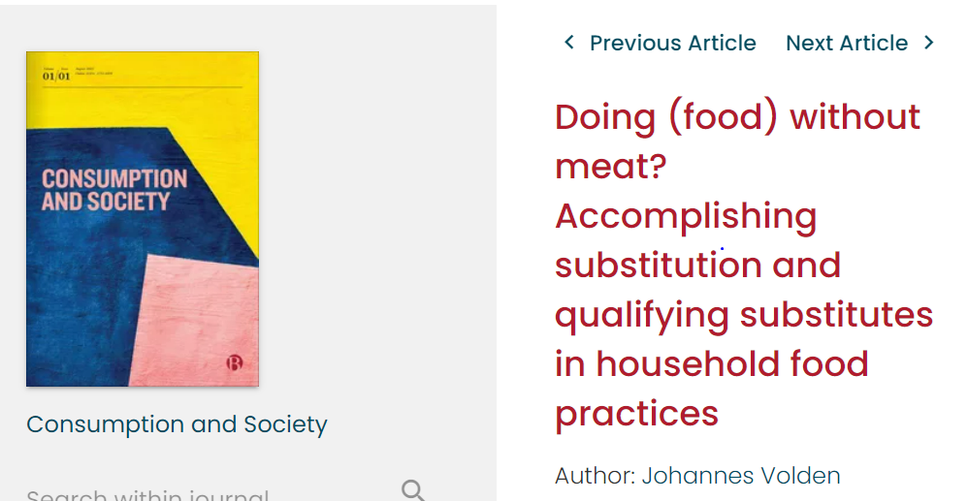
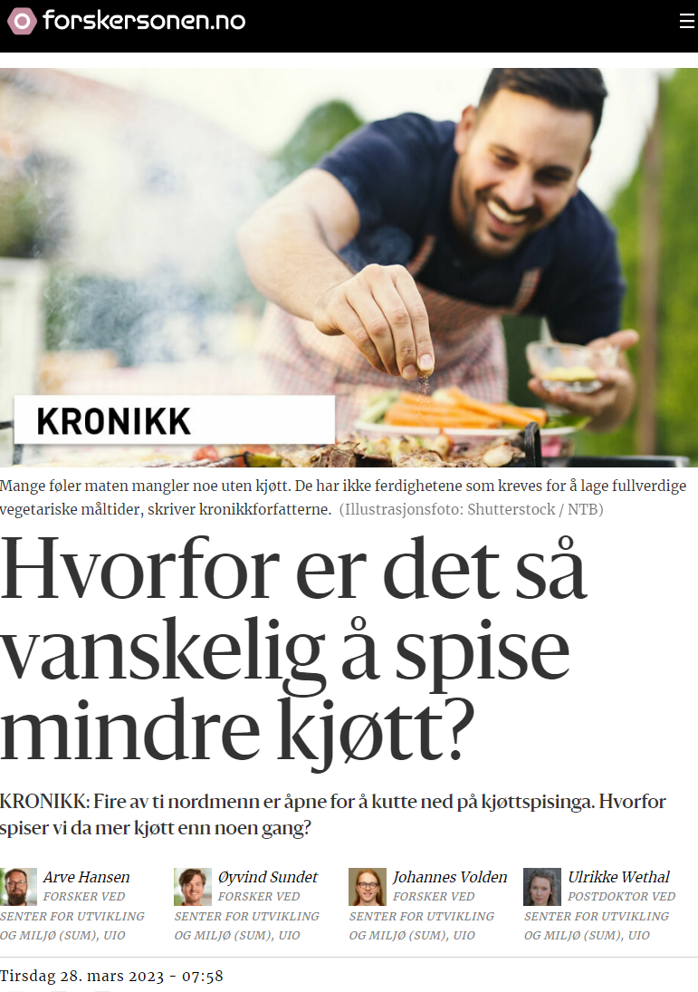
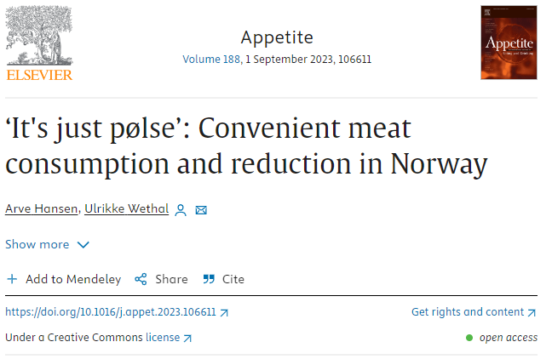
More?
Meatigation – Mitigating climate change through meat

Slide 15
In progress..
Adolfsson, Hansen and Wethal: Between distributed agency and choice architecture: Comparing and combining nudge and practice theoretical approaches to changing consumption
Contact:
Arve.Hansen@sum.uio.no

