Slide 1
Studiebarometeret 2022
Kenneth Bo Nielsen

Slide 2
Structure
BA programme
MA programme
All anthropology programmes in Norway
Not detailed tour of results
Focus on «tilknytning til arbeidslivet»
For discussion: what is to be done?

Slide 3
BA Programme
Scores from 1 to 5
3 comparisons: w/national average; w/UiO average; w/ourselves the year before
Green arrow good, red arrow bad
We did well before
We do well now
No areas where we are fantastically outstanding
One sore spot

Slide 4
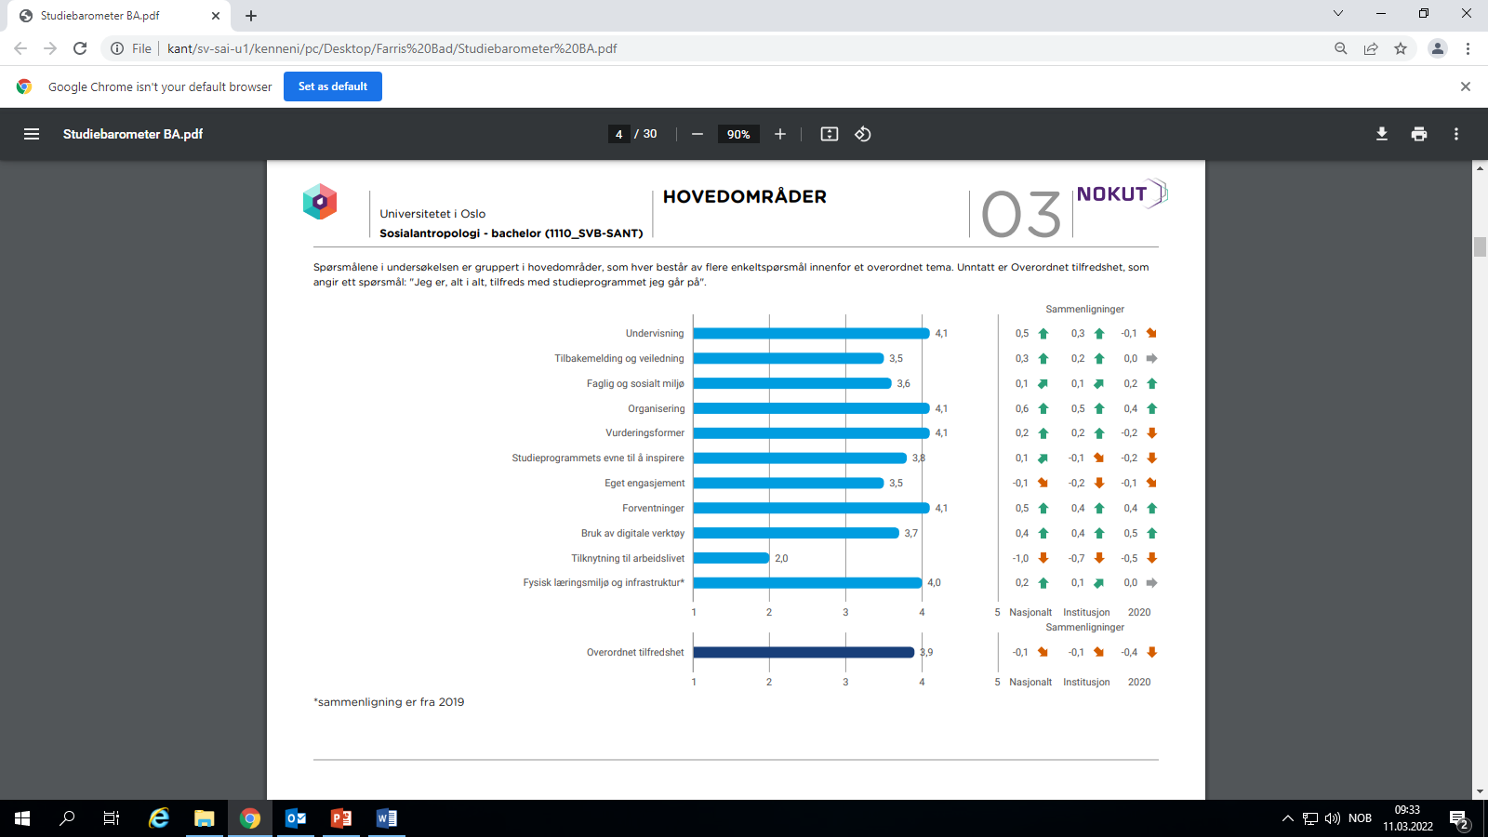

Slide 5
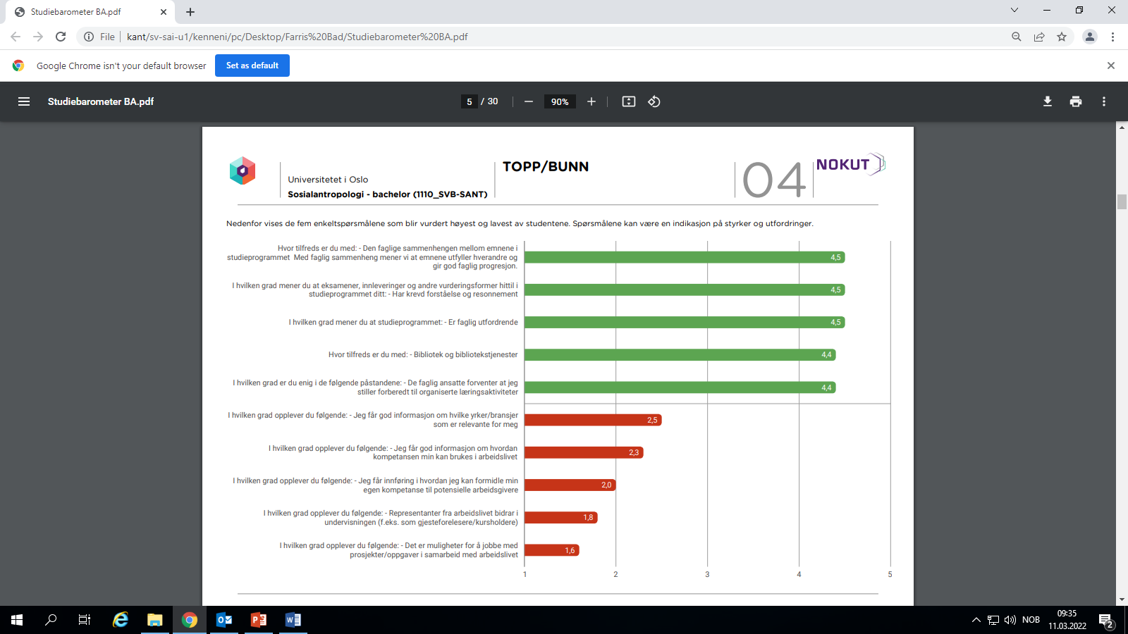

Slide 6
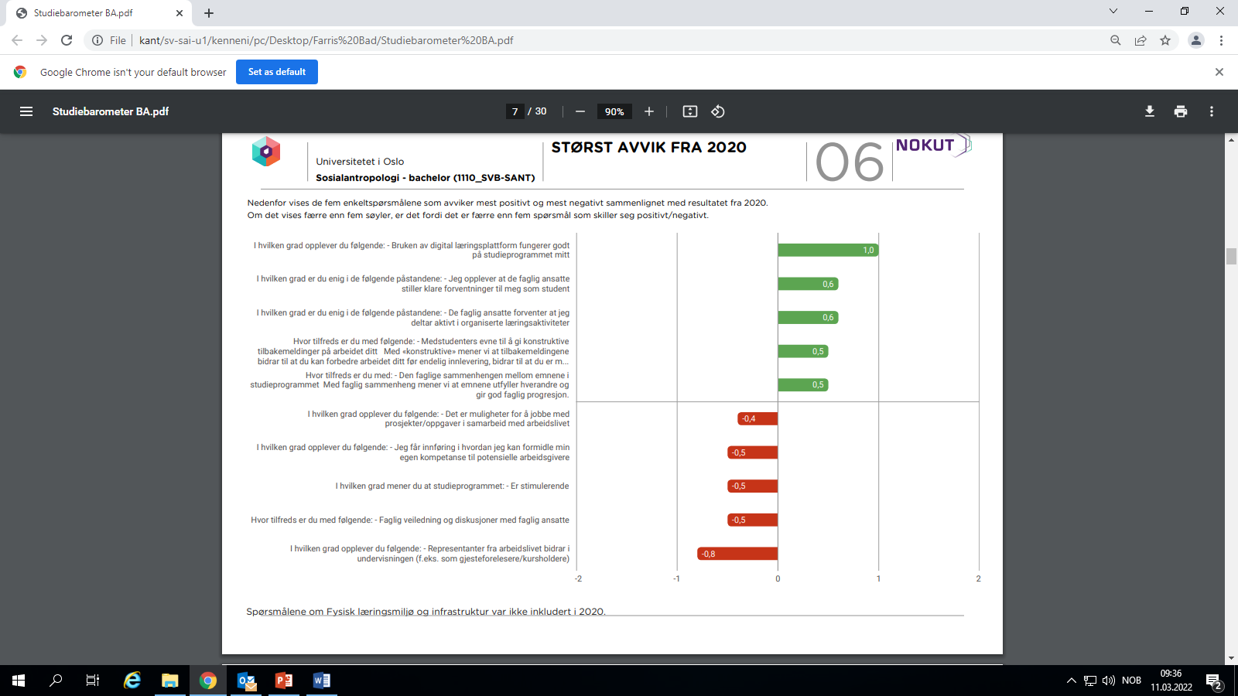

Slide 7
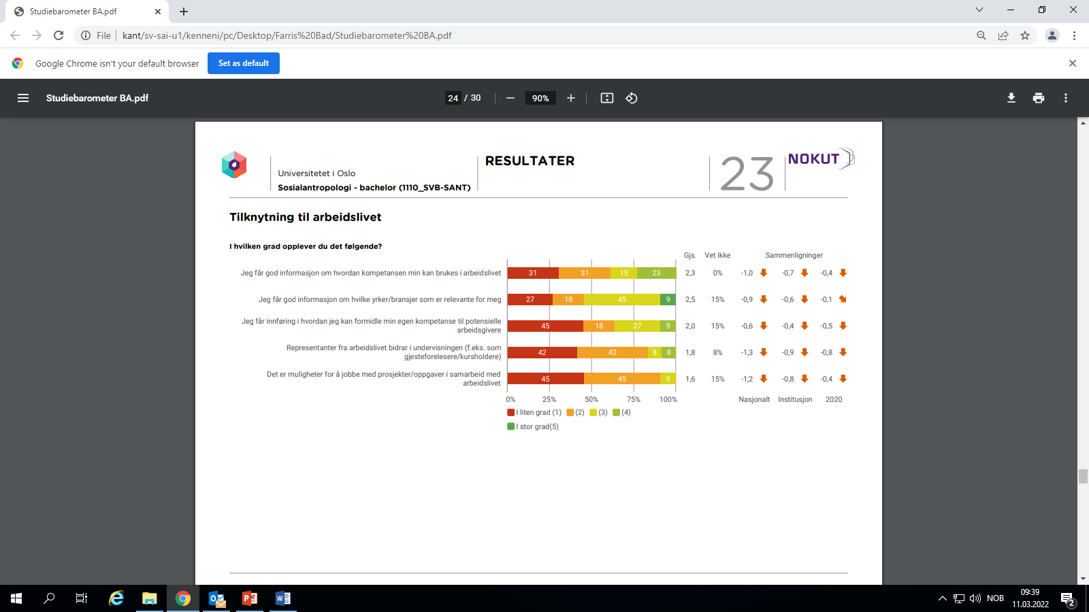

Slide 8
MA Programme
Great improvement all round
Teaching, inspiration, organisation, overall
«Tilknytting til arbeidslivet»

Slide 9
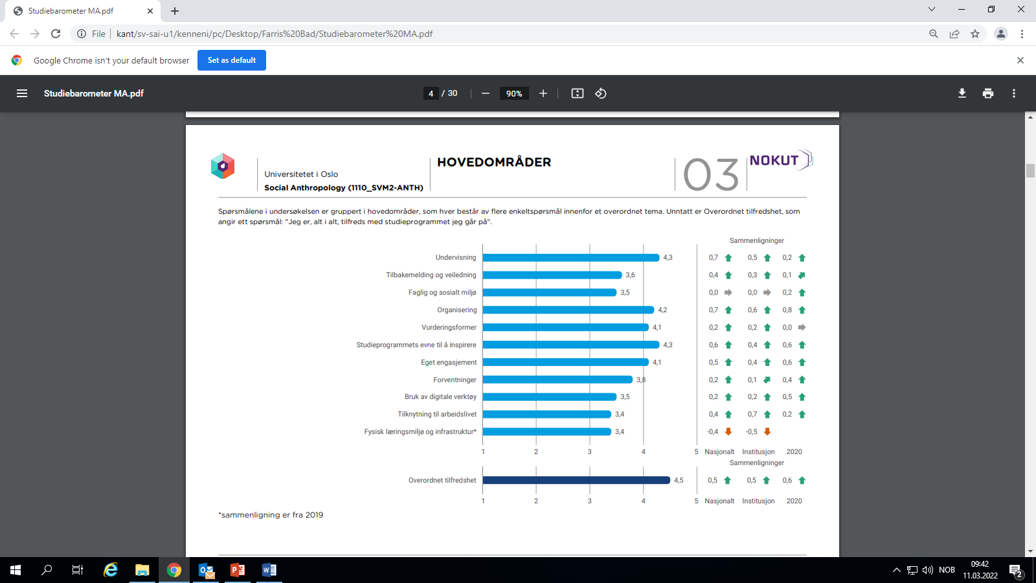

Slide 10
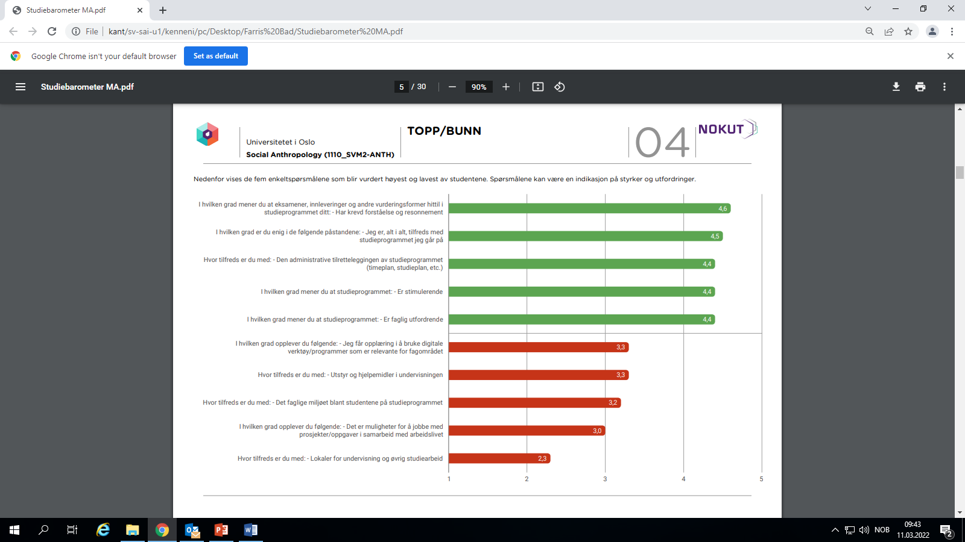

Slide 11
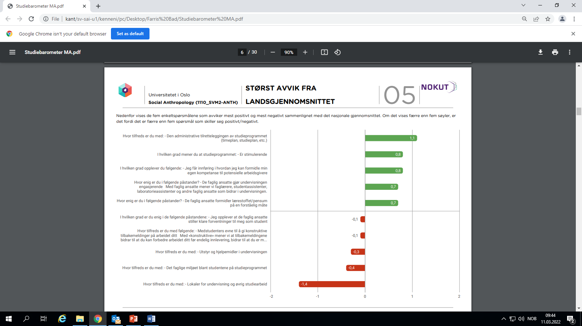

Slide 12
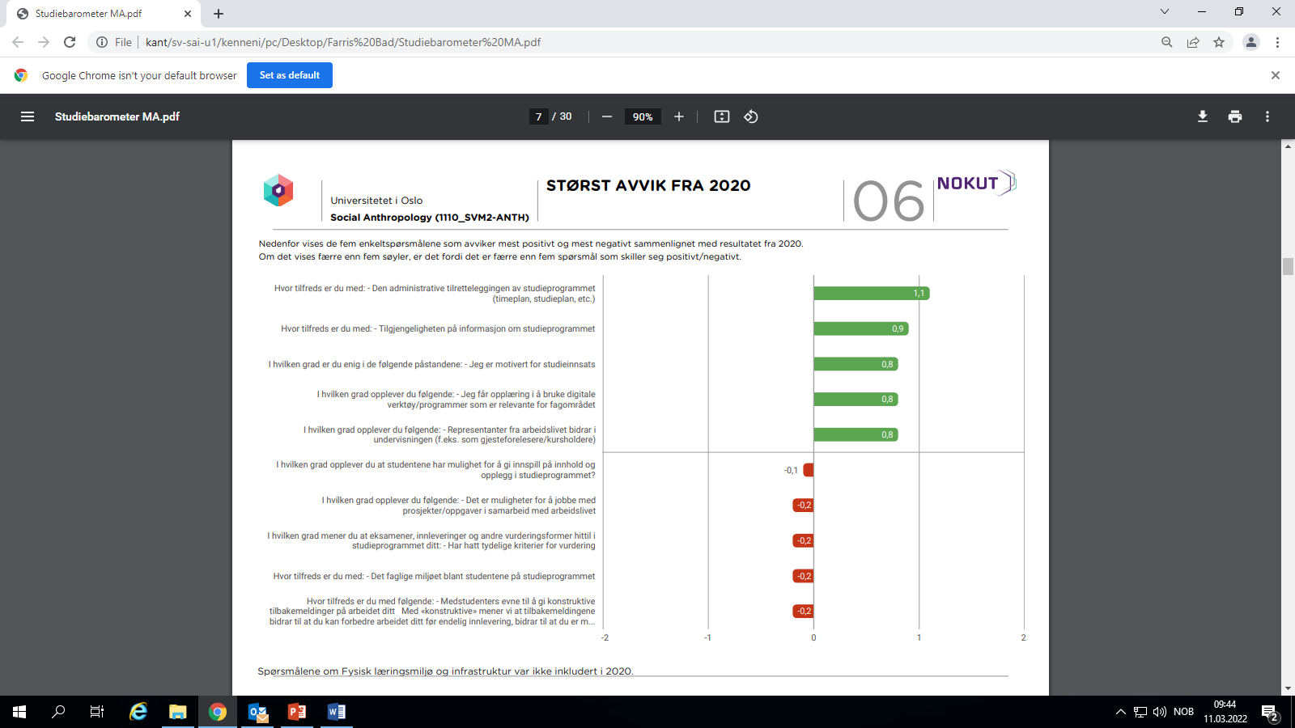

Slide 13
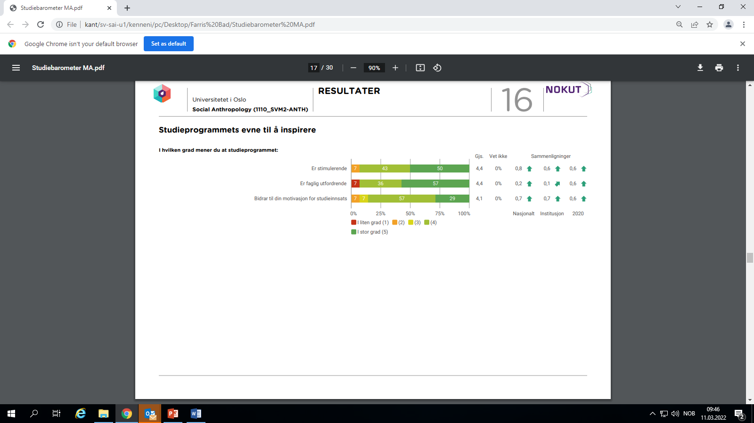

Slide 14
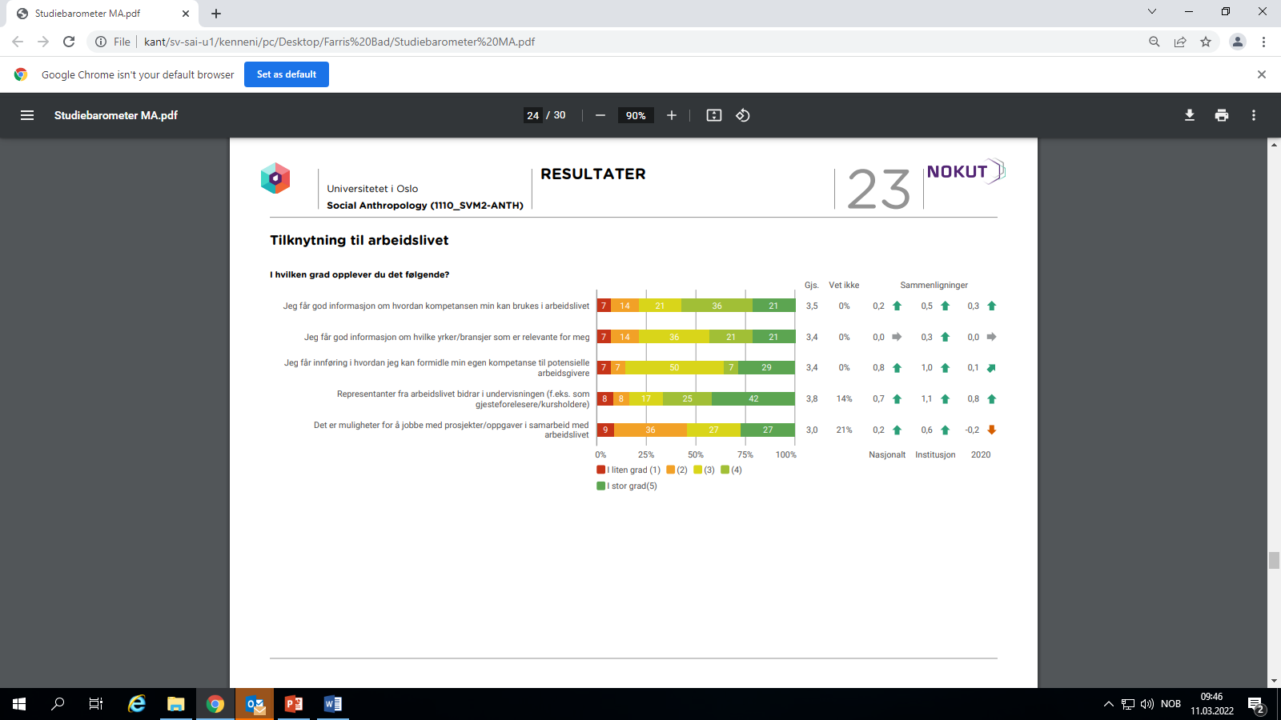

Slide 15
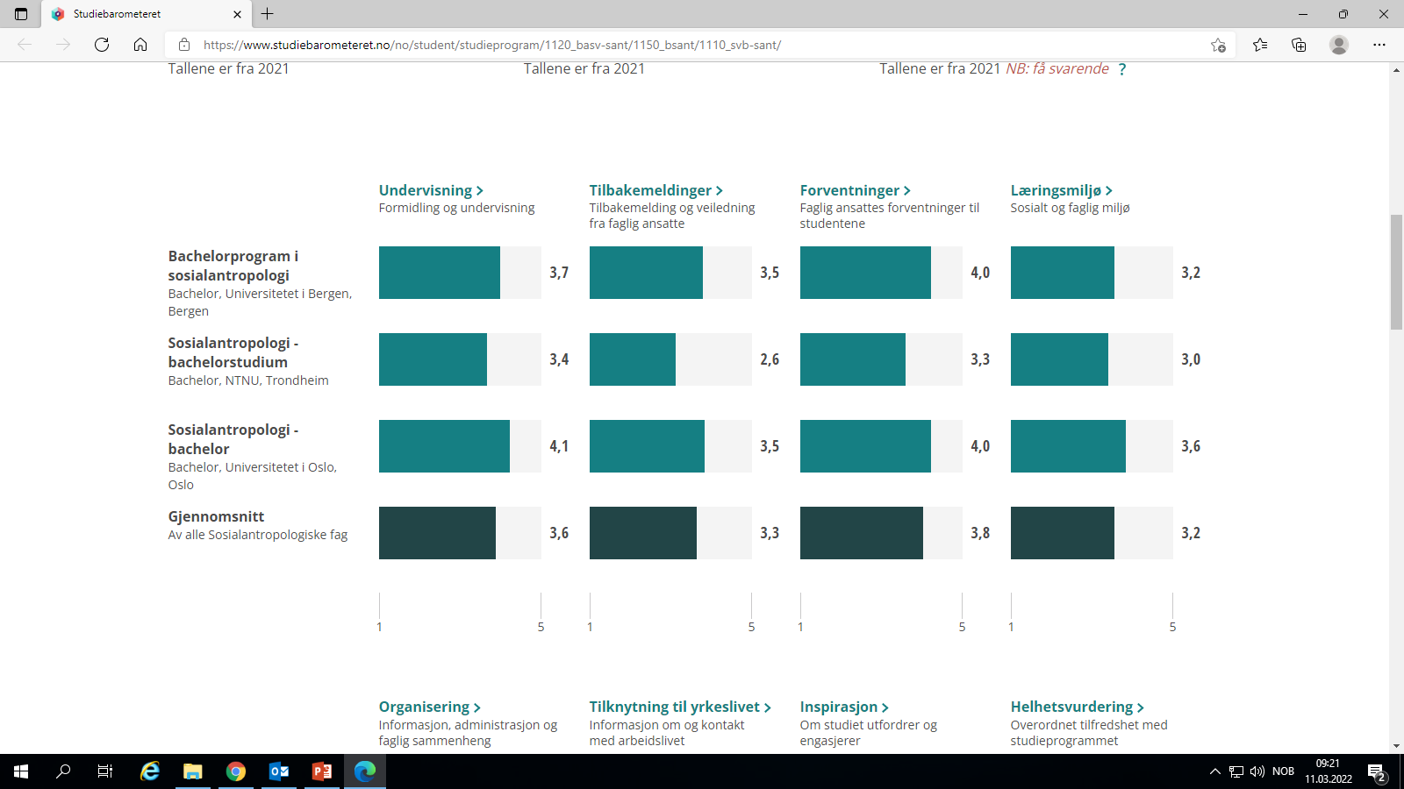

Slide 16
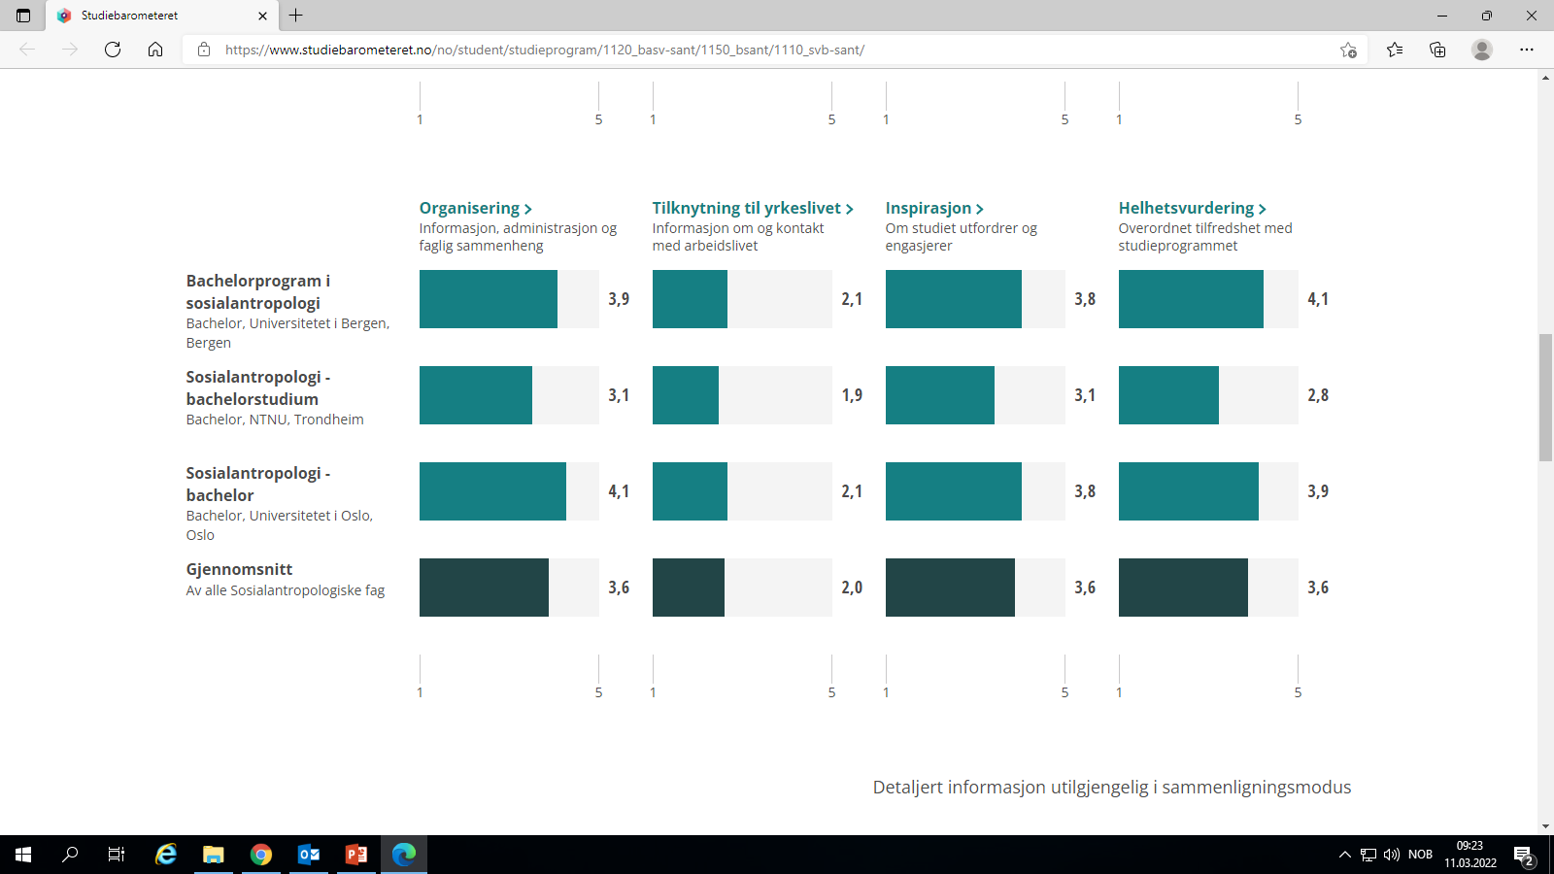

Slide 17
