Slide 1
Master programme in International Community Health

Slide 2
Overview
2 years 120 credits programme
60 credit master thesis
Research based
Fieldwork/data collection (3rd semester)
Housed at the Department of Community Medicine and Global Health, Institute of Health and Society.
https://www.uio.no/english/studies/programmes/ichealth-master/

Slide 3
The focus of the program
ICH focuses on both international and global health issues, development and challenges pertinent to improving health and health care provision, with a special focus on low income countries and communities.
Global health with emphasis on communities
Multidisciplinary teaching approaches
English language programme that admits international and Norwegian students from a wide range of academic backgrounds.
Diverse classroom
The study programme is aiming to facilitate learning across disciplines and develop critical approaches and perspectives on international and global health.

Slide 4
Learning outcomes
The students shall be familiar with the concepts of, and knowledge related to, the global distribution of illness and access to health care services, and be able to critically analyse global health burdens, policies and initiatives.
The students’ competencies are acquired through emphasising on multidisciplinary and multi-sectoral approaches and bringing together the understanding of a wide range of players in improving community health.
The students will also have acquired and demonstrated the skills necessary to plan and conduct a research project of relevance to global health

Slide 5
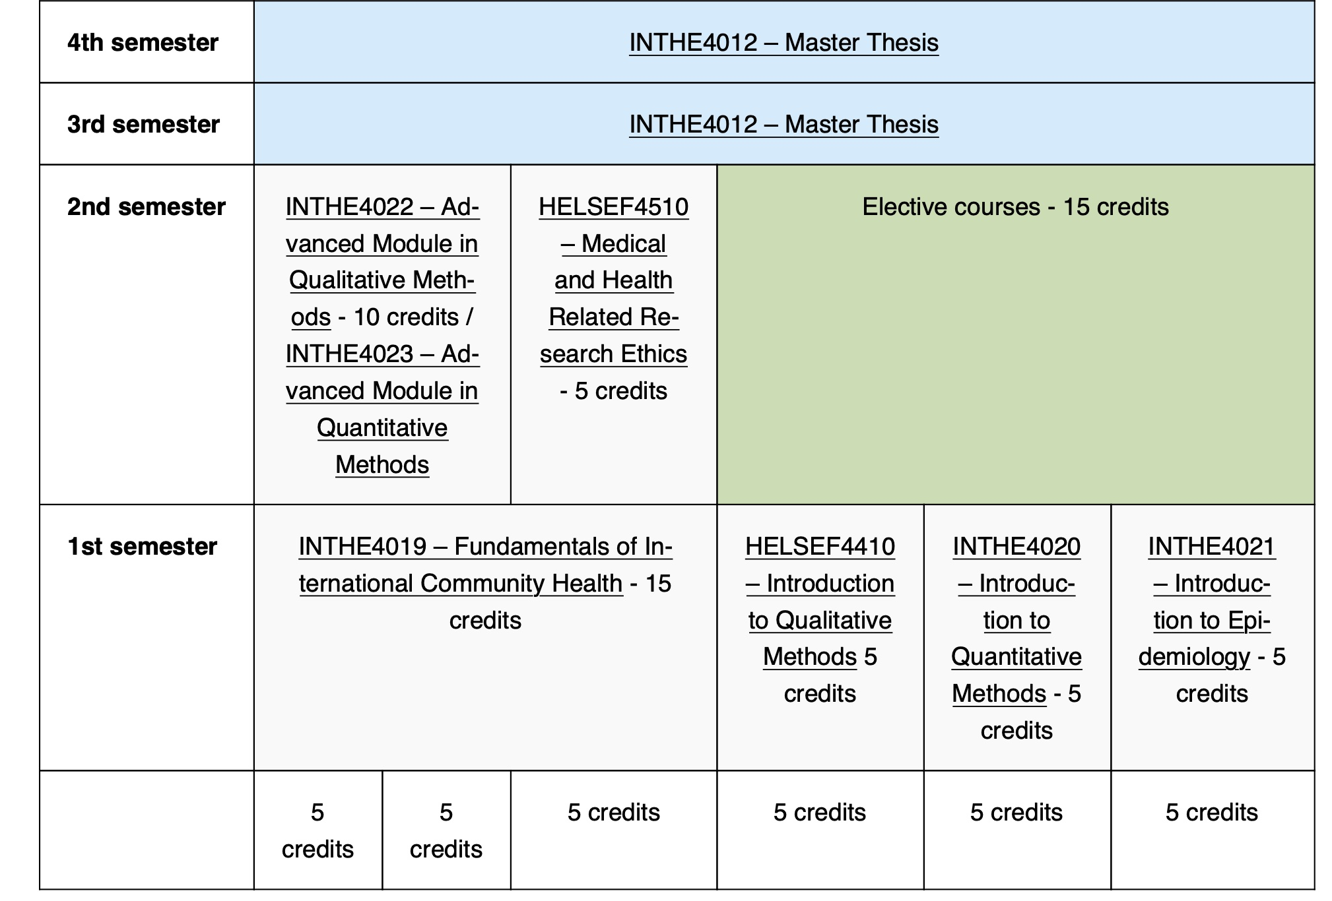
Programme structure
Fieldwork/data collection

Slide 6
Learning environment
interactive lectures
group works
case-studies
seminars
both theoretical and practical

Slide 7
Multidisciplinary teachers
global /community /public health
medical anthropology and medical history
preventive medicine and epidemiology
infectious diseases
health systems
medical ethics

Slide 8
Fieldwork
How can you gain first-hand knowledge and skills in global community health?

Slide 9
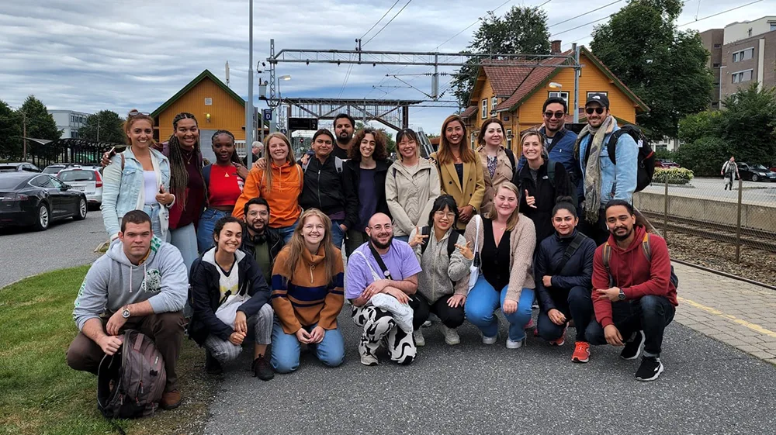
Social activities
The students arrange several social activities: cabin trips, potlocks, christmas party, picknic etc.
A very including student group.

Slide 10
Career prospects
Former students have received positions at
Universities
The Norwegian Institute of Public Health (FHI)
Municipalities
Non Governmental Organizations
Health authorities in different countries

Slide 11
Admission requirement
Bachelor degree:
A bachelor degree in social sciences or in health-related disciplines
Minimum avaragne grade of BA- degree: C
Language requirements:
A minimum average grade of 4,0 in English foundation course (140 hours) from Norwegian upper secondary school.

Slide 12
Additional documentation
A Statement of purpose letter
Maximum 1 page. In this motivation letter you should write a little about your background and how it fits into this program, and indicate topics or areas of research you would like to get involved in and if there are any countries or regions you are most interested in, as well as other relevant information. The letter must be written in English.
CV
Maximum 2 pages. Documentation of relevant work experience (if applicable)

