Slide 1
Educloud for students at ISS
For those of you who have yellow and red data in your project This is a guide for accessing and using Educloud Consult the Institute's website on data management if you have any other questions. Contact the institute at datahandtering@sosgeo.uio.no for further guidance when needed.

Slide 2
Educloud
Provides secure storage of data and good processing opportunities during the project
Data stored in Educloud should not be transferred to your own PC or elsewhere
Anonymized data can be retrieved
See the next slide for access
Educloud functions to a large degree as your home area at UiO
You have access from your own PC via a virtual machine as long as you have internet (both mac and PC)

Slide 3
How to gain access
To access Educloud:
Note: Access to Educloud requires that you
have thoroughly classified your data in advance,
If necessary, have applied for and obtained approval from SIKT
Go to https://research.educloud.no/register
Select "Apply for access to a project"
Log in with ID-porten
Apply to join project ec301
For expedited processing, inform datahandtering@iss.uio.no
Once you are accepted into the project, follow the further steps in this guide to use Educloud

Slide 4
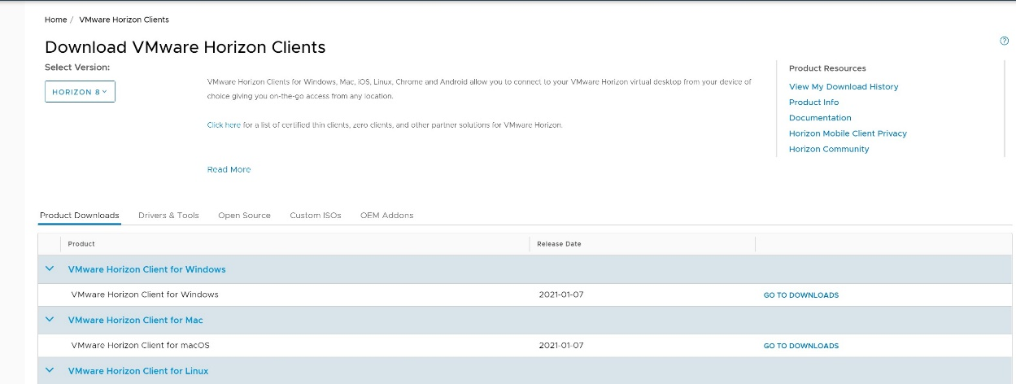
Step 1: download VMWare Horizon client
Go to https://www.uio.no/tjenester/it/maskin/programvare/programkiosk/
Download Vmware client for your computer (windows or mac)

Slide 5
Step 2: Log on to Educloud
For first time setup: follow Educlouds guide https://www.uio.no/english/services/it/research/platforms/edu-research/help/getting-started-with-educloud.html

Slide 6
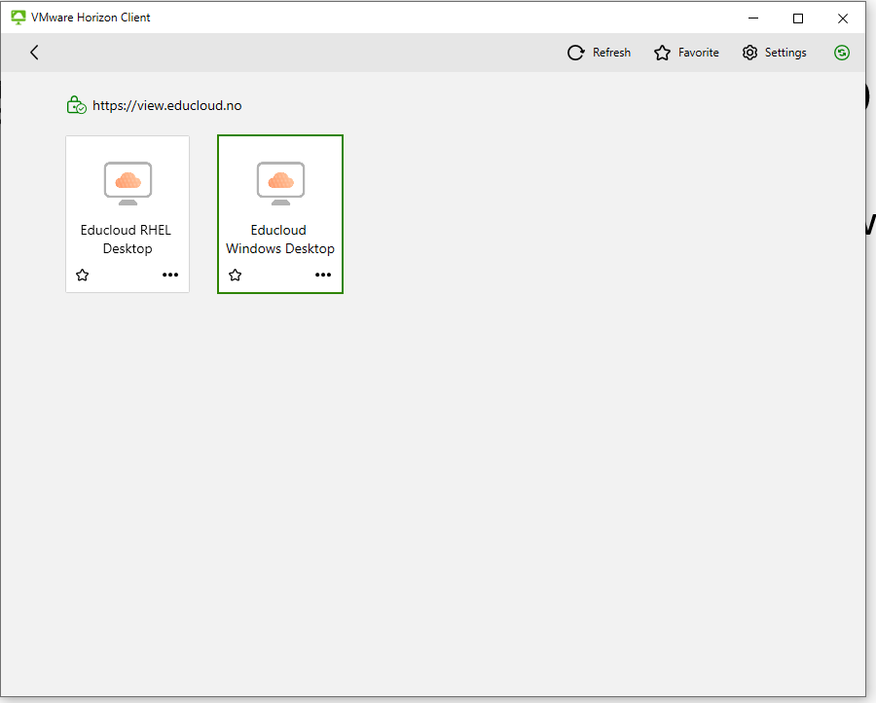
Step 3: Open Educloud Windows desktop
Choose Educloud Windows desktop

Slide 7
Folder and file structure
Educloud has two types of folders:
Home area (Documents, downloads, pictures, etc) which are only accessible to you
Network folders (EC301) which are accessible to all project users
Use the Home area folders (such as Documents) as your workspace for your files
We recommend creating a consistent naming system to make it easy for you to find them later.
It might be a good idea to separate your raw data (interview recordings) into one folder and result files (transcribed interviews, analysis, other processed content) into another.
The raw data should be write-protected so that they cannot be changed. (e.g. interview recordings, interview notes)

Slide 8
Process data in Educloud
For transcribing or other processing of raw data in your project, you should use software already installed in Educloud.
If you need software that is not available, contact datahandtering@iss.uio.no and we will assist you.
When, for example, you have transcribed an interview in Word or using a transcription program, save it in the desired folder in your home area.
Give folders and files clear and consistent names, so that you can easily keep track of them.

Slide 9
Use of F4 transcription software
F4 is a usefull tool for working with your transcriptions
F4 should be located via the Home menu inside Educloud

Slide 10
Recording
Familiarize yourself with the procedures for interviews and recordings at the departments website

Slide 11
Links
GDPR at UiO- https://www.uio.no/for-ansatte/enhetssider/beskjed/2018/gdpr.html
Thesis and privacy matters for students- https://www.uio.no/studier/eksamen/personvern-oppgaveskriving/
Departmental webpage regarding privacy and data processinghttps://www.sv.uio.no/studier/master/iss/Datahandtering/Datahandtering-ved-iss.html
Classification- https://www.uio.no/tjenester/it/sikkerhet/lsis/tillegg/lagring/infoklasser.html

Slide 12
Contact
Runar Forsetløkken
Room 240 Harriet Holters hus
Email: datahandtering@iss.uio.no

