Slide 1
Social Innovation Futures: beyond policy panacea and conceptual ambiguity
Paper presented to TIK Internal Seminar Series, 14th January 2015.
Paul Benneworth, Center for Higher Education Policy Studies
Effie Amanatidou, Manchester Institute for Innovation Research, UK
Monica Edwards Schachter, CSIC-INGENIO, Valencia, Spain
Magnus Gulbrandsen, Centre for Technology, Innovation & Culture (TIK), University of Oslo, Norway

Slide 3
Overview
Social innovation as a solution to Grand Challenges of the 21st Century?
Conceptual overstretch & subtle critique
Four areas for re-theorising SI
Five questions for a future research agenda.

Slide 4
Social innovation & Grand challenges
Part I

Slide 5
Social Innovation & Grand Challenges
Grand Challenge of ‘social exclusion’
Demands for new kinds of social infrastructures
Demands for new kinds of knowledge (not just technical)
Emergence of new kinds of innovation models (creating new social structures)

Slide 6
Social innovation in a nutshell
Grand challenges demand new kind of innovation, changing existing social systems not incrementally evolving (Garud & Karnoe, 2013).
Innovations create new social networks & capacities → new social structures and systems
Social Innovation emerged to describe:
bottom-up phenomena of new ideas, approaches, techniques, organisational forms grew into new social capacities

Slide 7
SI as policy panacea
Eu2020 strategy aims to make Europe :
“smart, sustainable and inclusive economy” through selective policy interventions in “employment, innovation, education, social inclusion and climate/ energy” (CEC, 2010).
Geoghegan-Quinn (2012)
‘Research and innovation must respond to the needs and ambitions of society, reflect its values and be responsible’
OECD (2014): Fostering Innovation to Address Social Challenges
‘The multidimensional package of existing social challenges and the systemic failure in fostering social innovation clearly call for a reform of the research and innovation system governance’ with participation of multi stakeholders (e.g. universities, research institutes, private companies, government, civil society, citizens).

Slide 8
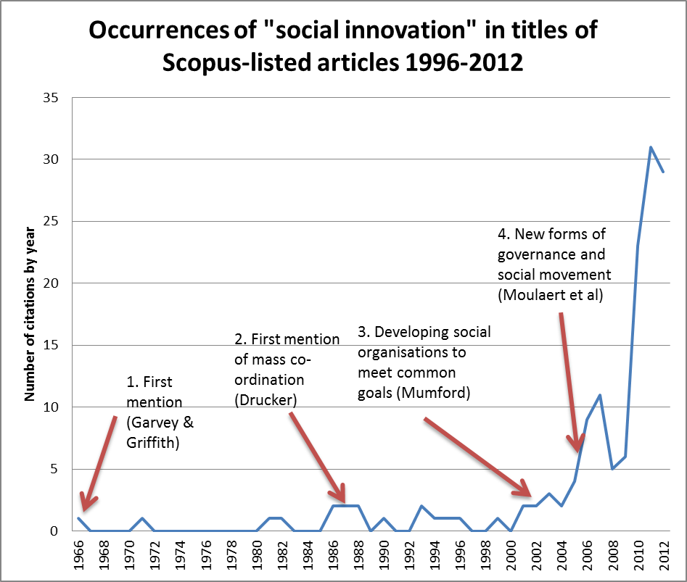

Slide 9
CONCEPTUAL Overstretch & SUBTLE critique
Part 1I

Slide 10
The call for action
Necessary to advance in our understandings of social innovation (Neumeier, 2012)
Get beyond pejorative denomination of:
buzzword (Pol & Ville, 2009)
catchword (Godin, 2012)
Answer ‘desperate quest for a definition’ usually attributed to SI (Djellal & Gallouj, 2012: p. 121).

Slide 11
Is SI a ‘chaotic concept?’
CC: “more than simply a slogan or buzzword because it has some reputable intellectual basis but may nevertheless be found vulnerable on analytical and empirical grounds. What is special about such an idea is that it is able to operate in both academia and policy discussions” (McNeill, 2006 (sic), p. 336 quoted in Jenson & Harrisson, 2013, p. 15)0F
Is ‘transition towns’ a social innovation?
Yes: increasing urban sustainability, carbon neutrality, resource sustainability
No: promotes gentrification → exacerbates social exclusion → regressive!
No standard answer of what is social progress – politically defined
Left-dirigiste: equality of outcome
Right-laissez faire: equality of access

Slide 12
Beyond the political problematic
SI identified with innovative bottom-up initiatives to help groups and communities cope with marginalization and deprivation (Boyle & Harris, 2010; Moulaert et al., 2013; CE, 2013).
SI also related to hegemonic conceptualizations of innovation, social change and social justice (STEPS, 2010; Smith, Voß & Grin, 2010).
SI is at centre of paradoxes between sustainability, social justice and economic efficiency

Slide 13
From normative to objective definitions
SI definitions social innovation all cognate within loosely defined conceptual field (Howaldt & Schwarz, 2010)
Part of SI’s value lies in acting as a rallying point for diverse consituencies (Policy concept, Böhme & Gløersen, 2011)
But need not to mistake policy mobilisations as real objects of study

Slide 14
Divergent SI definitions…
Innovative neo-Castellian urban movement (Pickvance, 2003; Moulaert et al., 2005; Gerometta et al., 2005).
Change in organisation of allocative processes (Drucker, 1987),
Experiments in social services for socially excluded groups (Phills et al., 2008)
Innovation outside state or market (in VCS) (Haugh & Kitson, 2007)
Innovation not dominated market/ profit-seeking values (Munshi, 2010; cf. Novkovic, 2006)
Innovation system with strong Quadruple Helix (cf. Leydesdorff, 2012)
Public sector innovation improving services (Mulgan, 2006)
Innovation in public service delivery e.g PPP (Gerometta et al., 2005; Gallie et al., 2012).

Slide 15
Four tensions in SI concepts
Between normative-policy goals and objective-scholarly understanding: ‘policy-based evidence-making’ (Torriti, 2010) or policy-led theorising (Lovering, 1999)
SI’s ontological foundations between different disciplines risking ‘thin concept borrowing’ (Hassink, 2007), especially in public administration etc. whose primary concern is not innovation per se.
Extent to concepts concerned with innovation as co-ordinated and managed change process vs social change.
In ways different innovation studies traditions use ‘social’ e.g social capital, social learning and social knowledge exchange

Slide 16
SI problems as innovation problems
SI - weakly-theorized change process
Which fields could help sort the mess?
How can we mobilise IS to ‘save’ SI?
SI as (Benneworth/ Cunha, vv., 2013a, b):
Mass change in how activity organised…
…collectively co-ordinated…
…with new social institutions…
…changing social power relations.

Slide 17
Bringing social innovation back to the ‘mainstream’
Part III

Slide 18
A. Mass change in activity organisation
SI as ‘radical innovation’?
New movers who perceive new needs
Importance of outsiders in driving change
Lifecycle & change accumulation/ tipping
BUT
Not over-exaggerating Incremental I
Radicalness quickly becomes ‘new normal’
Importance of ‘prepared mind’

Slide 19
B. Collective change co-ordination
SI as innovation systems
Interactions → networks → systemic chars
Shared assets → common directions of travel
Role of policy & culture in ISs shaping SI.
BUT SI embedded in regular ISs.
Do failures in ISs stimulate social innovation?
Can SI knowledge be exchanged regularly?
Role of regulations in stymying SI?
Commonalities of IS trust/ SI trust/ reciprocity?

Slide 20
C. New social institutions
Is there institutional innovation in SI?
Example of Living Laboratories
New ways of defining actors, routines, norms, scripts
Institutions as contested points of stability
Idea of institutional logics explaining fit/ rejection
BUT
Range of “institutionalisms” in Inn Studs
How do proto-ideas → ‘accepted ways’ (MOMA)
Limitations/ restrictions: Path dependence, lock-in…

Slide 21
D. Changing power relations
SI as MLP/ socio-technical transitions?
Distinguishing landscape/ regime elements
Purposive change and SNM
Temporality, crisis and change opportunities
BUT
Artificiality of distinctions
How does upscaling function between places?
How to create needs where niches emerge?

Slide 22
Five questions towards a future research agenda
Part 1V

Slide 23
1. Where is SI ‘fuzzy’?
Where are the key dividing lines?
Soc Innovation ←→ Technl Innovation
Micro-practical←→ Macro-normative
Social values←→ Market values
Consensus ←→ Winners vs. Losers

Slide 24
2. What are SI’s mainstream concepts?
Productive processes creating new properties
Structuration: tendencies guiding evolutionary trajectories
Institutionalisation communities with own logics/ fit or interfere with others
Homologising processes carried ‘rhizomatically’
Conflicts and tensions in change process.
Dominant innovation paradigm experiences overtaken by another
Incumbency allows dominating framing processes and preparing minds
‘Political’ processes’ and the double loop of Politics

Slide 25
3. How can SI be made ‘coherent’?
The Stylised Facts of Innovation (TI & SI)
Not special but ubiquitous/ heterogeneous
Based on user needs/ problems AND basic knowledge.
Problematic “5% inspiration, 95% perspiration”.
Threat to be resisted so emerge when crisis reduces resistance making people less resistant to finding solutions.
Recursive (autopoetic) changes create new needs
Not axiomatically good with winners, losers and struggle of who is which!
Takes a long time, and technology needs ripening conditions.

Slide 26
4. How can SI policy be ‘coherent’?
allowing grass-roots action to spread and drive wider processes of social change
SI & attitudinal change: people embrace org’l change to seize an opportunity
SI policy is affected by technology and industrial policy & market regulation
2 foci for a good SI policy framework:
lowering barriers to action so that more needs → rallying calls
Ensure that attempting to solve problems not penalised

Slide 27
5. Whither SI research in I_{nnovation} S_{tudies}?
leitmotif ‘renormalisation’ of SI
Getting beyond idea of exceptionalist SI
Considering SI (policy) parallel to TI (policy)
Beyond strong practices to weak actions
How does ‘social’ reduce transaction costs?
Empirical demonstrations of emergent properties through normalised lenses.

