Slide 1
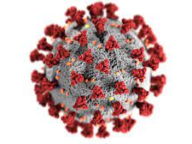
Following the pandemic on Reddit – Moderating an infodemic
Frauke Rohden, Eu-SPRI, June 2021
Notes:
Slight change in title and focus of the presentation from hyperlinks towards moderation.
***
Submission: Following the pandemic on Reddit – Science enthusiasts’ hyperlinking practices; keywords science communication, online communities, digital methods
This contribution examines the hyperlinking practices in discussions of the novel coronavirus on the social media platform Reddit. The platform is organized into thematic sections with “science”, “askscience” and “dataisbeautiful” ranking highly among the most subscribed to ‘subreddits’. Additionally, special subreddits on the novel coronavirus have been created in 2020. However, beyond value for professional use on the one hand and discussions on misinformation on the other hand, little is known about the informal public engagement with science among these communities of science enthusiasts online. Social media can blur the lines between scientific and nonscientific content and increasingly emphasizes informal communication patterns. At the same time, informal groups forming around interests or issues online might show distinct behaviors tied to small subcommunities rather than large topics or platforms.
Using digital methods, I examine the sources and formats referred to in coronavirus-related online discussions by and for informal communities of science enthusiasts on Reddit and compare the use of hyperlinks across different subreddits. The aim of this paper is to contribute to a more nuanced understanding of diverse online communities’ engagement with science and the role of online publics in the use, creation, and amplification of scientific knowledge.

Slide 2
About
Public engagement with science in online spaces
Digital methods
User perspective
How are moderators‘ approaches to managing the covid-19 „infodemic“ made visible in different communities on the social media platform Reddit?
Notes:
Part of my thesis work as doctoral candidate at university of oslo; digital methods to trace science and science communication in different online spaces -> covid turned out to be a fascinating case for that; Reddit as an interesting platform mixing social media aspects and older „forum type“ of interactions
If you‘ve noticed the change in the title: I originally wanted to do an analysis on hyperlinking but as I was getting into the space, I noticed I would have to account for differences in policies between the communities I was looking at
I am interested in how things present themselves to a user of the platform -> digital methods, using pushshift and wayback machine to collect data on moderation policies and discussions about them (not interviews with moderators)
Tentative new research question
Pivot in focus and early into this project -> murky theoretical background; happy for suggestions for reading, maybe also in relation to care work?

Slide 3
What is Reddit?
„Front page of the internet“
„Best place on the internet (whose power you underestimate)“¹
„assemblage of over one million online communities“²
Linking extreme communities to mainstream news³
Complete and rich text corpus for computational methods⁴
Opportunity for outreach and science communication⁵
[1] Barkouni, T. (2021, March 29). Der beste Ort im Internet (dessen Macht du unterschätzt). Krautreporter. https://krautreporter.de/3740-der-beste-ort-im-internet-dessen-macht-du-unterschatzt
[2] Chandrasekharan, E., Samory, M., Jhaver, S., Charvat, H., Bruckman, A., Lampe, C., Eisenstein, J., & Gilbert, E. (2018). The Internet’s Hidden Rules: An Empirical Study of Reddit Norm Violations at Micro, Meso, and Macro Scales. Proceedings of the ACM on Human-Computer Interaction, 2(CSCW), 1–25. https://doi.org/10.1145/3274301
[3] Burton, A. G., & Koehorst, D. (2020). Research note: The spread of political misinformation on online subcultural platforms. Harvard Kennedy School Misinformation Review. https://doi.org/10.37016/mr-2020-40
[4] Medvedev, A. N., Lambiotte, R., & Delvenne, J.-C. (2019). The Anatomy of Reddit: An Overview of Academic Research. In F. Ghanbarnejad, R. Saha Roy, F. Karimi, J.-C. Delvenne, & B. Mitra (Eds.), Dynamics On and Of Complex Networks III (pp. 183–204). Springer International Publishing. https://doi.org/10.1007/978-3-030-14683-2_9
[5] Hara, N., Abbazio, J., & Perkins, K. (2019). An emerging form of public engagement with science: Ask Me Anything (AMA) sessions on Reddit r/science. PLOS ONE, 14(5), e0216789. https://doi.org/10.1371/journal.pone.0216789
Notes:
Reddit is a website that means a lot of different things to different people.
Currently ranks in top 20 of Alexa internet statistics (behind youtube, facebook, wikipedia, but in front of netflix, instagram, twitter) [https://www.alexa.com/topsites]
Founded in 2005 by two American college roommates, biased towards american young males, but has global user base
Self-description „front page of the internet“
Recent German online news article: „best place on the internet“ with underestimated influences
assemblage of different communities, rather than one platform
Playing a role in misinformation, linking 4chan and other especial altright platforms to mainstream news and social media
Text corpus for training machine learning algorithms and other computational methods on natural language
Useful for science communication
Driving wikipedia pageviews
Mental health support network
Part of altmetrics evaluations of research
…
Benign and toxic disinhibition (Lindgren 2020, Suler 2004); the wikipedia page has sections on activism, philantrophy, infamous pranks, as well as a section on controversies by year…
***
Choudhury, M. D., & De, S. (2014). Mental Health Discourse on reddit: Self-Disclosure, Social Support, and Anonymity. Proceedings of the International AAAI Conference on Web and Social Media, 8(1), Article 1. https://ojs.aaai.org/index.php/ICWSM/article/view/14526
Moyer, D., Carson, S. L., Dye, T. K., Carson, R. T., & Goldbaum, D. (2015). Determining the influence of Reddit posts on Wikipedia pageviews. In Proceedings of the Ninth International AAAI Conference on Web and Social Media.

Slide 4
How does Reddit work?
Macro, meso, and micro norms (Chandrasekharan et al., 2018)
Ranking content
Organizing content
Unwanted content
Community involvement
(Medvedev et al., 2019)
Notes:
opened up for user-created subreddits in 2008
Article on moderation discovered there is macro, meso, and micro norms: some moderation practices shared across entire platform, some across group of subreddits, and some are unique for an individual subreddit
Ranking content: user voting (distributed social moderation), newest
Organizing content: tags (flairs), new subreddits, megathreads, rules for posting specific days of the week
Unwanted content: volunteer moderators (centralized moderation), policies (site-wide and subreddit specific), minimum user requirements, eg karma or selected (flaired) users only, automoderator (triggered by selected words), private subreddits
Community involvement: volunteer moderators (starter of the subreddit), modmail, moderation feedback/discussion threads (can get controversial or lead to splitting up of subreddits)

Slide 5
Science on Reddit
1 | announcements | 75.145.571 | 11 | todayilearned | 24.176.648 | 21 | explainlikeimfive | 18.733.408
2 | funny | 34.151.462 | 12 | movies | 24.115.542 | 22 | LifeProTips | 18.690.001
3 | AskReddit | 30.397.190 | 13 | news | 22.224.541 | 23 | Art | 18.686.183
4 | gaming | 28.573.703 | 14 | Showerthoughts | 21.301.900 | 24 | books | 18.675.000
5 | aww | 27.253.710 | 15 | EarthPorn | 20.679.293 | 25 | mildlyinteresting | 18.267.428
6 | pics | 26.175.828 | 16 | Gifs | 20.575.441 | 26 | DIY | 18.212.576
7 | Music | 26.169.132 | 17 | IAmA | 20.570.294 | 27 | nottheonion | 18.154.353
8 | science | 25.505.055 | 18 | food | 20.280.560 | 28 | sports | 18.152.682
9 | worldnews | 25.346.709 | 19 | askscience | 19.984.634 | 29 | space | 17.642.422
10 | videos | 24.306.758 | 20 | Jokes | 19.566.850 | 30 | gadgets | 17.593.697
Notes:
[From redditlist, 18.5.2021] Some movement up and down ranking but largely stable over time, going back a few years in wayback machine (ie these numbers are a snapshot but the distribution of topics is mostly consistent over time). Does look different by posts/ activity, growth
It‘s not entirely transparent how these are suggested at sign-up, that might be driving the high numbers of subscribers. Much funny content and memes. Still, science, curiosity, and learning are big on reddit. Also question format (askreddit), fun facts (todayilearnd, mildlyinteresting). Science ranking above worldnews and news, politics and other infamously polarized subreddits don‘t show up in subscribers, only in activity. Science was among early subreddits before users could make their own, but unlike programming and nsfw it did not get crowded out.

Slide 6
Covid-19 on reddit
„Infodemic“
Existing moderation practices
Subreddit responses
Platform-wide response
Notes:
Like other platforms, reddit had to find a way to deal with the „infodemic“ tied to covid-19
I wanted to look at hyperlinking but before I even started collecting data I realized the moderation policies would heavily influence the outcome, so I looked closer at moderation
Using their existing moderation toolboxes, different subreddits responded differently
Some subreddits banned (i.e. this is a place for entertainment, covid is not, so keep it out of here)
Platform-wide: Sticky to r/coronavirus, cdc.gov link in search results (cp other social media sites)
In some subreddits interesting negotiations, solutions, …
What can be said on reddit/on this subreddit? How should covid-19 related content be organized?
Examples from 3 different groups of subreddits: science-related, new coronavirus subreddits, language-centered subreddits (i.e. mixed content)

Slide 7
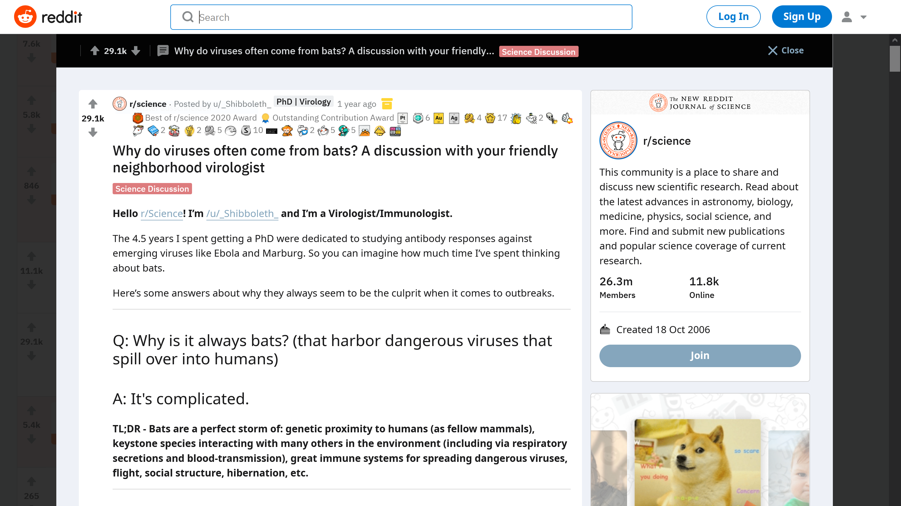
Science subreddits and covid-19
Notes:
Science subreddits: Applying existing (heavy) moderation policies; megathreads, discussions, flairs
Note: awards, flaired user (phd virology), flaired as science discussion; humor (it‘s complicated), TL;DR summary

Slide 8
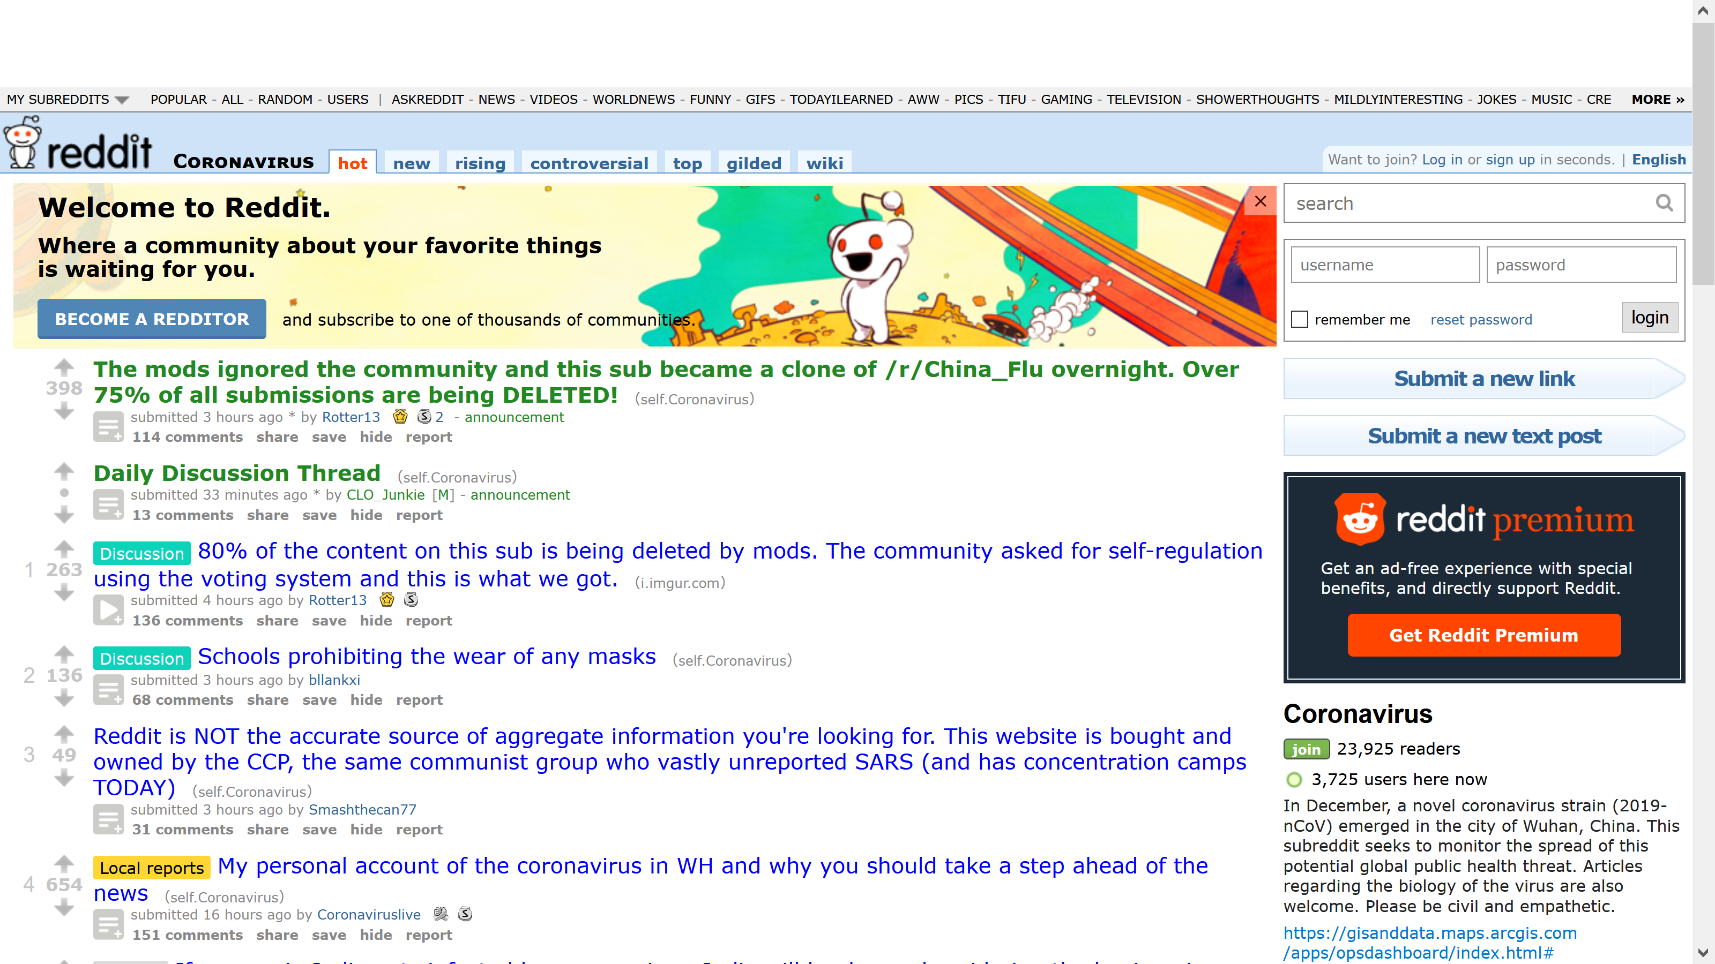
New subreddits for covid-19
Notes:
New subreddits: Subreddit drama, controversies around what this subreddit is for and what can be said in this space (this is from end of january 2020); splitting up into r/china_flu with laxer moderation and making r/coronavirus the official place for covid-19 information on reddit with very tight moderation starting february 2020; more recently some complaints about moderators and making r/covid-19 the new r/coronavirus
Zhang, J. S., Keegan, B., Lv, Q., & Tan, C. (2021.). Understanding the Diverging User Trajectories in Highly-related Online Communities during the COVID-19 Pandemic.

Slide 9
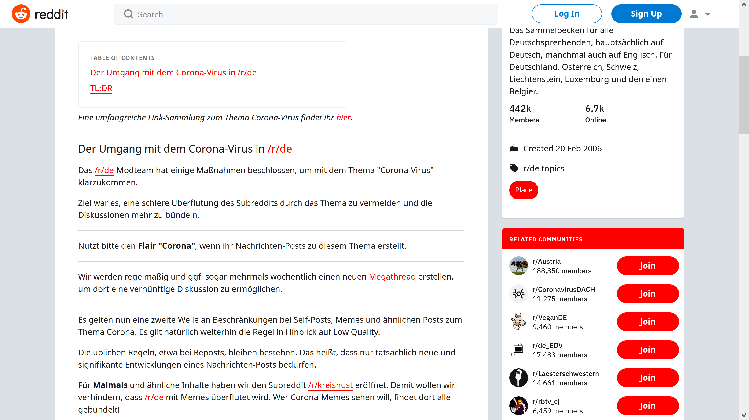
Covid-19 in mixed subreddits
Notes:
From German wiki how they want to handle the flood of covid-related content: Flairs, megathreds, creating a new subreddit for covid-19 memes
In r/norge: Enforced flairs (few megathreads)
In r/sweden: no flairs, regular megathreads until recently (daily/weekly as needed), now in content schedule of the subreddit [old „memes on fridays“ rule, recently a schedule of Monday: Cooking, Tuesday: Corona-thread, Wednesday: Simple questions and surveys, Friday: Free talk, Saturday: Corona-thread, Sunday: OC and self-promo] after discussion with users

Slide 10
How special is Reddit?
Similarity to other online environments
distributed social moderation
Methodological implications for social media research?
Distinguishing forms of moderation
Attending to community norms beyond platform vernacular
Visibility of content to users
Ethical implications of volunteer moderation work?
Unpaid care work
Power over discussion spaces
centralized moderation
meso- and micro norms
Use for research and science communication efforts
Changes in norms over time
Notes:
Moderation: more transparent than algorithmic curation, but also more erratic and personal, creating a different space
Distributed social moderation (upvoting/downvoting) and centralized moderation (policing content, sometimes after flagging by users) are implemented in different forms across platforms, and more importantly, communities on platforms, leading to meso and micro norms. Spaces with active moderation are different from ‚anything goes‘ platforms and/or algorithmically curated feeds. Forums, blogs, youtube comments, facebook groups, … might have elements of these.
Methodological implications for social media research
Forms of moderation
Micro norms
Content visibility to actual users (try out switching between default „top“ and „new“ comments on youtube)
Ethical implications of volunteer moderation work
Unpaid work
But also power over discussion spaces (controversies and movement of users to other subreddits are visible results, but less visible ones?)
Volunteer moderators shape the space you might enter as a researcher for doing research, or for disseminating research

Slide 11
Thank you!
frauke.rohden@tik.uio.no

