Slide 1
How can we build long term and reciprocal research alliances?
Magnus Gulbrandsen, Professor
Oslo Institute for Research on the Impact of Science (OSIRIS), TIK Centre for Technology, Innovation and Culture, University of Oslo
Conference: Boosting the Impact of Social Sciences and Humanities
Cardiff University, 20-21 September 2017

Slide 2
Main themes
Why the interest in alliances between researchers and external stakeholders?
How do Norwegian researchers engage with actors outside of academia?
Is there anything special about social science and humanities?
Based on what we know: what can be done to build and sustain alliances?
Notes:
Based on surveys, interviews, cases

Slide 3
Context
I will use examples from my own empirical investigations of impact, relevance, university-industry relations: surveys among academics, interviews with academics and external stakeholders, analyses of specific contemporary and historical cases, policy documents and more
Norway: strong growth in public funding of research for 15 years with social science and humanities at or above the average; social science is the second largest field after medicine and health

Slide 4
Why the interest in alliances?
Interaction between universities and society tied to economic growth and (desired) societal development – in empirical investigations as well as in more normative contexts (policy)
The best universities in the world seem to be highly involved in external interaction
Relevant to the individual: often relation between external interaction and excellence and/or the joy of one’s discipline/field/speciality
But: many broad and confusing concepts (commercialisation, dissemination, engagement, impact, innovation, societal relevance, third mission, triple helix, university-industry relations…)

Slide 5
What we know about alliances
Variation in patterns between disciplines, types of institutions, research groups and also between individuals
Alliances are with many different actors, not just industry
Many “channels” or forms of interaction in alliances, not just formal research collaboration or commercialisation – “informal” alliances more frequent and perhaps important than formal ones
Comprehensive surveys in countries like the UK and Norway show that the intensity of external interaction is as high in social science and humanities as in other fields

Slide 6
We also know that Impact takes time

Slide 7
Example: the University of Oslo
A nine-volume history for the 200th anniversary in 2011 highlighted the relationship between the university and society
Huge impacts not least in the development of Norway’s health and school sectors
Perhaps most important: the steady stream of qualified civil servants with strong work ethics
In other words, long term teaching-based alliances crucial for the university’s impact

Slide 8
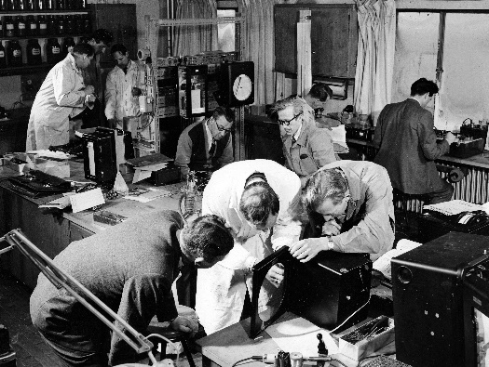
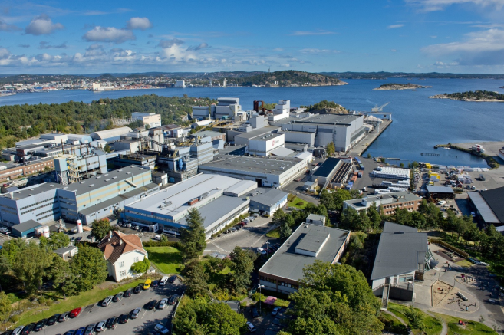
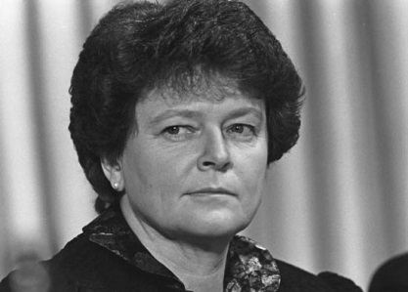
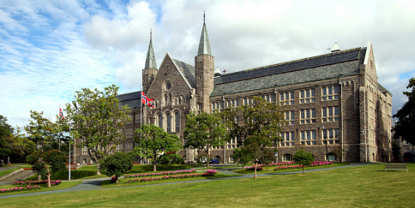
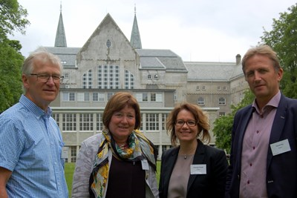
Alliances develop over many decades and the outcome is difficult to predict
Many of the central preconditions for successful alliances rest with the non-academic partners and the wider institutional setting: absorptive capacity, ability to articulate needs and problems, sufficient funding
Example: long-term industrial development

Slide 9
4400 Norwegian researchers
In the last three years I have…:

Slide 10
Five main engagement types
Dissemination to users/the general public
Training in/for non-academic organisations
Individual consultancy, professional practice and adjunct positions
Formal research collaboration
Commercialisation
We may see these forms of engagement as types of alliances or activities in alliances

Slide 11
Differences between fields

Slide 12
Two distinct stories
Similarities
Differences
Dissemination is the most common activity and commercialisation the least common in all fields
Some researchers from all fields found in all activities
The same factors influence the tendency to get involved in these activities regardless of field
Humanities overrepresented in dissemination, underrepresented in formal research collaboration and commercialisation
Social science overrepresented in training and consultancy, underrepresented in commercialisation

Slide 13
Engagement is related to…
Non-academic work experience lasting more than one year
Very common (48% in humanities, 59% in social science, 53% average)
A research profile defined to a greater extent as “applied” or “problem-oriented”
Much more common in social science than humanities
Seniority
Impact may be related to a certain level of expertise and experience
External funding
Less common in humanities than other disciplines

Slide 14
Social science and humanities
Seeing them as “special” implies a certain perspective and level of analysis
We often exaggerate the similarities between social sciences and humanities – and their differences from other fields
Compared to social science, humanities researchers define their activities to a much greater extent as “basic research”, they are more international and have less external funding
At another level, there are major differences within these two fields but also transformations going on

Slide 15
Are SSH special fields?
Yes: The non-academic partners are somewhat different, the practices of interaction differ (to some extent), and humanities has fewer externally funded projects and is concentrated in HEIs
No: An indirect form of impact based on dissemination and training is central across fields and commercialisation is not common at all
No: Few indications that impact has a different time dimension in SSH
I believe we often exaggerate the similarities between social sciences and humanities – and their differences from other fields

Slide 16
The stakeholder perspective
In interviews, non-academics express the importance of different types of interaction in the same way as academics
Dissemination and training more important than commercialisation
Positive view on alliances with SSH researchers
There are many with SSH background in various non-academic organisations
Unclear perception of boundaries
Between research and established knowledge, between different disciplines
Dislike arguments of exclusivity, decline and historical prerogative
“We are so special”, “The golden age is over”, “We have done this since the days of Plato”

Slide 17
Conclusions
Strong alliances are based on many activities that SSH researchers are very much engaged in already
Not just research: alliances that include teaching and training are important
Positive for academic involvement in alliances: non-academic work experience, interest in applied research, external funding, seniority
Alliance partners’ quality and institutional conditions often overlooked: Tendency in policy discussions of alliances to only highlight the academic partners’ obligations, characteristics and rooms for improvement

Slide 18
Suggestions for discussion
Is “alliance” a good word – is it realistic at all to achieve common goals with external non-academic stakeholders?
SSH alliances with which stakeholders? What do these stakeholders need?
Is it possible to consider stronger alliances with other scientific disciplines because they have similar challenges in demonstrating innovation and impact?
What should be done when alliances threaten a synergistic or fragile relationship between excellence and impact?
When are alliances “good enough”?
Do the main challenges of building alliances rest with the practices of collaboration – or rather with perceptions and ideological viewpoints?

Slide 19
Thank you
For more information, contact magnus.gulbrandsen@tik.uio.no or see http://www.sv.uio.no/tik/english/research/projects/osiris/

