Slide 1
The OSIRIS approach to impact assessment
Magnus Gulbrandsen, Professor
Oslo Institute for Research on the Impact of Science (OSIRIS) and TIK Centre for Technology, Innovation and Culture, University of Oslo
Meeting at NIFU
Oslo, 9 May 2018

Slide 3
Background
OSIRIS is an 8-year research centre set up to understand how and under what circumstances research leads to effects in society
Huge challenges with our current understanding of impact
Burgeoning, rapidly developing but also fragmented field
Overwhelming bias towards simple input-output measurements and huge challenges in finding good measures of outputs
Too much emphasis on the researcher side (especially on research found in universities) in evaluations and in policies that seek to promote impact
Notion of impact somewhat or very politicised
OSIRIS is not directly tied to evaluation and assessment
Notes:
Based on surveys, interviews, cases

Slide 4
Our choices
We look at impact as a process, not as an expression primarily of a relationship between measurements of inputs and outputs
We look at impact from the user side and three types of users:
Users in policy (ministries, public agencies etc.)
Users in firms/engaged in innovation
Users in healthcare systems
We will do detailed studies of what happens to R&D after it leaves the lab/the research unit through surveys of users, longitudinal case studies of “problem areas” and special investigations (macro- and microeconometrics, vignette cases, database development)
Notes:
newer methods for impact assessments instead highlight the process or pathway through which research has social, economic or other effects beyond academia
believe many of the central bottlenecks and preconditions for impact rest with users – often with limited opportunities for influence by researchers

Slide 5
A user-based perspective
Impact is fundamentally about the use of research – for innovation, for new policy directions, for improved healthcare and more
Users are often missing or have limited roles in assessments (user surveys, user panels) because the rationale is still to measure research rather than to understand its use
Impact is rarely one easily identifiable output or point in time but rather a complex phenomenon that evolves slowly
What does impact look like in this process, seen from the user side?

Slide 6
Advantages of a process perspective
Opens the “black box” between inputs and outputs and is less dependent upon problematic measures of “success”
Allows entities to transform, move or even disappear without leading to missing data (e.g. when a firm “disappears”)
Facilitates the analysis of complex relationships such as accumulation of advantage, small events with large effects, serendipity and planned versus emergent types of impact
Allows a better understanding of the sequence of events and how they are related to specific outcomes
What are the central preconditions for impact?

Slide 7
Four examples that illustrate how we think about impact in OSIRIS

Slide 8
George Lucas very much inspired by Joseph Campbell’s book “The hero with a thousand faces” (a study in comparative religion) when he created the Star Wars universe
The monomyth
The journey of the hero
The metamorphoses
“Campbell was my Yoda”
Great (and traditional) impact case that demonstrates the huge challenges of measurement such as:
Attribution
Time lag
Type of effect
Causality

Slide 9
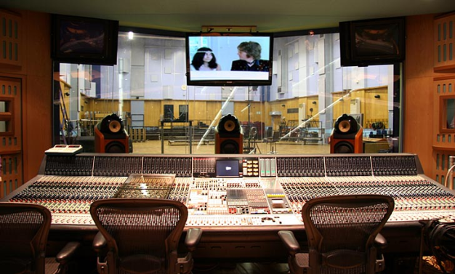
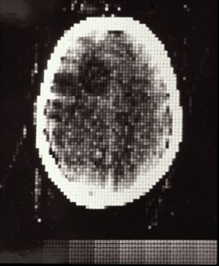
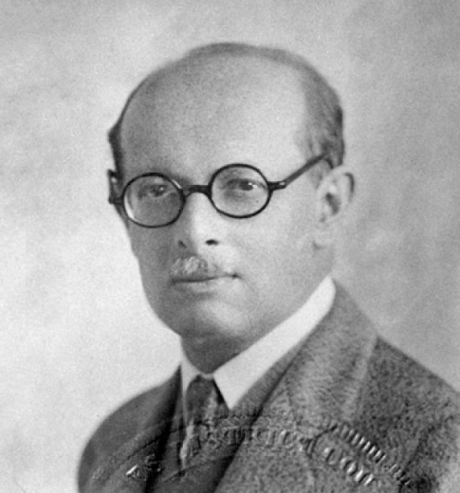
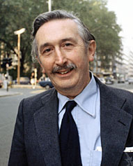
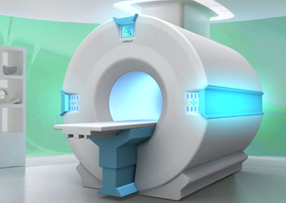
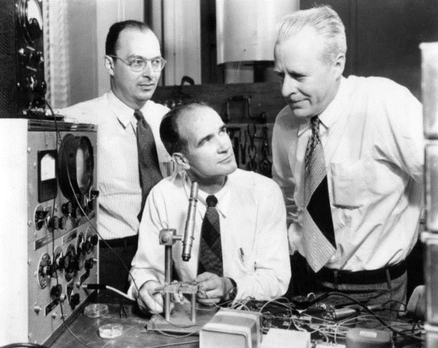
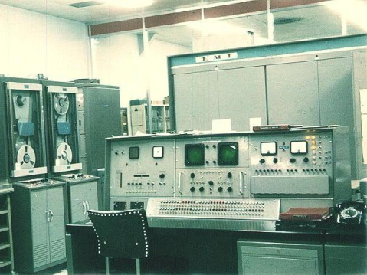
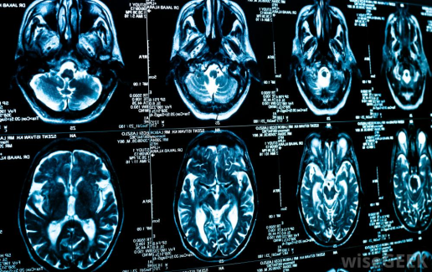
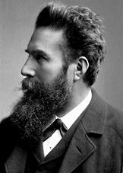
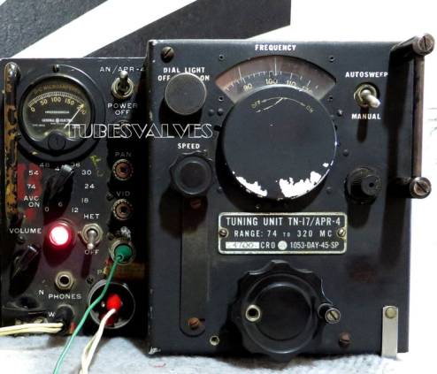
Complexities of the impact process:
The number of actors involved (firms, universities, RTOs, hospitals, patients)
The importance of industrial R&D
The combination of different scientific and technical disciplines
Differences in culture, time perspectives, resources and more
Impact may depend also on the ability to orchestrate this process
Godfrey Hounsfield

Slide 10
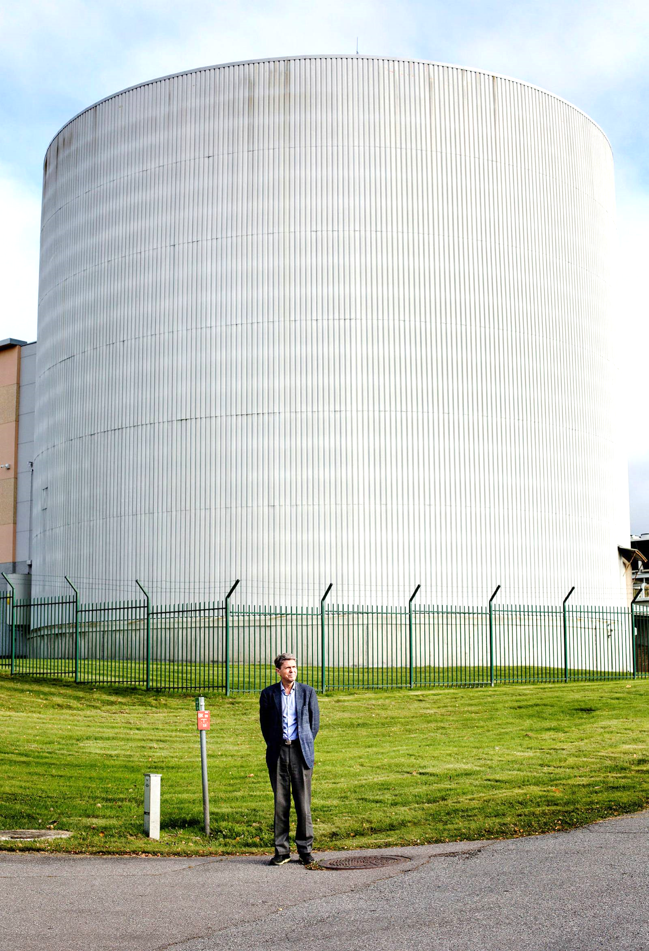
Multiphase flow
Preconditions of the impact process:
Powerful actors on the demand side that can articulate their challenges
Existing collaborative relationships, mutual understanding, trust and infrastructures
Public support for fundamental, applied and mission-oriented R&D
Creative individuals (!)
The value aspect of impact: who is multiphase flow good for?
A panel of scientists placed this as the most important research-based innovation in Norway the last 50 years
R&D at the Institute for Energy Technology and SINTEF and related research and education at several universities
Crucial technology for the Norwegian oil and gas industry based on huge practical challenges in the North Sea
Benefits estimated at “hundreds of billions of NOK”
Notes:
Legge inn bilde fra DN lørdag for to uker siden

Slide 11
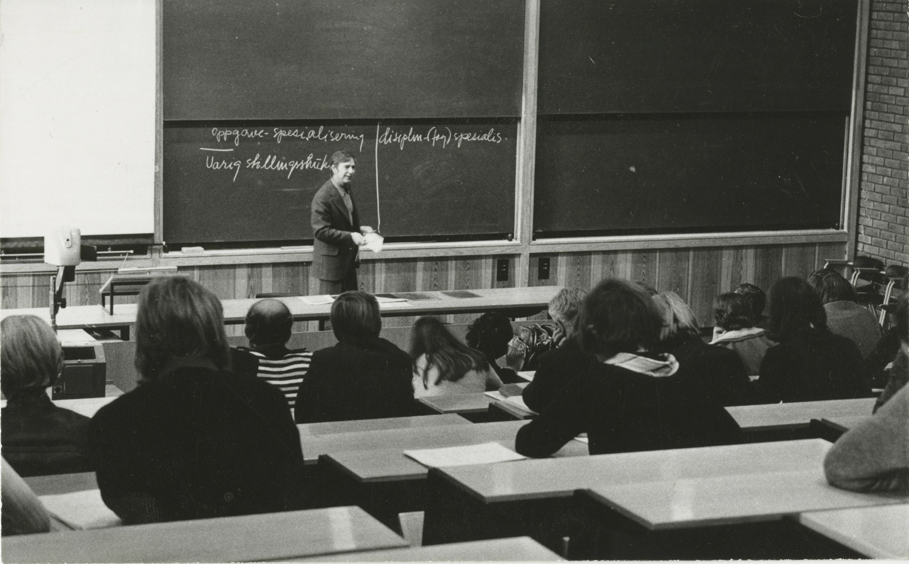
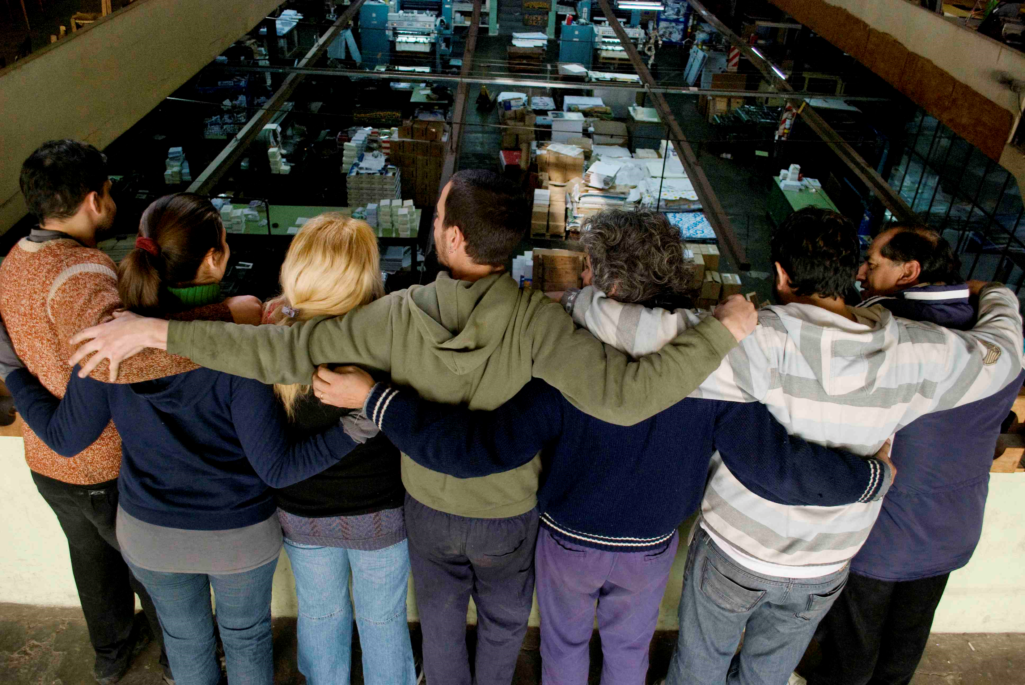
Democracy in the workplace
The “collaboration experiments” between unions and business associations, led by social psychology professor and work researcher Einar Thorsrud, have probably had large effects since the start in the early 1960s
Related to the “Nordic Model” of “flat” organisational structures, high degrees of collaboration etc.
New legislation, the “Basic Agreement”, employee rights to influence adaption of new technology
R&D applied, normative and based on challenges of bureaucracy, alienation and routinisation
Types of impact:
Direct instrumental effects on productivity
But also political, conceptual and symbolic effects
Over time the indirect effects may be seen as the most important ones; and here social science and humanities should not be disregarded

Slide 12
More on impact as a process
A process is a series of steps/events that are taken/happen and that lead to an observable outcome which we can call impact
Process analysis involves identifying events, intermediary outcomes, their contexts – and based on this create a timeline with analyses of causality and the movement of ideas, people and relations
Advantages of a process perspective include a better understanding of path dependencies, complex and non-linear sequences
Many impact evaluation approaches are process-oriented:
The payback framework (Donovan & Hanney 2011; Hanney et al. 2007)
SIAMPI (Molas-Gallart & Tang 2011; Spaapen & van Drooge 2011)
ASIRPA (Joly et al. 2015)

Slide 13
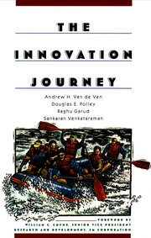
Impact and innovation processes
Looking at impact as a process is very similar to looking at innovation as a process (for our purpose impact = innovation)
The most famous process studies of innovation – the Minnesota Studies (van de Ven 1999) – followed 14 processes over a very long period of time
Main finding about users: “Innovation receptiveness, learning, and adoption speed are facilitated when the innovation is initially developed within the user organization and inhibited when end users are provided no opportunities to reinvent, or modify, innovations developed elsewhere” (Ch. 1)

Slide 14
The linear model of impact
Traditional impact measurement: relation between inputs and outputs
Process measurement: create a better understanding and indicators for the various parts of the pathway
Research
Inputs
Basic research
Applied research
Development
Market/user
Society
Outputs
Production/ implementation
Sales/use/ effect
Impact

Slide 15
The chain-linked model of impact
The research process
Research
Knowledge
D
S
I
Potential market, need or problem/ problem area
Invent or create an analytical design
Detailed design and test
Redesign and produce or move to practice
Distribute and market, monitor and follow-up
The impact process
Multiple contexts and stakeholders
c
c
c
c
Based on Kline & Rosenberg (1986)

Slide 16
Impact seen from the user side
May not directly involve research at all or only a particular selection of it – impact processes run independently (more or less or most of the time) of the processes of research
As such a pure user perspective may be problematic if the aim is to evaluate research
We need some additional perspectives to understand the relationship between impact and research – I will sketch some ideas that I have called organisational, cognitive, cultural-political and dynamics

Slide 17
Some perspectives for analysing users 1
Organisational
Organisations need certain capabilities in order to use research (e.g. Cohen & Levinthal 1989, 1990) – important to look also at capabilities to influence research
Cognitive
To achieve coordination (and reduce cognitive distance), users need to align research results and perspectives with the prevailing perceptions, meanings, values etc. of their context (Nooteboom 2006)
A large psychological distance (Trope & Liberman 2010) may limit the ability to imagine that research could be used or complicate coordination

Slide 18
Some perspectives for analysing users 2
Cultural and political
Transilience: the degree to which a new idea makes old competences and ways of working obsolete (cf. Abernathy & Clark 1985)
Impact resilience: how impact may be limited over time due to the resilience of the receiving organisation or problem area
Dynamics
Movement of ideas: proliferation (research meets other ideas), reinvention (old research gets rediscovered), reimplementation (new uses of research are discovered), termination (research ideas get discarded)
Movement of people and material movements
Divergence and convergence

Slide 19
Example from the Norwegian Work and Welfare Directorate
How should people who have been ill be reintroduced to work? Use of “individual placement theory” from research
Organisational: absorptive capacity is centralised, attempts at creating intermediary organisational units
Cognitive: huge distance between some research units and the users, some research from different national contexts
Cultural-political: high degree of transilience
Dynamics: limited involvement of researchers (reinvention), emphasis on internal personnel movement and on material translation of research

Slide 20
Example: biodiversity
How should biodiversity in Norwegian nature be protected? Use of biological/ecological research
Organisational: absorptive capacity varies from extremely high to very low; users essential for gathering and distributing data to research
Cognitive: researchers want to be useful but struggle with many of the user contexts
Cultural-political: high degree of resilience which may be good for the impact process (possibly also for research)
Dynamics: high movement of people between users and research, infrastructure for data sharing

Slide 21
Example: surveys on use of research
We are just now testing an extended questionnaire on use of research for policymaking in seven Norwegian ministries
We are interested in how the employees there get in touch with research and researchers, what they do with research once it is in-house, characteristics of their policy area and more
Full-scale survey in 2019, including a version tailored for the health and care sector and versions for Spain and the UK
Also testing two additional sets of questions to the national R&D survey to firms in Norway early autumn 2018

Slide 22
Quick summary
Seen from the user side, the impact process is most likely fairly independent from research in the sense that the barriers and driving forces to a little extent derive from characteristics of the research
Analysing impact processes from these perspectives can be a useful complement to more research-focused impact assessments
Looking at research impact in this way may open up for new opportunities as impact and research are seen as something less unique and more similar to other social processes
Challenges: what is a user (or a problem area), and how to define impact as something that still may involve research?

Slide 23
Thank you for your attention
Comments to: magnus.gulbrandsen@tik.uio.no
Twitter: @OSIRIS_TIK
Web page: http://www.sv.uio.no/tik/english/research/projects/osiris/
The web page includes a blog section – our version of policy briefs

