Slide 1
What do the 2014 REF results tell us about the relationship between excellent research and societal impact?
Richard Woolley, Nicolás Robinson-García | Policy seminar, NIFU Oslo 1 Nov 2017
www.ingenio.upv.es

Slide 2
THE RELATIONSHIP BETWEEN EXCELLENCE AND IMPACT
Focus on scientific excellence is increasingly accompanied by concern about the impact of research
A core rationale for OSIRIS is to understand this relationship better
One way to look at this question is through national evaluation systems data and information
UK REF remains the ‘industry leader’ in many respects
Does the push to generate impact from research become implicitly linked to research quality
Does excellent science come to be seen as a pre-condition for high quality impacts?

Slide 3
THE UK REF 2014 – QUALITY DEFINITIONS
4* scientific outputs: ‘world-leading in terms of originality, significance and rigour’ (REF 02.2011: 43) and in which ‘world-leading denotes an absolute standard of quality’ (REF 02.0211: 45).
4* social impacts: ‘outstanding…in terms of their reach and significance’ (REF 02.1011: 44).
impact: “an effect on, change or benefit to the economy, society, culture, public policy or services, health the environment or quality of life, beyond academia” (REF 2011: 26)
(Need to be very cautious about not misinterpreting the qualities that outputs or impacts were assessed to embody as if these are characteristics of the units that submitted them…)

Slide 4
OUR ANALYSIS, OUR QUESTIONS
We are NOT analysing whether 4* outputs are generating 4* impacts
Looking at the relationships between submissions of scientific outputs assessed as 4* and of social impacts assessed as 4*
by submitting departments or units
in particular disciplines and fields
Are academic units that produce 4* outputs also generating 4* impacts (and vice versa)?
Is there a relationship between these two indicators of research quality in different fields?

Slide 5
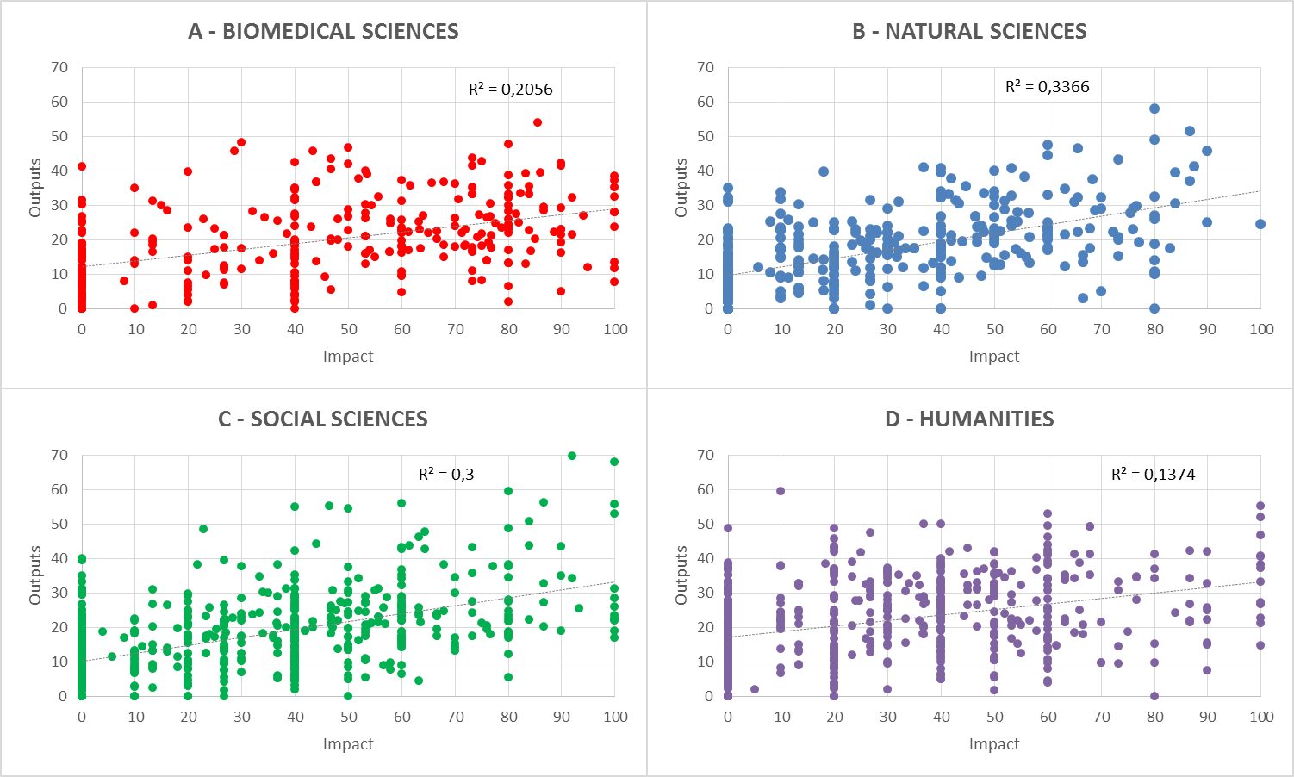
4* OUTPUTS & IMPACTS IN THE UK REF 2016
Relationship between the percentage of submissions meeting criteria for 4* for scientific outputs and impacts, all unit submissions, main REF panels

Slide 6
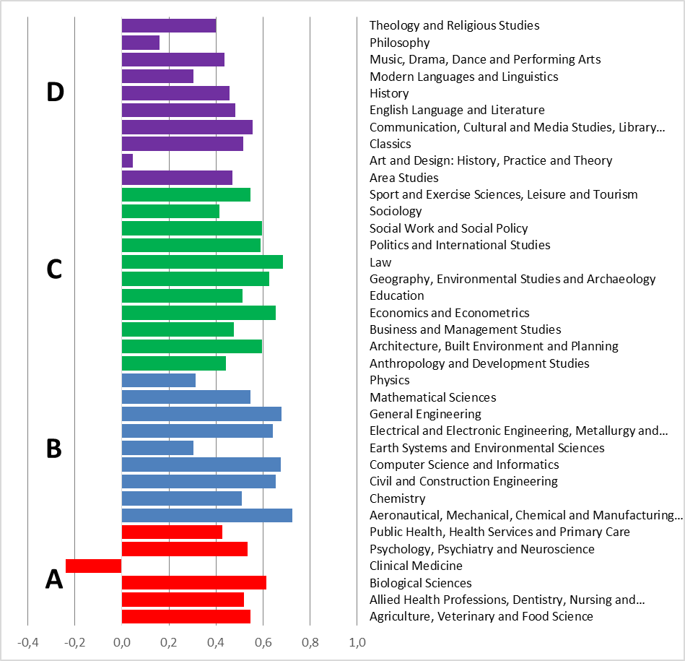
4* OUTPUTS & IMPACTS BY DISCIPLINE
Correlation between the percentage of submissions meeting criteria for 4* for scientific outputs and impacts, all unit submissions, by REF sub-panel

Slide 7
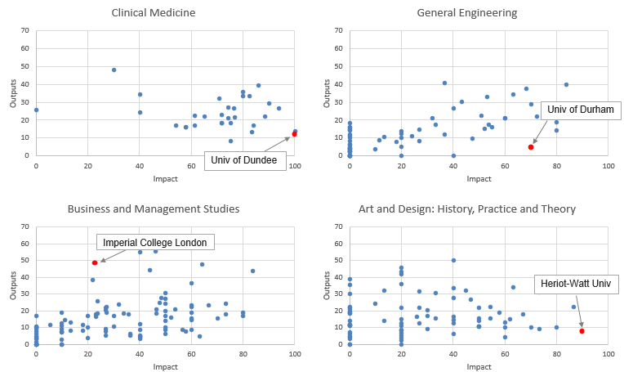
HETEROGENEITY WITHIN DISCIPLINES, VARIATION BETWEEN
Relationship between the percentage of submissions meeting criteria for 4* for scientific outputs and impacts, all unit submissions, selected REF sub-panels

Slide 8
RICHNESS AND VARIETY OF CONTRIBUTIONS
Clinical Medicine (Univ. Dundee): outputs 194 articles + 1 patent; impact six cases providing evidence of breakthroughs in cardiac clinic trial procedures and genetic causes of atopic diseases, new approaches to drug and chemical safety
Engineering (Univ. Durham): outputs 101 articles + 2 patents; impact profit-generating contributions to prosthetic joints, environmentally beneficial contributions to aerospace components
Business & Management (Imperial College): outputs 204 articles; impact important government policy influence and success in healthcare organisation, telecoms regulation, and company innovation strategies
Art & Design (Herriot-Watt Univ.): outputs 15 articles + 4 exhibitions + 3 designs + 2 artefacts; impact innovative and market-driving contributions to products, processes and marketing in the technical textiles sector

Slide 9
RESULTS
Great heterogeneity in the combinations of 4* outputs and 4* impacts research groups are producing
There is variation in the way this heterogeneity plays out across different major fields and disciplines
In all fields some research groups produce 4* scientific outputs without producing any 4* impacts, and vice versa
The substantive 4* impacts that are being produced are immensely varied, which may well be playing a role in the assessment dispersion that we see – assessments are being made of very different activities, processes, outcomes and impacts

Slide 10
OUR CONCLUSIONS
Heterogeneity and diversity constitute the strength and vibrancy of the UK university research system
Excellent science is not a necessary pre-condition for highly significant societal impacts
There are risks associated with driving policy in pursuit of an idealised “excellent science” (high output-high impact) to which ever more disproportionate amounts of resources may be channelled
The chief risk is a reduction in the diverse ways that research and impact are being coupled together
Consequence of compromising systemic capacity to deal with diverse societal needs that rely on the myriad, embedded, patchwork of UK university research successes

Slide 11
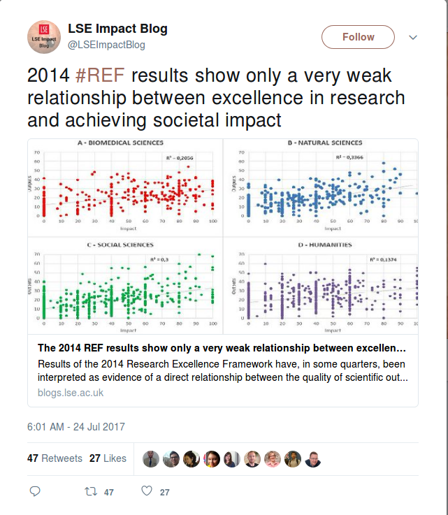
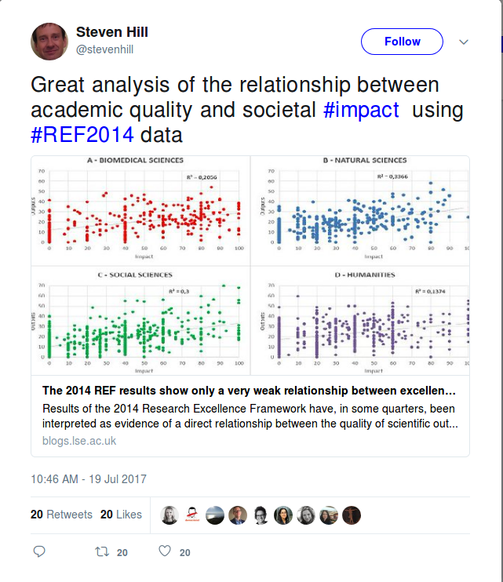
TWITTER

Slide 12
Richard Woolley
Ingenio (CSIC-UPV)
ricwoo@ingenio.upv.es
BLOGPOST
http://www.sv.uio.no/tik/english/research/projects/osiris/osirisblog/
DATA https://doi.org/10.6084/m9.figshare.5132077.v1
www.ingenio.upv.es

