Slide 1
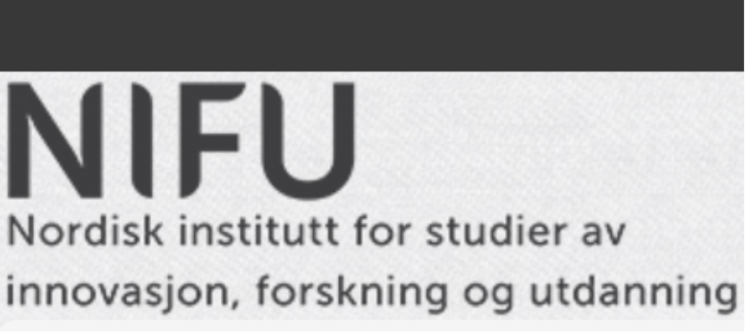
Innovation pattern heterogeneity and crisis resilience
A data-driven retrieval of the firms’ approaches to innovation
RelinC: The role of research, skilled labour and innovation in the Coronacrisis.
A project funded by The Research Council of Norway.
Marco Capasso (NIFU) & Marina Rybalka (SSB)

Slide 2
Sector-based taxonomies
Pavitt taxonomy (1984, Research Policy)
  scale-intensive (SI)
  supplier-dominated (SD)
  science-based (SB)
  specialised supplier (SS)
Miozzo-Soete (2001, Technological Forecasting and Social Change)
  supplier-dominated services (SDS)
  physical network services (PNS)
  information network services (INS)
  knowledge intensive business services (KIBS)
Similarities and differences among sectors
  in the sources, nature and impact of innovations
  defined by the sources of knowledge inputs, by the size and principal lines of activity of innovating firms
  and by the sectors of innovations’ production and main use

Slide 3
Heterogeneity also within sectors
Firm-level taxonomies
Cesaratto and Mangano (1993, Economics of Innovation and New Technology)
de Jong and Marsili (2006, Research Policy)
Leiponen and Drejer (2007, Research Policy)
In our study, we avoid a rigid clustering of firms, trying instead to uncover the different approaches of each firm to innovation

Slide 4
New firm-level taxonomy based on approaches to innovation
Main data source
    CIS 2018
Period
    Cover innovation activities in 2016-2018
Sample
    6360 Norwegian firms
Method
    Factor analyses

Slide 5
Community Innovation Survey 2018
Formal R&D-activities
Innovation expenditures (in total and by type) + expectations on future changes
Cooperation in innovation
New funding and public financial support
Purchases of machinery, equipment and software
Product innovation and the degree of novelty
Main product marked, strategies and use of IPR
Channels of knowledge acquisition and methods of work organizing
Hampering factors
Process innovation

Slide 6
Factor analyses
New taxonomy
    8 main types
    3 additional types

Slide 7
Main types-1
1. Active R&D doers
    Have formal R&D activities on regular basis (both intramural and extramural)
    Cooperate often with others
    Receive mainly public support for R&D and innovation
    Main marked: outside Norway
2. Process developers
    High score on all types of process innovation
    Main strategy: improving existing goods or services
    Cooperate within own concern on the local/regional level
    Innovation expenditures go mainly to machinery, equipment and software based on new technology
3. Innovation suppliers
    Use actively different types of IPR
    Sell, license out and exchange their own IPRs to/with others
    Innovation expenditures go mainly to purchase services from others
    Main marked: not local/regional
4. Strategical adapters
    Main strategies: focus on high-quality products, on improving existing products and satisfying established customer groups
    Practice customization of their products
    Implement machinery, equipment and software based on new technology

Slide 8
Main types-2
5. Radical innovators
    Have formal R&D activities on regular basis
    Introduce product innovation with high novelty degree (new product on the national or international marked)
    Use actively patenting and license out their IPRs
    Cooperate with customers outside Norway
    Main marked: outside Norway
6. Custormer-oriented service suppliers
    Main strategy: focus on customer-specific solutions
    Practice “co-creation” and “customization” of their products
    Introduce service innovation with local/regional/national novelty degree
    Cooperate with private customers and public sector
7. Hard trying innovators
    Irregular R&D-activity, innovation expenditures go mainly on own personnel
    High score on all types of hampering factors to innovation
    Try to cooperate with competitors locally
    Introduce product innovation that is new for firm or for the local marked
8. Knowledge absorbers
    Use actively all channels for the knowledge acquisition
    Offer goods and services co-created with users, often public sector organisations
    Practice skills upgrading, regular brainstorming sessions, cross-functional work groups or teams
    No formal R&D activities or significant innovation expenditures and introduced no innovation
    Implemented machinery, equipment and software based mainly on existing technology

Slide 9
Additional types
9. Innovation promisers
    Have not introduced any innovation, but have plans to increase their innovation expenditures
    Have recently got funding for innovation (both private and public)
    Have some formal R&D activities
    Main strategy: Focus on one or a small number of key goods or services
    Main marked: Outside EU
10. Individual standard services suppliers
    Main strategy: introducing new goods or services
    Oriented towards households and individuals as main customers
    Innovation expenditures go mainly on own personnel
    Introduce service innovation with novelty at local/regional/national level
    Main marked: Norway
11. Early technology adopters
    Have invested in machinery, equipment and software based on new technology
    Expect reduction in innovation expenditures in the next period
    Have recently obtained funding to innovation through the loan
    Have introduced new goods that are new to the firm
    Cooperate with suppliers

Slide 10
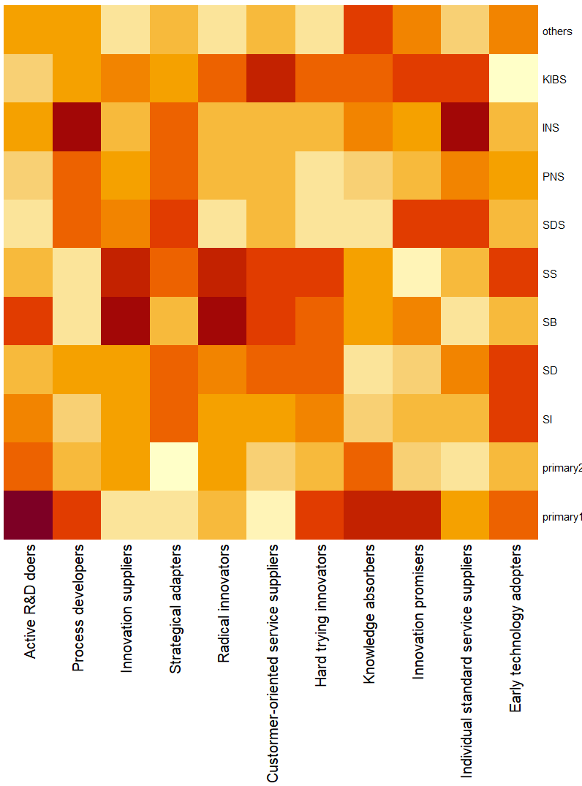
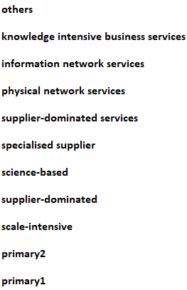
Comparison

Slide 11
Covid-19 related support to businesses
Business Compensation Scheme
    part of the government’s measures to mitigate the financial effects of the infection control measures
    Yields enterprises with a significant loss of turnover (30 per cent loss or higher per month) due to the coronavirus situation (20 per cent in March 2020)
    Compensation up to 50-70 per cent of unavoidable costs (80-90 per cent at March-April 2020)
Salary compensation for persons who are laid-off
    For employees that have been laid off on 31 August 2020 or earlier
    Compensation for wages for the first 20 days of being laid off
    First 2 days are paid by the firm, 18 days are paid by NAV (the Norwegian Labour and Welfare Administration)
Extraordinary support through the ordinary schemes
    loans and subsidies
    not covered here

Slide 12
Approaches to innovation and crisis resilience
Use of Business Compensation Scheme
    34868 firms in total in 2020
    1196 of 6360 firms in our sample based on CIS2018
Use of temporary lay-offs
    74434 firms in total in 2020
    Only 46 of 6360 firms in our sample based on CIS2018
Use indicator variables as dependent variables
    1 if the firm received business compensation during 2020, 0 otherwise
    1 if the firm had sent employees on temporary lay-off during 2020, 0 otherwise
Estimate bivariate probit model with controlling for:
    Scores for 11 types of approaches to innovation based on CIS2018 and factor analysis
    Share of employees with high education (13 years of education or higher)
    Firm size, age, main industry and region

Slide 13
Results: Resilience or vulnerability?
Lower probability for significant turnover loss
    Active R&D doers
    Innovation suppliers
    Individual standard services suppliers
Higher probability for significant turnover loss
    Strategical adapters (negative spin-offs?)
    Radical innovators (high risk?)
    Hard trying innovators (vulnerable from before?)
Knowledge absorbers
    Higher probability for use of temporary lay-offs
    Lower probability for significant turnover loss
Higher share of skilled employees
    Lower probability both for significant turnover loss and for use of temporary lay-offs

Slide 14
Thank you!
Marina Rybalka / SSB ryb@ssb.no
Marco Capasso / NIFU marco.capasso@nifu.no

