Slide 1
Following the Pandemic on Reddit: Hyperlinking Practices of Science Enthusiasts
Frauke Rohden, PhD Candidate, University of Oslo
frauke.rohden@tik.uio.no
4S, October 2021

Slide 2
About
Informal public engagement with science online
Four Reddit communities related to covid-19
What characterizes the different covid-19 subreddits?
Which sources and actors do the different communities refer to when discussing covid-19?
Notes:
Work in progress, also methodologically: what can computational methods do for me (and what not); will have to go quickly through statistics but happy to share after

Slide 3
Data Submissions from 2020-01-01 to 2021-08-31
r/Coronavirus
r/COVID19
r/nCoV
315023 submissions by 90655 authors (avg 3.5, median 1)
33021 submissions by 15732 authors (avg 2.1, median 1)
7901 submissions by 1135 authors (avg 7, median 1)
2.4m subscribers
created May 2013 (official March 2020)
15.2k subscribers
created Jan 2020
349k subscribers
created Feb 2020
r/China_Flu
102k subscribers
created Jan 2020 (currently restricted)
65675 submissions by 17493 authors (avg 3.8, median 1)
29% of collected posts in March 2020
17% of posts in March 2020
32% of posts in March 2020
23% of posts in March 2020
Notes:
Submissions (without comments)
From 2020-01-01 to 2021-08-31
Subscriber numbers on Oct 4th 2021
Collected using Pushshift API wrapper in Python
More submissions in china_flu, more subscribers in covid19
Some highly active users but most only contribute one post

Slide 4
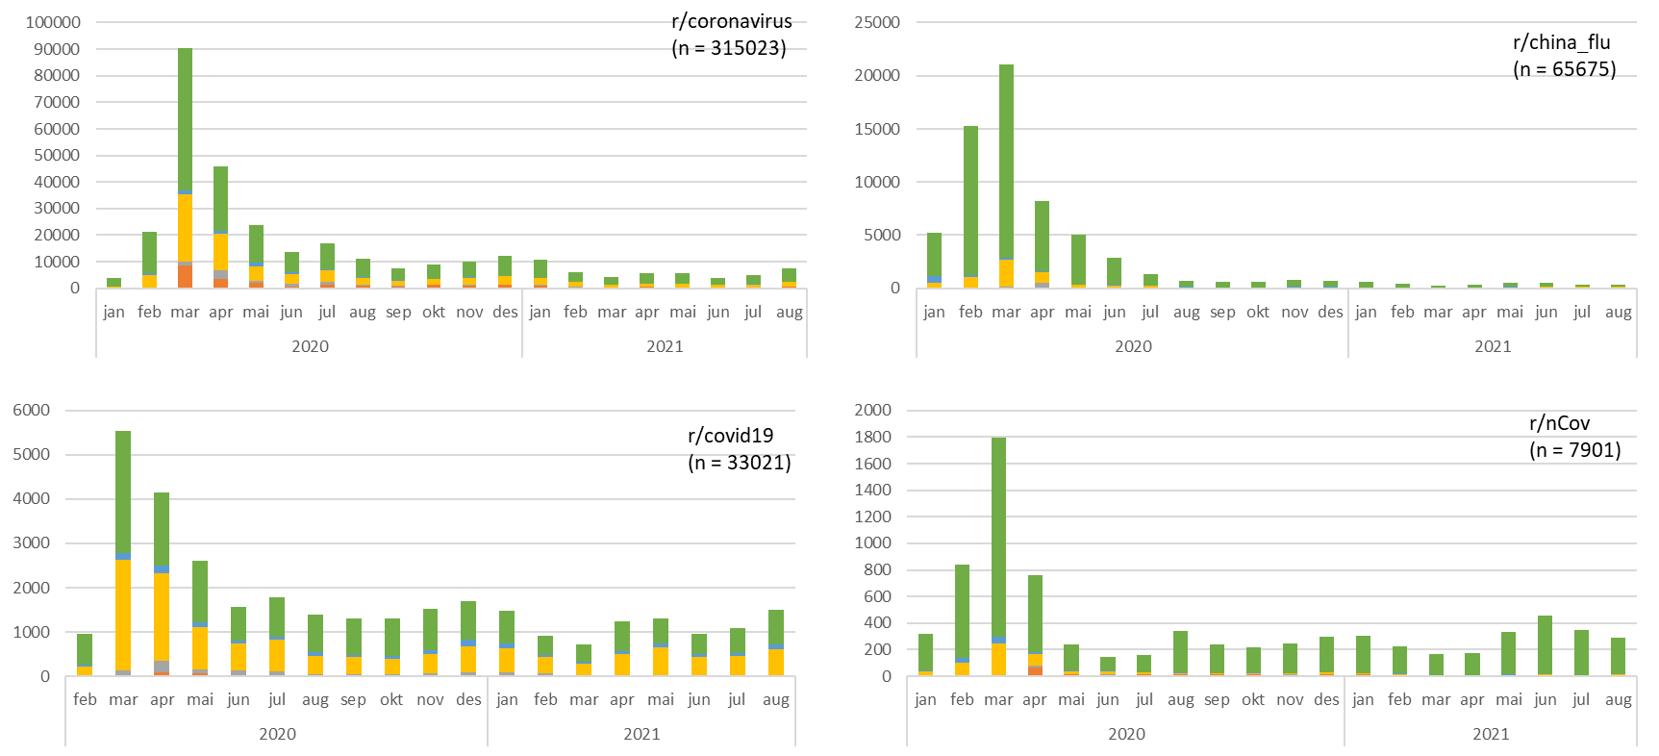
Posts and moderation
Notes:
Most content in March 2020 for all
Different abilities to sustain interest
Different moderation (not entirely reliable, but indicators of removals): green = no indicator of removal, yellow = moderator, orange = automod

Slide 5
„Flairs“ - Submissions
r/Coronavirus
273927 (87%) flaired
r/China_Flu
55313 (84%) flaired
r/COVID19
30912 (94%) flaired
60 unique flairs
r/nCoV
5742 (73%) flaired
Topics, countries, time stamps
e.g. „General“, „Preprint“, „Academic Report“, „Press Release“; also removal reasons
1038 unique flairs
224 unique flairs
e.g. „General“, „Discussion“, „Question“, countries, evaluation („grain of salt“, „rumors – unconfirmed source“)
139 unique flairs
e.g. location, „good news“, „academic report“, removal reasons
Notes:
Tagging by users themselves or (mainly) by the moderators, large majority of posts is flaired
Smallest subreddit has most detailed flair system
Mix of topics, countries, evaluations, removal reasons
Also for authors but much less used (verification of expertise), skipping here

Slide 6
Top 20 submitted domains
r/nCoV | submissions | % of submissions | r/COVID19 | submissions | % of submissions | r/China_Flu | submissions | % of submissions | r/Coronavirus | submissions | % of submissions
r/nCov* | 1150 | 14,6% | youtube* | 3646 | 11,0% | r/China_Flu* | 23713 | 36,1% | youtube* | 19267 | 6,1%
youtube* | 641 | 8,1% | medrxiv.org | 2533 | 7,7% | youtube* | 4069 | 6,2% | r/coronavirus* | 16613 | 5,3%
bbc.com | 256 | 3,2% | r/COVID19* | 1461 | 4,4% | reddit* | 3325 | 5,1% | reddit* | 11182 | 3,5%
reuters.com | 223 | 2,8% | reddit* | 1410 | 4,3% | twitter.com | 2500 | 3,8% | twitter.com | 10297 | 3,3%
straitstimes.com | 199 | 2,5% | biorxiv.org | 1123 | 3,4% | reuters.com | 1201 | 1,8% | reuters.com | 8151 | 2,6%
urdupoint.com | 156 | 2,0% | nature.com | 604 | 1,8% | straitstimes.com | 1070 | 1,6% | nytimes.com | 6617 | 2,1%
reddit* | 145 | 1,8% | thelancet.com | 475 | 1,4% | channelnewsasia.com | 820 | 1,2% | cnn.com | 5644 | 1,8%
japantimes.co.jp | 135 | 1,7% | sciencedirect.com | 465 | 1,4% | theguardian.com | 758 | 1,2% | elcoronavirus.blogspot.com | 5351 | 1,7%
france24.com | 123 | 1,6% | ncbi.nlm.nih.gov | 403 | 1,2% | scmp.com | 637 | 1,0% | covid19newshq.com | 4971 | 1,6%
ndtv.com | 115 | 1,5% | jamanetwork.com | 317 | 1,0% | imgur.com | 580 | 0,9% | theguardian.com | 4809 | 1,5%
cidrap.umn.edu | 89 | 1,1% | cdc.gov | 277 | 0,8% | nytimes.com | 479 | 0,7% | google.com | 3881 | 1,2%
allafrica.com | 87 | 1,1% | twitter.com | 271 | 0,8% | cnbc.com | 439 | 0,7% | washingtonpost.com | 3181 | 1,0%
themoscowtimes.com | 80 | 1,0% | nejm.org | 268 | 0,8% | edition.cnn.com | 430 | 0,7% | cnbc.com | 3174 | 1,0%
timesofindia.indiatimes.com | 78 | 1,0% | academic.oup.com | 260 | 0,8% | i.imgur.com | 418 | 0,6% | bbc.co.uk | 3118 | 1,0%
theguardian.com | 76 | 1,0% | cell.com | 228 | 0,7% | cnn.com | 413 | 0,6% | apnews.com | 2921 | 0,9%
dw.com | 76 | 1,0% | medium.com | 207 | 0,6% | thehill.com | 392 | 0,6% | thehill.com | 2918 | 0,9%
ctvnews.ca | 62 | 0,8% | science.sciencemag.org | 204 | 0,6% | ibtimes.sg | 388 | 0,6% | bbc.com | 2767 | 0,9%
english.kyodonews.net | 59 | 0,7% | onlinelibrary.wiley.com | 195 | 0,6% | bbc.com | 361 | 0,5% | nbcnews.com | 2437 | 0,8%
egyptindependent.com | 57 | 0,7% | pubmed.ncbi.nlm.nih.gov | 193 | 0,6% | nypost.com | 289 | 0,4% | npr.org | 2367 | 0,8%
thethaiger.com | 56 | 0,7% | google.com | 176 | 0,5% | interview-welt.de | 265 | 0,4% | bloomberg.com | 2290 | 0,7%
other domains | 4038 | 51,1% |  | 18305 | 55,4% |  | 23128 | 35,2% |  | 193607 | 61,3%
Notes:
This is submissions, changes with removal indicators but not reliable, BUT: even submissions differ!!!
All have social media, self-referencing (both to own and other subreddits)
Huge difference in r/covid19 having submissions from academic outlets directly
Very long tails, none other than self ref have >10% of the submissions
China_flu has least diverse distribution, coronavirus most (but also size diff)

Slide 7
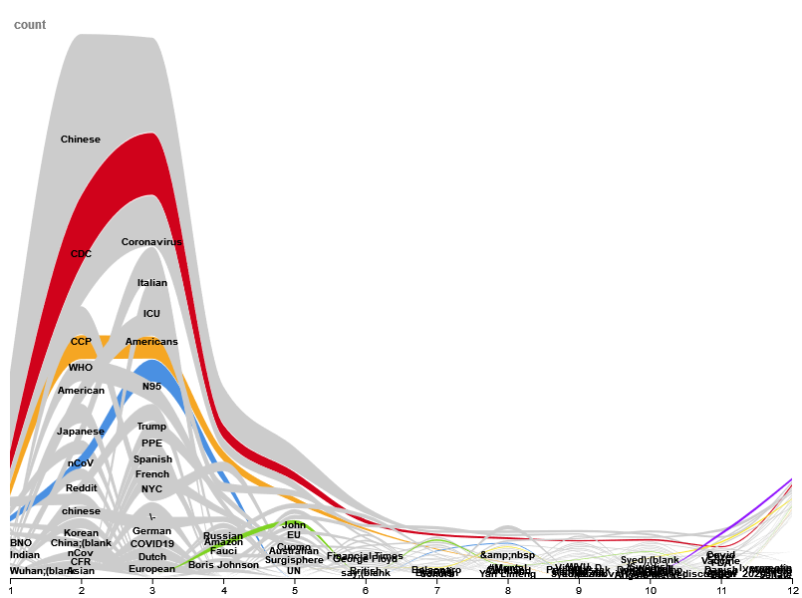
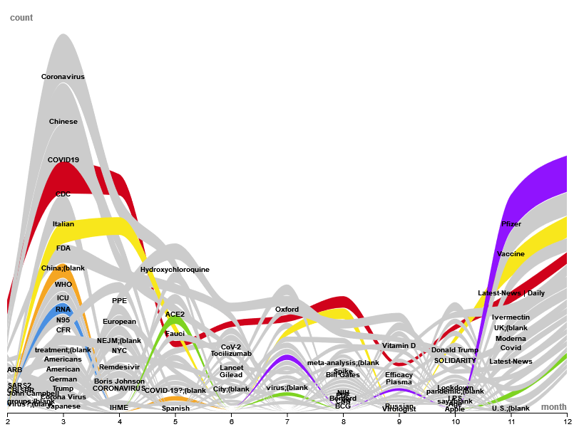
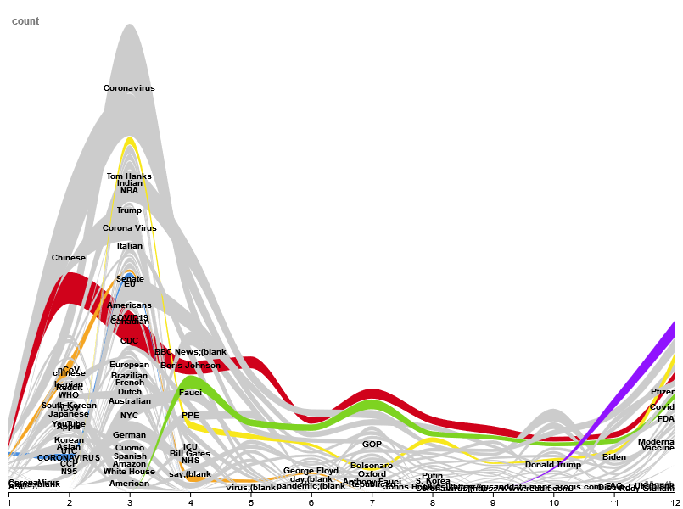
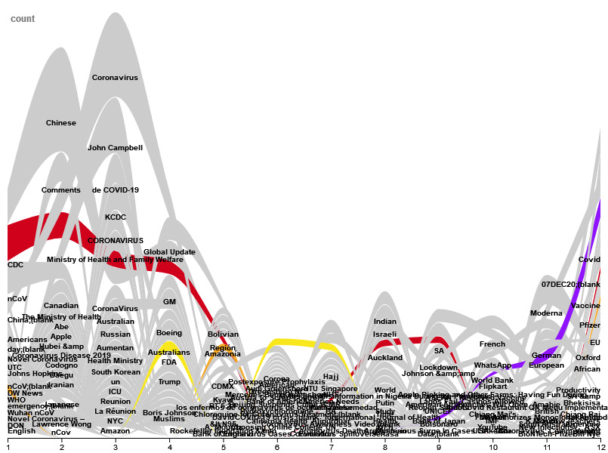
Actors
Named Entity Recognition (NER): People; Organizations; Nationalities, religious or political groups
Top 20 by month for 2020
r/China_Flu
r/covid19
r/Coronavirus
r/nCoV
Notes:
Named Entity recognition (using spacy NLP library in Python) to get at actors referred in the sources
CDC – red, WHO – orange, FDA – yellow, Fauci – green, Pfizer purple, N95 – blue
But also messy, e.g. discussions about Trump/Bolsonaro, especially as prominent people getting covid, Amazon and Costco as providers of resources, diffe

Slide 8
Discussion
Distant reading and the long tail
How to represent diversity?
Most enaged with, most popular, most frequent?
(Sub)Communities and platforms
Social media micro and meso norms (Chandrasekharan et al., 2018)
User trajectories (Zhang et al., 2021)
Informal science communication?
Amplification and spread of (mis)information
Re-contextualising and curating across outlets
Notes:
Most users only one post, but still some community standards

Slide 9
Thanks!
Get in touch: frauke.rohden@tik.uio.no

Slide 10
References
Zhang, J. S., Keegan, B., Lv, Q., & Tan, C. (2021). Understanding the Diverging User Trajectories in Highly-related Online Communities during the COVID-19 Pandemic. Association for the Advancement of Artiﬁcial Intelligence, 12.
Chandrasekharan, E., Samory, M., Jhaver, S., Charvat, H., Bruckman, A., Lampe, C., Eisenstein, J., & Gilbert, E. (2018). The Internet’s Hidden Rules: An Empirical Study of Reddit Norm Violations at Micro, Meso, and Macro Scales. Proceedings of the ACM on Human-Computer Interaction, 2(CSCW), 1–25. https://doi.org/10.1145/3274301

Slide 11
Backup

Slide 12
„Flairs“ - Authors
r/Coronavirus
8137 (3%) flaired
r/China_Flu
r/COVID19
221 (1%) flaired
19 unique flairs
r/nCoV
NA
e.g. „PhD – Geography“, „Virologist“, „Scientist“
286 (2%) flaired
11 unique flairs
e.g. „Frequent Contributor“, „not a bot“
82 unique flairs
Vaccine status, contributor status (frequent, reliable, helpful, wholesome), specialist status, verified status, bot
Notes:
Very few users are flaired
Contributor status, expert status/academic discipline (but also nurse, generic „scientist“, …)
r/Coronavirus also uses vaccine status
r/nCoV exhausted itself on the post flairs

Slide 13
Actors
r/coronavirus
r/china_flu
r/covid19
r/nCov

Slide 14
Posts and moderation
r/coronavirus
(n = 315023)
r/china_flu
(n = 65675)
r/covid19
(n = 33021)
Notes:
Green = stayed up (in API), other colours = removed for different reasons: yellow = moderator removed, orange = auto-moderator (all in API as of September)
r/covid19 deleted almost half at some points, especially march/april
r/china_flu became alternative when r/coronavirus moderation got stricter
Both r/covid and r/china flu see about 30% of their overall posts in this time in march 2020 (the others 23 and 17)

