Slide 1
Science as a rescuer? Public trust in science amid COVID 19
Silje M. Tellmann, Taran Thune.
TIK Centre for Technology, Culture and Innovation, University of Oslo.
Eu Spri, June 2021

Slide 2
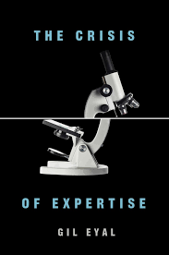
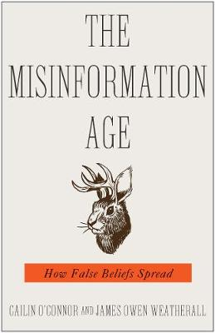
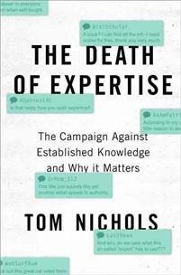
A crisis of public trust in science?
Long-term concern over declining public trust in science
Peak after 2016: Post truth and fake news

Slide 3
A retrospective glance at public trust in science: a differentiated picture
Previous surveys finds that the public holds a rather positive and optimistic view about science in general (Hendriks, Kienhues and Bromme, 2016)
Delimiting science to specific contexts shows a more differentiated picture
Funding context (fear of vested interests)
Topic (e.g. energy research, climate research)
Peoples perspectives on science and attitudes towards the topic of interest is often confounded (cf. climate research)
Notes:
The literature disagrees on what we really discuss when we discuss public trust in science: Surveys to the public, which often ask very genereal questions, suggest however that public trust in science remains stable and generally high over several decades (US context). Delimiting science to specific contexts shows a more differentiated picture. Firstly about the funding cotext, and about the topis. Therefore, more and more research on trust in science has shown how peoples ati

Slide 4
Other aspects:
Demographics:
Age
Income
Gender
Education
Public understanding of science → The role of education
Societal characteristics:
Inequality
Quality of institutions
Culture and values
Notes:
Cognitive and demographic aspects of the (individual) trustee affect trust in science:
Correlations between education and income, education and gender, and age and gender and trust in science.
This has been especially present in theories on public understanding of science, which, as the wording suggest, expect that higher educational level and knowledge of science will increase trust in science.
However, this is subordinated the weight of attitudes.
But trust is also situated at the society-level (affluence, inequality, quality of institutions, culture and values)

Slide 5
Trust in science: nested
Demo-graphics
Societal characteristics
Attitudes
Notes:
So, trust in science is nested with other aspects of the public

Slide 6
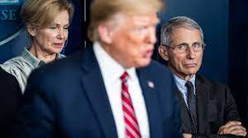
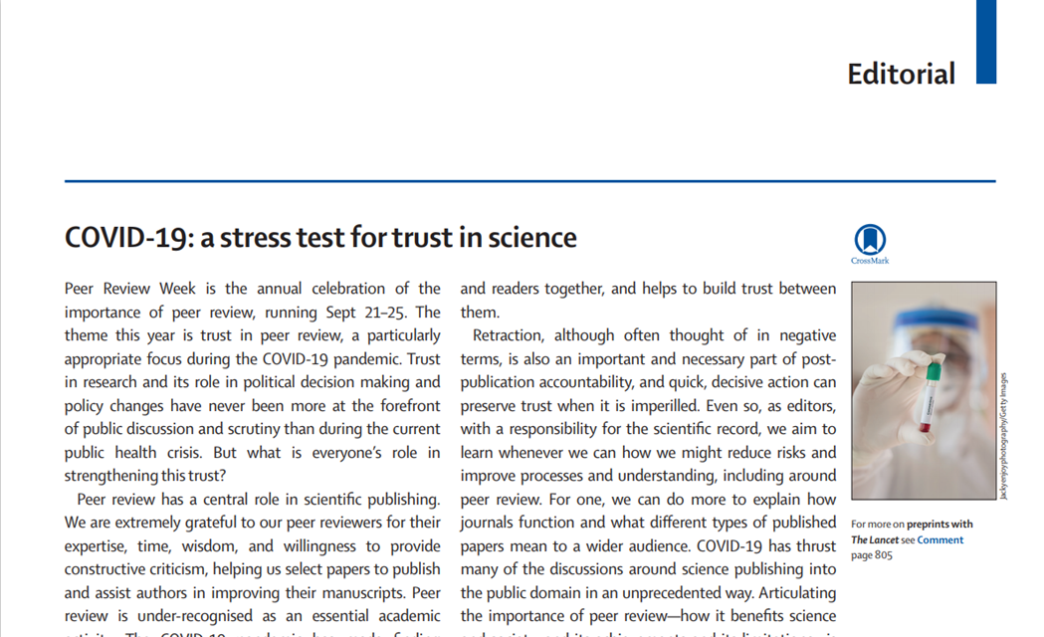
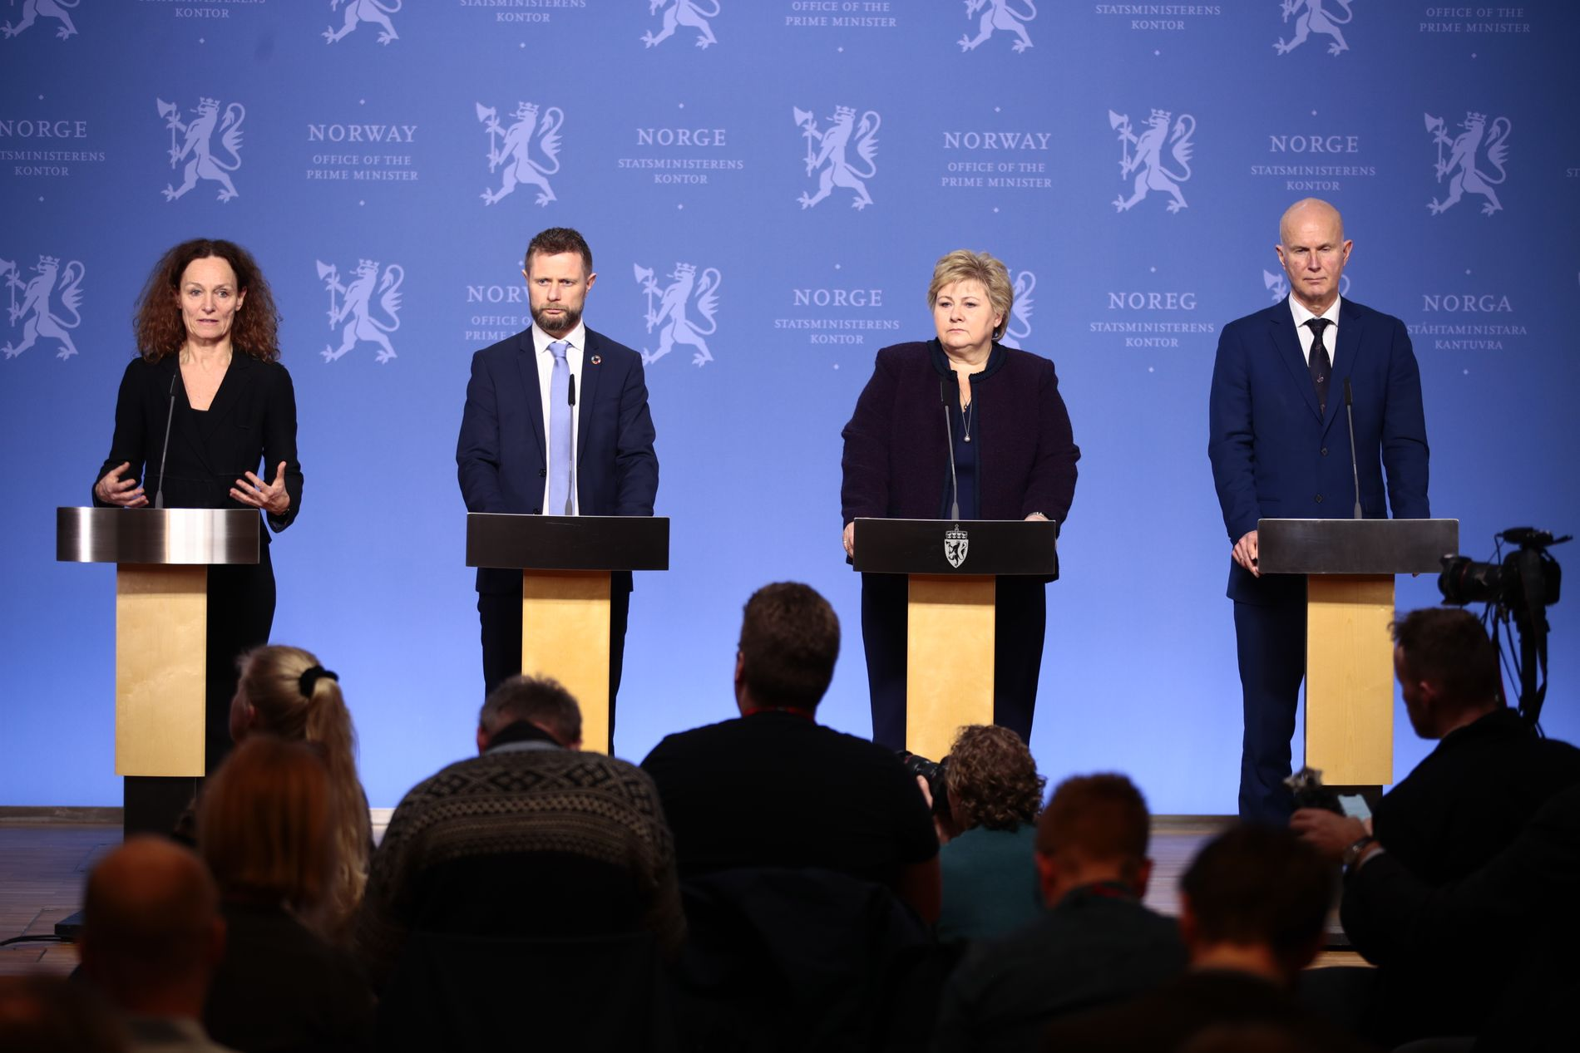
How has COVID 19 affected public trust in science?
The Lancet September 2020
Notes:
The urgency of the pandemic has put the scientific process—which often takes years and decades of debate—on display. Science has literally been presented as tour rescuer, and much efforts where put into scientific solutions to the pandemic, especially the vaccine. But science has also been put on stage, together with politicians, which both have provided them with added authority, but that has also been risky, as in the US:

Slide 7
Methods and data
Longitudinal population based survey performed among the Norwegian adult population.
The survey has been sent to a randomly selected sample of the population (+18 years) regularly for the past 3 years
The data has been collected by the Research Council of Norway
Still in an exploratory phase; we are comparing to other sources of data on trust during the pandemic
Notes:
In our study, we will hoever focus on the Norwegian context.

Slide 8
Trust in Government, OECD 2020 or latest available
Notes:
First of all: Norway: A generally high trust in Government/authorities. Previous research into trust suggest that high trust in one institution extends to other institutions. We can expect that the level of trust in science is generally high in Norway.

Slide 9
Trust in science in Norway before the pandemic (Nov 2019)
Notes:
This figure show the reported trust in science in November 2019: Shows generally high levels of trust, as expected, and moreover, it demonstrates that those with higher education (orange lines) place more trust in science that those without higher education (blue lines).

Slide 10
Differentiated trust in science – before the pandemic
Notes:
Moreover, trust is dependent on the topic of discussion. Some issues are very divided between those with and without higher education, especially research on climate change and renewable energy.

Slide 11
Trust in science before and during the pandemic
Notes:
Increasing level of trust in science in March 2020
But; significant differences in the population based on educational level. How can we understand the variety in trust among those without higher education?

Slide 12
Notes:
We also see that trust is dependent upon political attitudes. Especially the Progress Party, which is on the very Right side, stand out.

Slide 13
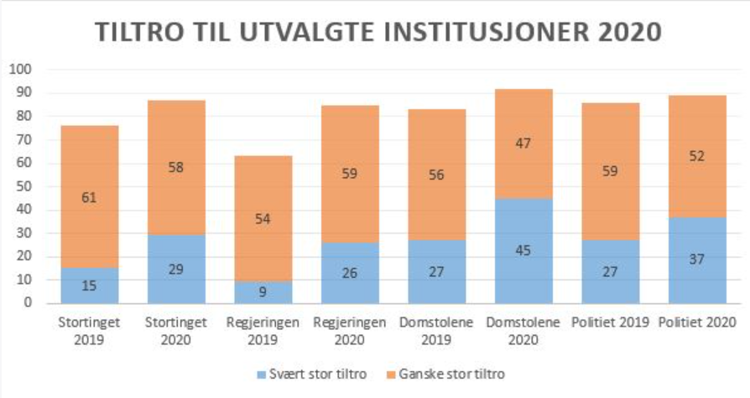
Increasing trust in institutions during the pandemic
Notes:
The findings are however consistent with a general trend in Norway; pandemic has had a trust-effect. Here we see trust in some main institutions in 2019 and 2020, and public trust has increased for all institutions, from the left; the Parliament, the Government, the courts, and the police.

Slide 14
Covid 19: High trust in health authorities
Notes:
Also, this graph shows the trust in health authorities peer week in 2020, and we see that trust has been stable and hogh after March 2020.

Slide 15
Strenghtened trust in science amid Covid 19
The pandemic has strengthened the overall trust in science -
also for groups that commonly show lower levels of trust in science
How much can be explained by the general increase of trust in institutions?
Some possible explanations:
The pandemic has made science more visible
The pandemic has demonstrated the relevance of science
The pandemic represent an externally imposed crisis that have consolidated the Norwegian public

Slide 16
The way forward
Issues we will look further into:
The relations between demographic aspects (such as education) and trust in science over time
Correlations between political preferences and trust in science, controlled for other variables
Are there other events that has led to increased attention to science that we can observe in our data?

