Slide 1
Emergency circumstances call for extraordinary measures: a study of research council COVID-19 emergency call projects
EU-SPRI 2021 conference
Science and Innovation – an uneasy relationship?
Trust Saidi and Magnus Gulbrandsen

Slide 2
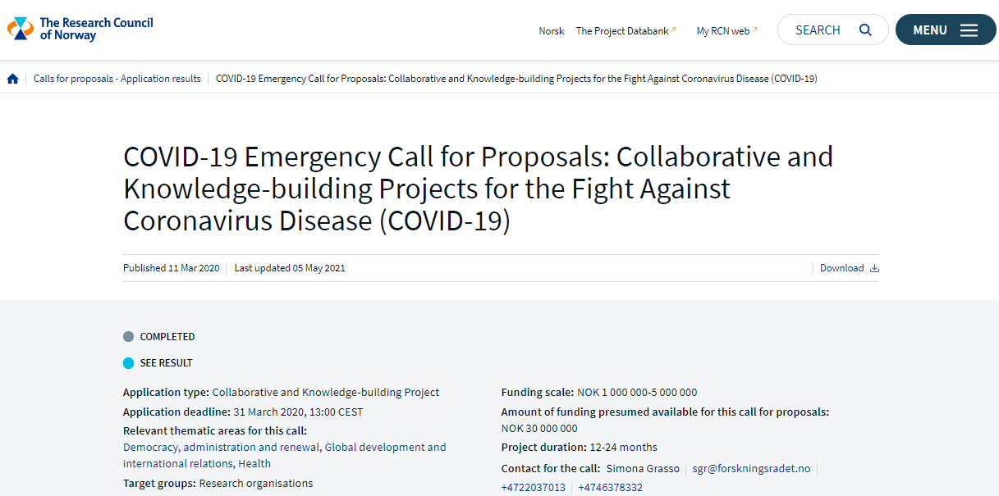
Notes:
Garud, R., Tuertscher, P. & van de Ven, A. (2013). Perspectives on innovation processes. Academy of Management Annals, 7(1): 775-819.

Slide 3
Focus of the study
How do the funded projects deal with complexities of the process of generating, implementing and diffusing new knowledge to create societal impact?
How are the ethical, temporal, relational, evolutionary and cultural complexities of the research and innovation processes dealt with in emergency funded projects?
What future changes could the complexities associated with research and innovation processes of emergency funded projects induce to medical science and innovation?
Notes:
Garud, R., Tuertscher, P. & van de Ven, A. (2013). Perspectives on innovation processes. Academy of Management Annals, 7(1): 775-819.

Slide 4
Theoretical framework
Institutional logic perspective embracing the socially constructed, historical patterns of material practices, assumptions, values, beliefs and rules (Thornton & Ocasio, 1999).
Five different kinds of complexities associated with innovation processes (Garud et al, 2013)
Relational
Temporal
Cultural
Ethical
Evolutionary

Slide 5
Methodology
We have built up a database of the 24 projects funded by RCN
Data collection was carried out through semi-structured interviews
8 interviews completed, transcribed and analysed so far
Completed interviews form the basis of this study
Once the planned interviews are completed, we expect a broader multi-stage coding strategy using Nvivo or similar.

Slide 6
Temporal complexities
Fixed time for the projects incompatible with the recruitment of PhD students
More resources and time needed to support PhD students
Short space of time for ethics approval, proposal submission and review
“We got funding for two years, and 5 million Norwegian kroner. So that was the frame. And that means that we needed high speed also, in getting the candidates to do the research. So, half a year after, we had the candidate in place, and then we had one and a half year to finish the project. So that's a challenge, both in the timeframe and also in the financing, because we don't have the financing for a PhD candidate. For two years, we need some more resources. So that's one of the drawbacks of setting up these sorts of short projects”
“So, I link registries, national registries in Norway, and the entire process of having, you know, the ethical committee, but then also going through all the registry boards, and then data delivery and all the lag time. Usually that process takes about a year. And with for example this project, the Regional Committees for Medical and Health Research approval was done in a week. So, everything was fast tracked”

Slide 7
Relational complexities
Existing projects capitalise on infrastructure
New project face challenges in setting up
Different disciplines coming together under the ambit of Covid-19
Covid-19 as a grand challenge is a key unifying factor.
“We would never have managed to start this project, if we had started from scratch, it would have taken us at least two years to get off the ground. So, we hit the ground running. Without that it would have been impossible. Absolutely. So, I think one take home message is that starting a concrete field project, as we are doing needs an existing infrastructure. And, in this case, an existing functional collaboration”
“Our project is actually one of the few that is totally new, it wasn't based on something that we had going on, that we could just add to. I think a lot of them had that and that made them produce papers and things like that a lot quicker, because they already had the infrastructure for the projects”

Slide 8
Ethical complexities
Tradeoffs between fast tracking the projects and research integrity
Digital platforms are increasingly being used for research
Accelerated publications may interfere with research quality
Rising incidents of retraction of articles even in high impact journals
Ethical considerations such as safety of the participants and researchers remain crucial
“Well, we need to be really sure about the results we put out there. And you have, I am sure you have already seen how a lot of the results that have been fast tracked also regarding medication use and there has been false signals. There has been also signal or publications that have been retracted even from the best medical journals. To do high quality science, you cannot do that overnight. So, you have to do high quality research which takes time and we as researchers, we have never been under so much pressure to do research fast”

Slide 9
Cultural complexities
Open science is fastly becoming prominent in a quest to make the results of publicly funded projects widely accessible
Open practices has far-reaching consequences on what is recognised as good science
Is “openness” emerging as the core organizing principle for medical research?
Who owns the data?
“You know that we have the data. It is overwhelming, it is massive. It is the data for the entire Norwegian population, and all their medication, use and all their hospitalisations. So, we have been extremely busy with this COVID 19. I think something that has been extraordinarily different is like, we find the data, especially in the public domain, like the journals, they are opening their space, just like open publications”

Slide 10
Discussion
Acceleration of ethics approval does not necessarily speed up the process of executing the research projects, but it reduces the waiting time.
As most projects that were funded were already existing, it is questionable whether they constitute projects per se or funding streams
Is the approval of web-based platforms by the ethics board a signal of a new dispensation on the use of digital tools in medical research?
Covid-19 as an organizing logic for conducting research
With the application of existing protocols, templates and techniques from previous projects, is the focus gravitating towards transferrable skills, methods etc.

Slide 11
Conclusion
From the results of the study, the likelihood of major changes in how research is done here is very low, but what could be interesting is that the Covid-19 “umbrella” offers a shared logic that may open up for some new types of interactions and processes.

Slide 12
Thank you
trust.saidi@tik.uio.no
magnus.gulbrandsen@tik.uio.no

