Slide 1
How does network position affect firms’ innovation?
Connecting RCN data to the Community Innovation Survey
Joar Kvamsås

Slide 2
Research collaboration networks and innovation
Innovation comes from a ‘variety in cognition’ (Schumpeter 1939)
Innovation can arise from the recombination of internal and external knowledge
The effect of network position on firm-level innovation can be measured by combining RCN data with other data sources

Slide 3
Measuring innovation
Community Innovation Survey
Firm-level microdata available from SSB, covering Norwegian firms with more than 10 employees
Includes questions on whether firms have introduced new products or processes in the survey period
Also contains data on firm size, R&D expenditure, funding etc.

Slide 4
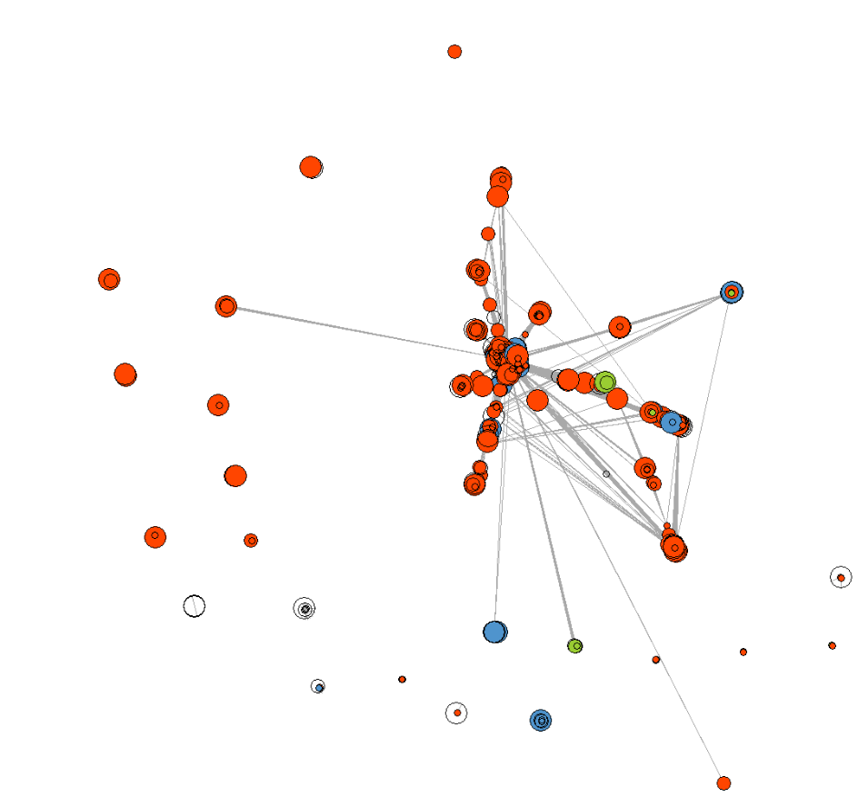
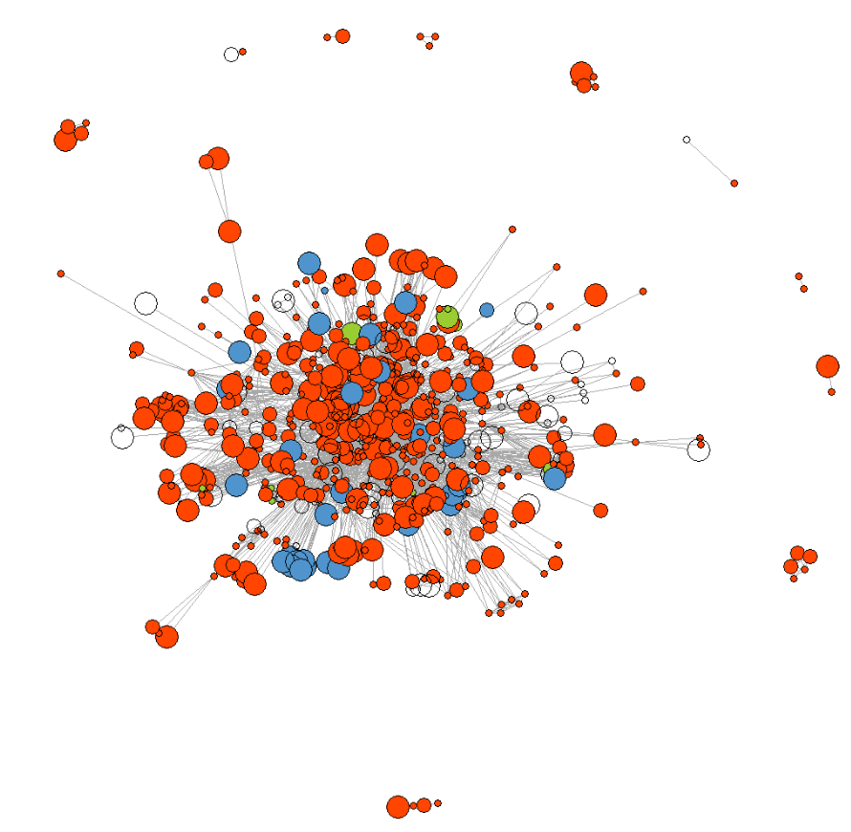
Measuring network position
Oil and gas
Marine
Maritime
Biotechnology

Slide 5
Measuring network position
Degree centrality
Reach
Ego network efficiency vs. Redundancy
Sample network: PROSBIO - Prosess- og biomedisinsk industri

Slide 6
Degree centrality
The number of a node’s direct ties
i.e., how many collaborators does a firm have?
The focal node and its direct connection make out a firm’s ego network

Slide 7
Degree centrality
The number of a node’s direct ties
i.e., how many collaborators does a firm have?
The focal node and its direct connection make out a firm’s ego network

Slide 8
Degree centrality
The number of a node’s direct ties
i.e., how many collaborators does a firm have?
The focal node and its direct connection make out a firm’s ego network

Slide 9
Degree centrality
Direct ties gives access to external knowledge stocks
Enables the transfer of highly complex, specialised and situated knowledge
H1: High degree centrality -> more likely to innovate

Slide 10
Reach
The number of a node’s indirect ties
How many actors can a node reach in k steps?

Slide 11
Reach
The number of a node’s indirect ties
How many actors can a node reach in k steps?

Slide 12
Reach
The number of a node’s indirect ties
How many actors can a node reach in k steps?

Slide 13
Reach
The number of a node’s indirect ties
How many actors can a node reach in k steps?

Slide 14
Reach
The number of a node’s indirect ties
How many actors can a node reach in k steps?

Slide 15
Reach
Indirect ties have a «Radar function»
Knowledge is less complex and specialised, and more mobile
H2: High reach -> More likely to innovate

Slide 16
Ego network efficiency/redundancy
The ratio of potential ties to actual ties in a node’s ego network
Denser ego networks have more redundant ties
Less dense ego networks are more efficient

Slide 17
Ego network efficiency/redundancy
The ratio of potential ties to actual ties in a node’s ego network
Denser ego networks have more redundant ties
Less dense ego networks are more efficient

Slide 18
Ego network efficiency/redundancy
The ratio of potential ties to actual ties in a node’s ego network
Denser ego networks have more redundant ties
Less dense ego networks are more efficient

Slide 19
Ego network efficiency/redundancy
Ego network efficiency gives access to more heterogeneous knowledge
Ego network redundancy gives access to more complex knowledge due to a close social structure and third-party triangulation
H3a: Redundancy -> More likely to innovate
H3b: Redundancy -> Less likely to innovate

Slide 20
Statistical analysis
Stepwise logistic regression
Testing the effects of degree centrality, reach and ego network redundancy on the likelihood that a firm engages in innovation
Controls for size, R&D intensity, sectors
Interaction terms between network position and R&D intensity (absorptive capacity)
Two dependent variables: Product and process innovation

Slide 21
Statistical analysis
Stepwise logistic regression
Testing the effects of degree centrality, reach and ego network redundancy on the likelihood that a firm engages in innovation
Controls for size, R&D intensity, sectors
Interaction terms between network position and R&D intensity (absorptive capacity)
Two dependent variables: Product and process innovation

Slide 22
Results: Degree centrality
Degree centrality positively affects firms’ innovation
The positive effect of degree centrality is highly dependent upon the firm’s own R&D intensity

Slide 23
Results: Reach
Reach positively affects firms’ innovation, but not as much as degree centrality
The effect of reach is largely independent from a firm’s own R&D intensity

Slide 24
Results: Ego network efficiency/redundancy
Higher redundancy (blue) has a more positive effect on innovation
Does not depend on R&D intensity
This is not true when it comes to creating products that are new-to-market
The only effect that is true for process innovation as well as product innovation

Slide 25
The potential of connecting RCN data to other data sources
How does network position affect the survival rate of upstart businesses? (Brønnøysund)
How are network effects moderated by geographic distance/location? (GIS)
How do networks promote the transfer of different types of knowledge? e.g. core vs. Non-core competencies? (Patent data, online product databases etc.)
How do network effects in Norway compare with those in other European economies? (CIS, similar databases in other countries)

Slide 26
Thank you!
joarkv@sv.uio.no

