Slide 1
Use of network data to study research impact
Magnus Gulbrandsen, TIK and OSIRIS
Seminar on R&D networks at TIK, 29 November 2018
magnus.gulbrandsen@tik.uio.no

Slide 2
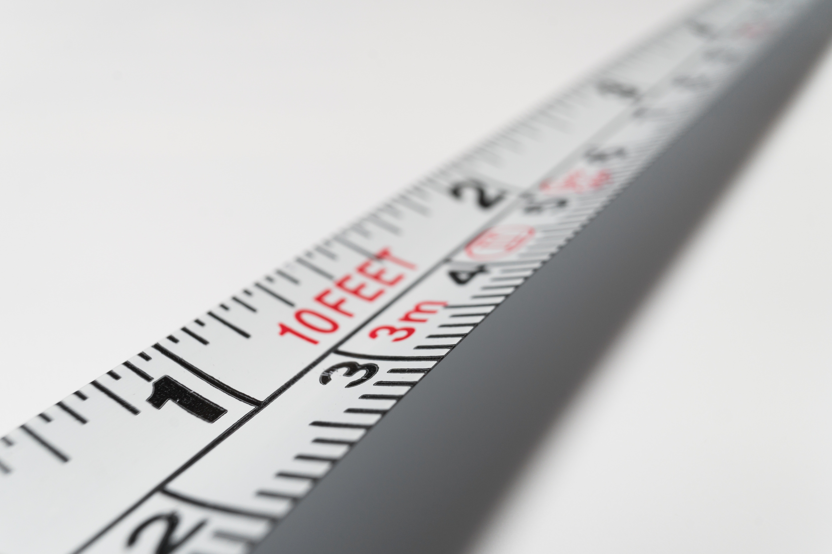
OSIRIS is an 8-year research centre set up to understand how and under what circumstances research leads to effects in society – we call this impact
Hosted by TIK, three partners
An important part of OSIRIS is to carry out case studies of “problem areas” and map over long periods of time how research has contributed
Research councils also want to measure impact in effective ways
Network data represents an interesting – and greatly underutilised – source for this type of work
Notes:
Based on surveys, interviews, cases

Slide 3
“I am strongly convinced that the core values of Horizon 2020 and its successor have to be Excellence, Openness and Impact. (…) We have an obligation and an incentive to be much better at understanding and communicating the impact of what we do. Not only to ministers of finance, but to the general public!”
Carlos Moedas, European Commissioner for Research, Science and Innovation, 2015

Slide 4
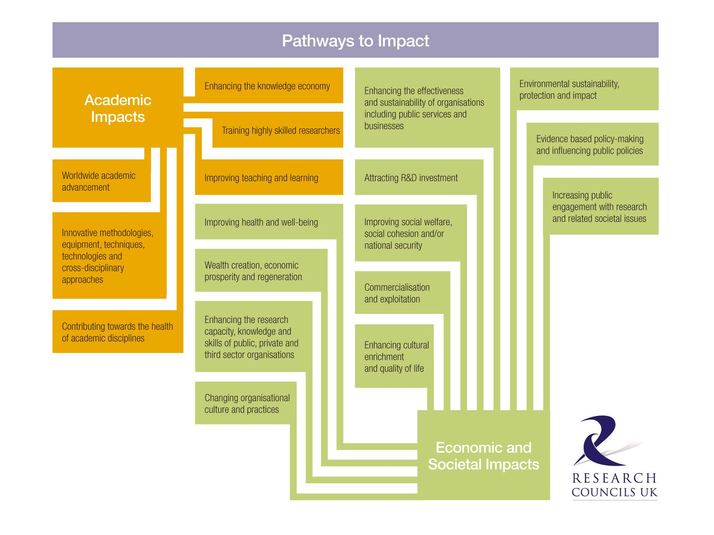
Defining impact
“An effect on, change or benefit to the economy, society, culture, public policy or services, health the environment or quality of life, beyond academia” (REF 2011)
We are interested in societal impact

Slide 5
Unrelated scientific fields
Also in applied journals and mission-oriented research programmes
Example: the oral contraceptive pill
Fields are united, implementation
(Also later cultural, social, health etc. impacts)

Slide 6
Aspects of impact processes
They may take a very long time – especially when looking at the larger picture
They involve different actors who are engaged in what is often called “productive interaction”
Over time, they represent combinations and recombinations of different research fields, projects and types of research (which can be seen as a central outcome, cf. Callon 2000; van de Ven et al. 1999)
Impact itself (the total societal effects) may be elusive, and it is often more realistic to study it

Slide 7
Network data
Well suited to exploring how interactions and combinations evolve over time within a process of impact
Can be used both historically (tracing backward) and possibly also in a forward following exercise
Nodes in such analyses can be actors (research units or organisations), projects, research fields and more
Linkages may be found in joint work, funding streams, co-publication etc.
Centrality and similar measures probably less important than overall network changes
A few recent investigations use network data to explore the development of some central underlying dimensions – believed important for impact

Slide 8
Proximity:
Organisational
Institutional
Geographic
Social
Cognitive
(based on Boschma 2005)
For each:
Diversity
Cohesiveness
In Bone et al. (2018), the authors use R&D network data to shed light on how different dimensions of proximity change in a project. In order to do this, they add bibliographic and interview data. The method is used to create narratives, draw maps and present indicators.

Slide 9
Other examples
Rafols & Meyer (2010) use R&D network data combined with bibliometrics to look at how interdisciplinarity in bionanoscience develops over time
Rafols (2014) does the same to look at how knowledge is integrated and diffused
Molas-Gallart et al. (2016) suggest a similar method to evaluate “translational research”
As far as I know, no impact evaluation approach incorporates R&D network data

Slide 10
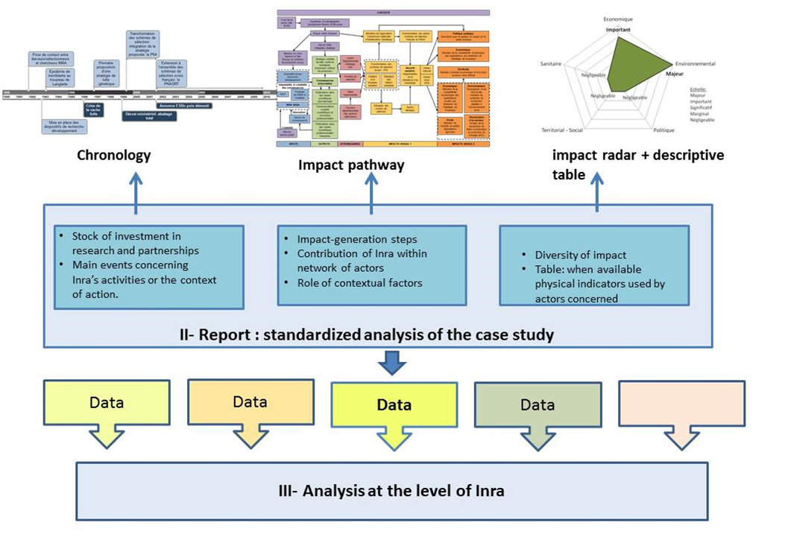
Advanced case-based approaches could also benefit from using network data more systematically
Here: the French ASIRPA framework (Joly et al. 2015)

Slide 11
Data requirements
High reliability (over time and inter-coder) about funding, actors, activities, outputs
Fairly easy incorporation of additional data about the actors involved
Opportunities for incorporating other data such as scientific publications (links to CRISTiN could offer some unique opportunities?) and various indications of other outputs/outcomes
Coverage of long time periods (European studies show that impact is often the result of repeated interaction within different organisational frameworks, cf. Gulbrandsen & Sivertsen 2018)

Slide 12
Conclusions
The use of R&D network data shows a lot of promise when it comes to better understanding of impact
A lot of methodological development is going on right now, and we are also looking into it in OSIRIS
Data collection/cleaning/coupling is resource intensive and may require several people working together on each case/analysis
The costs involved are probably worth it for the academic insights that result from such analyses (high-profile journal articles from the newest impact methods)
At the moment easier to use R&D network data in exploratory scientific investigations rather than for academic purposes

Slide 13
Thank you for your attention
Comments to: magnus.gulbrandsen@tik.uio.no
Web page: http://www.sv.uio.no/tik/english/research/projects/osiris/
Twitter: @OSIRIS_TIK

